Slide 1
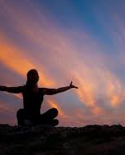

Spirituality at Coningsby St Michael’s

Slide 2
What does spirituality mean to you?
Talk to you partner and then share with the class.

Slide 3
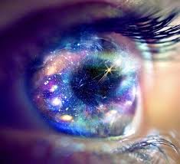
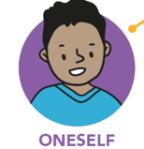
At Coningsby St Michael’s we believe that you are at the centre of your own spirituality and how you connect with yourself.

Slide 4
This means that what you believe and how you think and feel is special to you. You don’t need to think and feel like everyone else. You are unique. You know your own mind.

Slide 5
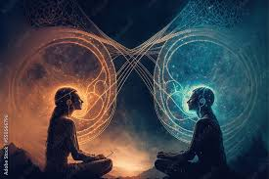
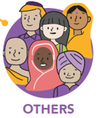
At Coningsby St Michael’s we believe that you are at the centre of your own spirituality and how you connect with other people.

Slide 6
This means how you connect with others, how you can be your true self with others, how you respect each other and listen without judgement. You feel like you’ve known each other forever and you help each other grow. This connection can be with more than one person at a time.

Slide 7
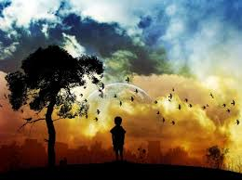

At Coningsby St Michael’s we believe that you are at the centre of your own spirituality and how you connect with nature.

Slide 8
Being in nature allows you to wonder about the world around you. You can use all of your senses to connect to the world. You can stop, pause, take a moment to breathe and be amazed by the world we live in. You can be in awe of the amazing things in our natural world.

Slide 9
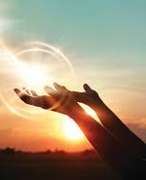



At Coningsby St Michael’s we believe that you are at the centre of your own spirituality and how you connect with what you believe is beyond our world.

Slide 10
This means what you believe about God, Heaven, the Earth – there is no right or wrong it is about you and what you believe.
How you have a sense of belonging, who you belong to and where you belong.
It is about your sense of purpose and meaning.

Slide 11
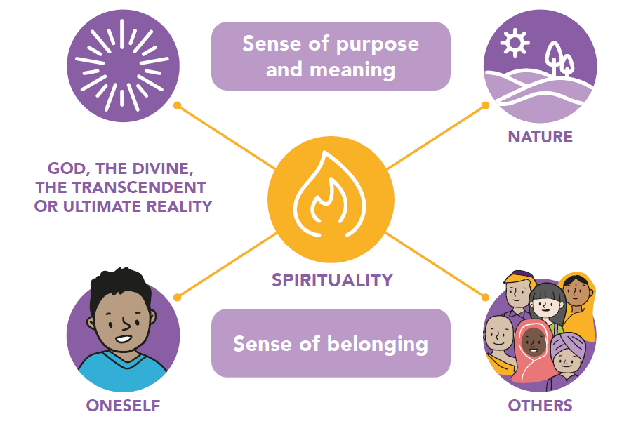
Spirituality at Coningsby St Michael’s looks like this…

Slide 12
Spirituality at Coningsby St Michael’s looks like this…
What does this mean to you?
We would like you to share your ideas about spirituality.
Draw/write your ideas on a leaf shape.
This will be added to our whole school Spirituality Tree in the hall.

