Slide 1
History 23-9-20
What were the main events during the Aztec period?
Can you re-arrange these statements so that they are in chronological order? You could use the timeline on this website to help you.
https://www.theschoolrun.com/homework-help/the-aztecs

Slide 2
Acamapichtli became the first powerful leader of the Aztecs.
In 1195 AD the Aztecs arrived in the valley of Mexico and eventually settled near lake Texcoco when they saw an Eagle fighting a snake on a prickly cactus.
Cortes formed an alliance with the Tlaxcala – enemies of the Aztecs – and began to attack the Aztecs.
In 1325 they built the city of Tenochtitlan and built the first Aztec Temple.
Tenochtitlán was rebuilt by the Spanish and called Mexico City, the capital of New Spain. The Aztec Empire was over.
In 1519 Spanish conqueror Hernan Cortes arrived in Tenochtitlán. He was treated very well by the Aztecs. During this time King Montezuma II ruled the Aztecs.
In 1521 the Aztecs were defeated by Cortes and he took over the city of Tenochtitlán.
The Aztec’s most successful leader, Montezuma I, came into power. He greatly expanded the Aztec Empire.

Slide 3
RE 24-9-20
Who is the God Christians believe in?
This week in RE we are thinking about how Christians know what God is like. We looked at the following bible extracts together and then completed the attached activity sheet. See if you can discuss these ideas with an adult and record your thoughts.

Slide 4
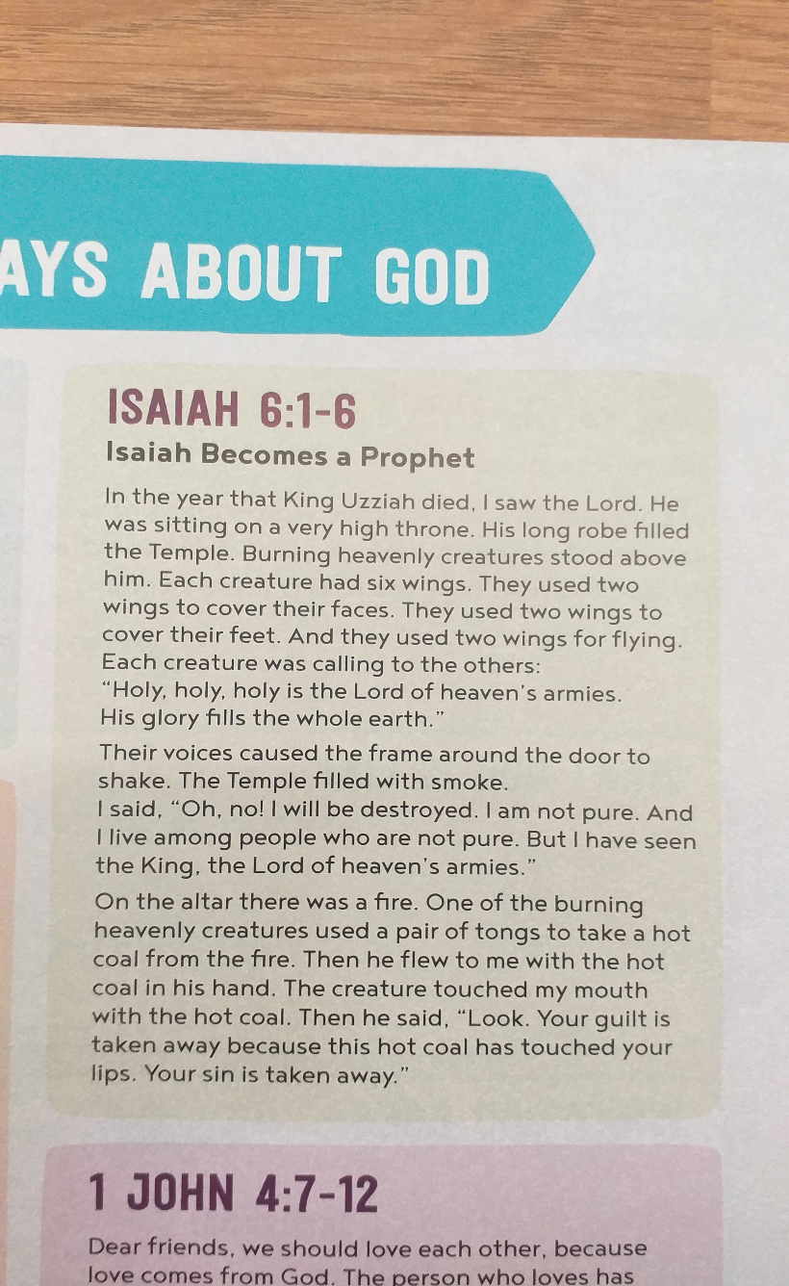
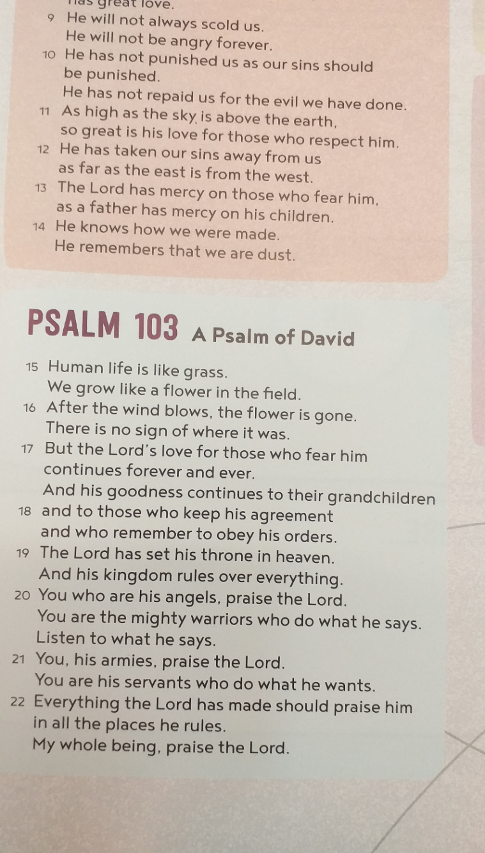

Slide 5
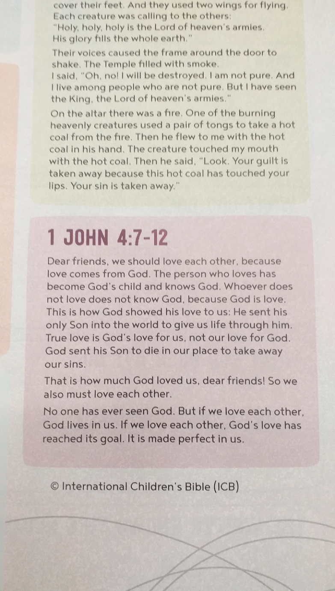
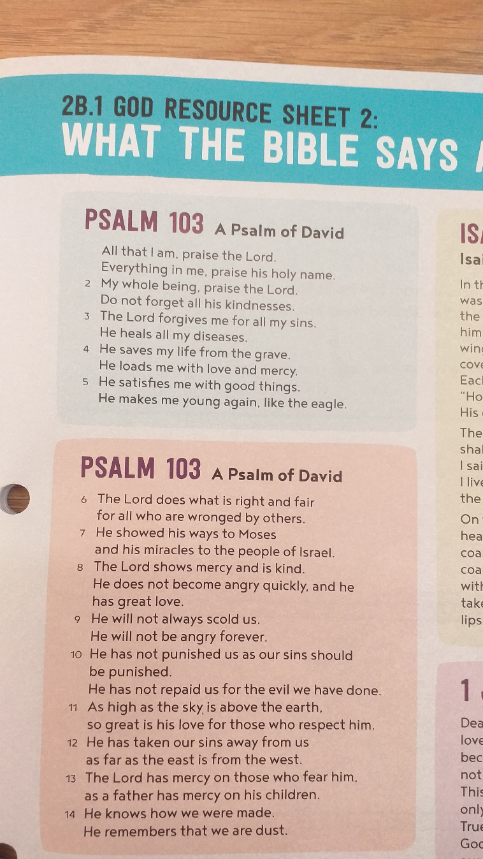

Slide 6
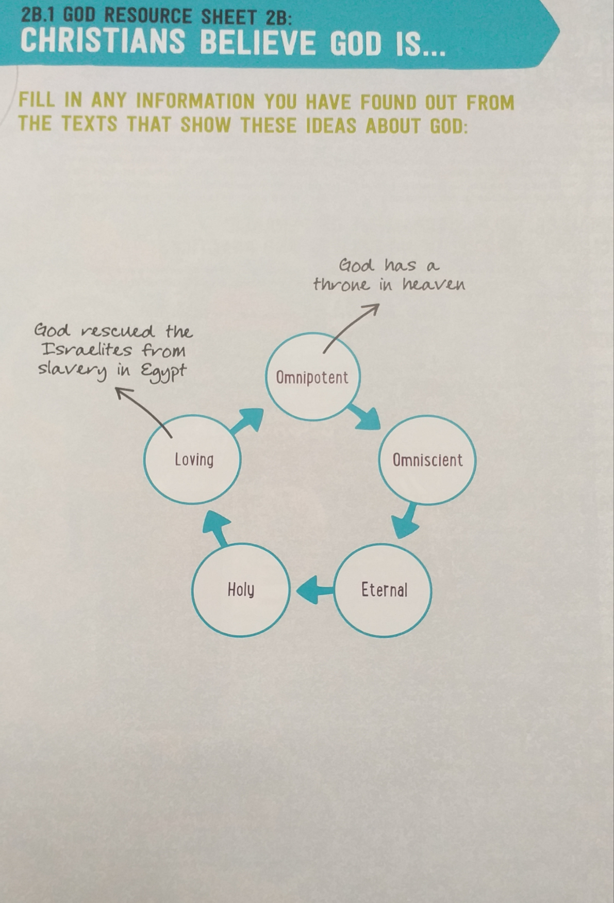

Slide 7
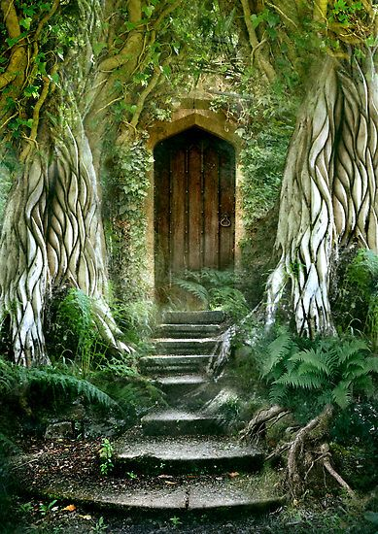
Big Write 25-9-20
What is behind the door?
Can you continue the story and describe what lies behind the door?
Although I had lived here all my life, never once had I seen this door at the end of the garden.
Why not? Had it always been here? I can’t explain why but as I crept up the stone stairs towards
the ancient door, I felt it had an air of magic about it…

