Slide 1
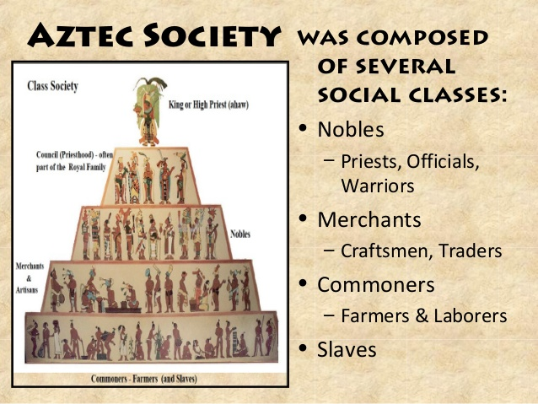
History 30-9-20
How was Aztec society organised?
Can you research the different roles in
Aztec society and write a short
Paragraph about each one? This is
A helpful website:
https://www.mexicolore.co.uk/aztecs/you-contribute/aztec-social-classes#:~:text=Aztec%20society%20was%20composed%20of,the%20high%20priests%20and%20priestesses.

Slide 2
RE 1-10-20
Who is the Christian God?
This week in RE we are thinking about how you imagine the Christian God. Based on the ideas about God that we have thought about for the last few sessions, can you record your thoughts about God? You could draw an image, a symbol, write a description or a poem. The choice is yours!

Slide 3
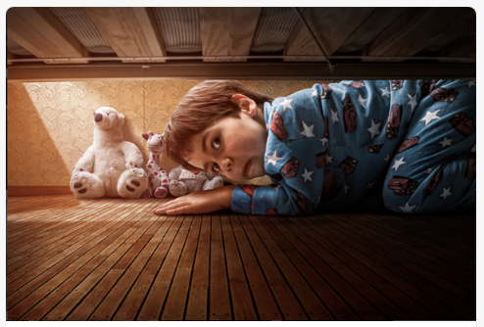
Big Write 2-10-20
Why is he under the bed?
How would you start the story?
A good story starter should hook the reader in and make them want to read more. Think about why the boy might be looking under the bed. Has he heard a noise, seen something, lost something? Maybe he has found something under there before? Try to use your senses to describe what your character can see, hear, smell and feel.
Remember… please don’t make it too scary or I might not be able to get to sleep!
Some good tips can be found here:
https://k12.thoughtfullearning.com/minilesson/starting-stories-5-great-beginning-strategies

