Slide 1
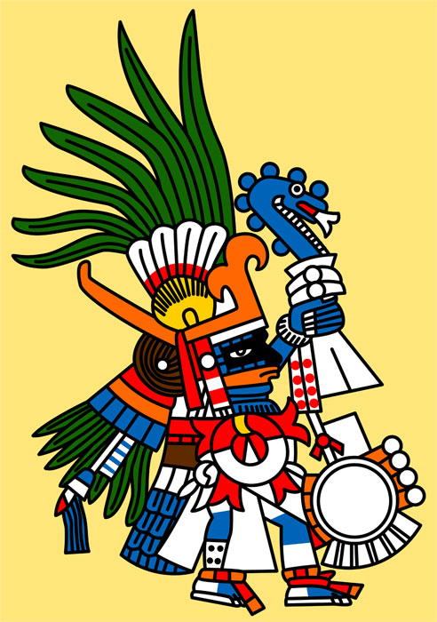
History 7-10-20
What do you know about Aztec Gods?
Take a look at the different Aztec gods that Aztec people worshipped.
Which is your favourite? Why?
Can you create an Aztec god of your own? What would your god represent? What would they look like? Draw and describe your god.
This following information should help you:

Slide 2


AZTEC GODS

Slide 3
Aztec Gods
Religion was extremely important in Aztec life.
They worshipped hundreds of gods and goddesses, each of whom ruled one or more human activities or as aspects of nature e.g. sun, rain.
They believe that everything in life is controlled by the gods, they bring good things, such as rain to make the crops grow, but also bad things like disease, drought and bad luck.

Slide 4
The Aztecs thought that the power of the gods should be acknowledged and thanks given to them, so as to avoid the catastrophes that their rage could cause.
For this reason monuments temples and statues were built, and sacrifices performed as gifts to the gods.

Slide 5
Huitzilopochtli
(Hummingbird)
He is the god of war and the rising sun and special guardian of Tenochtitlan.
He is the special god of the Aztec people, they believed he brought them success in war.
His temple on the main pyramid was the focus of fearsome sacrifices of the prisoners captured by Aztec warriors. Victims’ heads were strung as trophies on a great rack.
He is always shown as a warrior. He wears a warrior’s cotton oversuit and carries a shield and a snake of fire. His body and clothes are painted blue.

Slide 6
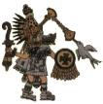
Quetzalcoatl
(Feathered Serpent)
He is the wind god and also the god of knowledge.
He is usually a friend to the people. He has taught them many skills, such as picture writing, art and science.
He taught men the calendar and devised ceremonies
He is shown with a beard to represent age or an old man.
He wears the mask of a serpent and a hat decorated with the feathers of a quetzal bird.

Slide 7

Tlaloc
Tlaloc is the rain god.
He is known as “he who makes things sprout”.
The rain he brings allow crops to grow.
Tlaloc also controls storms, thunder and lightening.
He is shown holding lightening in the form of a snake in one hand.
In the other hand he holds an axe which makes thunder-bolts.
The jaguar he sometimes has coming from his mouth is the roar of thunder.
Tlaloc is always shown with goggle eyes and long teeth.

Slide 8
Your task
Your task is to create an Aztec god of your own. Remember that they had a god or goddess to represent everything.
Describe what it is they represent and this can be more than one thing.
Describe what they look like and what the things they hold or wear represent (this should be to do with what they are god/goddess of).
Create an illustration of your god/goddess and label each important part.

Slide 9
RE 8-10-20
What do churches show about what Christians believe about God?
This week in RE we are thinking about the important areas and objects you might find in a church and how these show us what Christians believe about God.
We visit our local church with school at certain times of the year. Have a think about what it looks like inside and what important objects you can remember seeing.

Slide 10
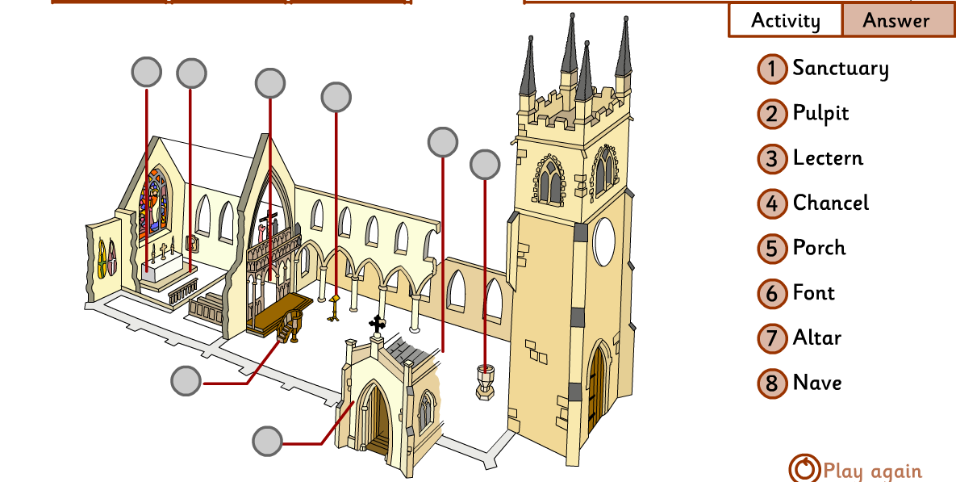
If you have access to a computer there are some church tours for you to look at here:
https://request.org.uk/restart/2014/05/22/church-tours/
Can you identify the areas and objects on this plan?

Slide 11
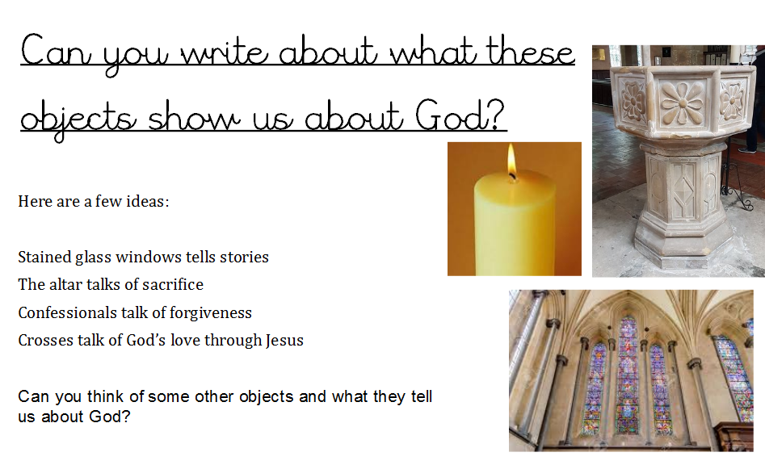

Slide 12
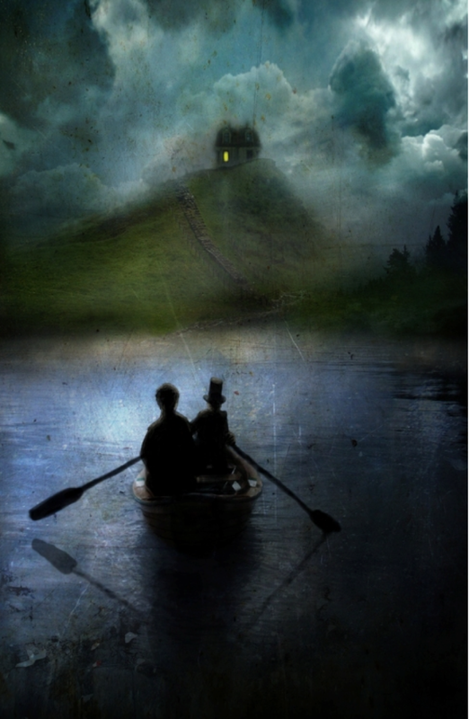
Big Write 9-10-20
Why were you there?
What were you doing rowing across the water last night? Who were you with?
This week in Big Write we are going to write a diary entry. Look carefully at the image and try to imagine that you were there.
Think about the emotions you could include in your diary entry; were you scared, excited or nervous? Was your companion a friend or an enemy? Who lives in the house?
Can you remember the features of a diary entry? Discuss what they are with an adult before looking at the next section.

Slide 13


Slide 14
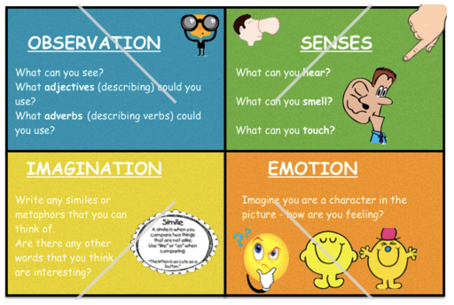
Sometimes, using a planning sheet like this can help to organise and plan your ideas…

Slide 15
Here is an example of how you might start your diary…
Dear Diary,
Last night was the most exciting night of my life! I met up with The Night Boatman as arranged and silently he began to row us across to the other side of the lake. I know I said it was exciting but as we rowed across I was so nervous I wanted to turn back, run home and jump into bed. What was I doing? All I could hear was each oar moving powerfully through the water as we floated closer to the shore…
How would you continue?

