Slide 1
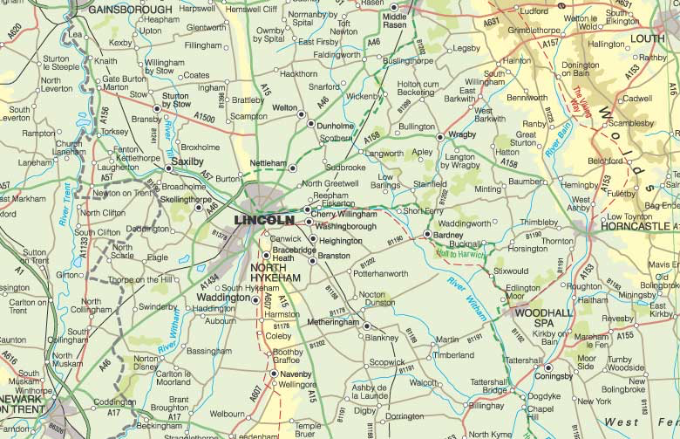
Geography:
Wednesday 4th November 2020
What does the map show us?

Slide 2
To start our new Geography topic about maps we are asking –
“What do you already know about maps?”
Can you use the space on the next slide or create your own version and write down anything you know already about maps. This could about what they tell us, how you use one, what types of maps you know about.
Don’t worry if you don’t know much yet… it means you have lots and lots to learn!

Slide 3
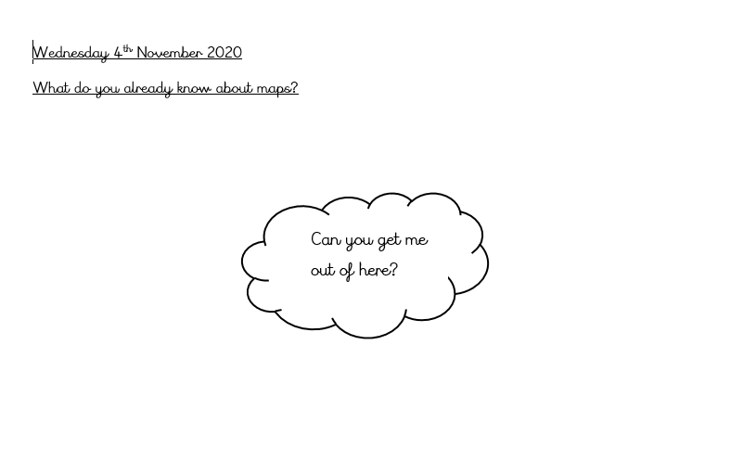

Slide 4
Take a look at the maps on the next slide. One is of Coningsby, one is Lincoln and one is London.
Can you think of at least 5 things that each map shows you about that area?
Now write some comparisons e.g:
There are more fields surrounding Coningsby than London.
Lincoln has a cathedral but Coningsby does not.

Slide 5
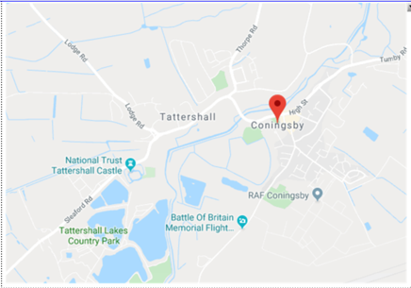
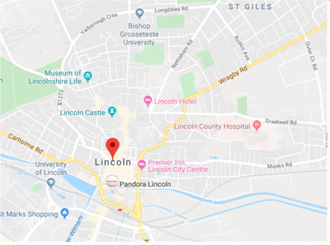
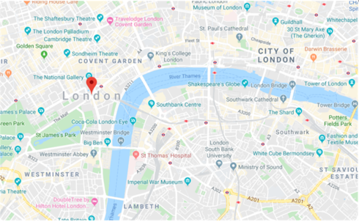
You can use these maps or go on google Earth to explore these areas.

Slide 6
RE:
Thursday 5th November 2020
What does good mean?
In RE this week we are thinking about this question. Can you discuss your thoughts with an adult or record them on paper?

Slide 7

What do you already know about our RE topic? You can
use the sheet on the
Following slide to record
your ideas…
Do you have to believe
in God to be good?

Slide 8

Which celebrities do you believe to be good or bad, and why?

Slide 9
Think about these questions:
What does it mean to be good or bad?
Who decides who is good or bad?
Do we all have to share the same views?
Can what you believe in mean that you are good or bad?

Slide 10
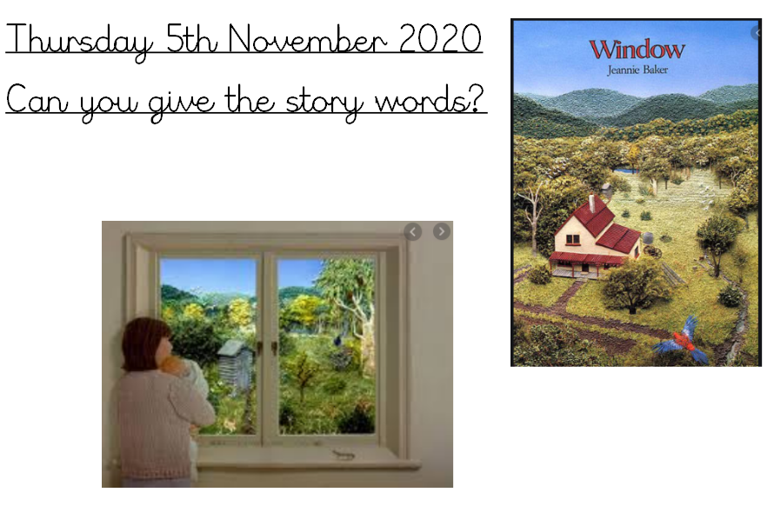
Big Write:
In Big Write this week we are looking at the book ‘Window’.
You can read it online here:
https://www.slideshare.net/MrsJuteau/windows-2992791

Slide 11
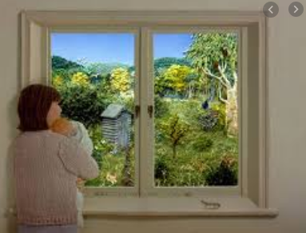
Use the planning grid on the next slide to write down ideas about what you can see, sense, feel and imagine in this image:
Next week we will be writing a description so add as much detail to your plan as you can…

Slide 12
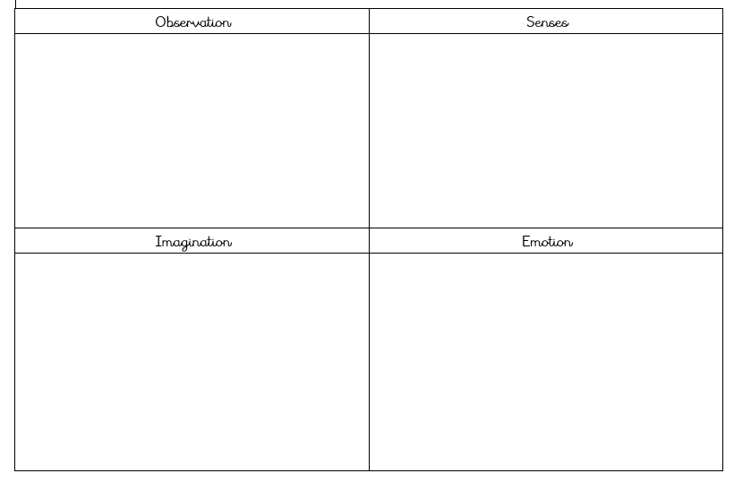

Slide 13
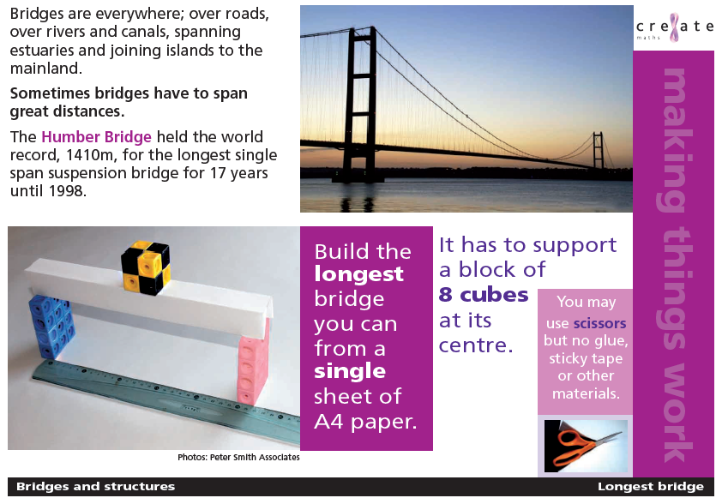
DT: Building Bridges
In DT this term we are going to be exploring bridges. You could create a mini fact-file about bridges or why not have a go at building one yourself. How strong can you make your bridge? How could you make it even stronger.

Slide 14
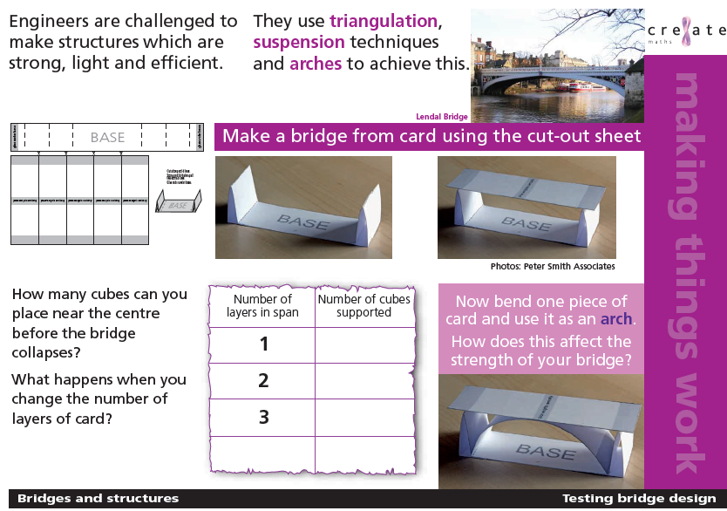
http://www.rochesterbridgetrust.org.uk/learning-activities/learning-about-bridges/
There is SO much information at this website! Why not take a look?

