Slide 1
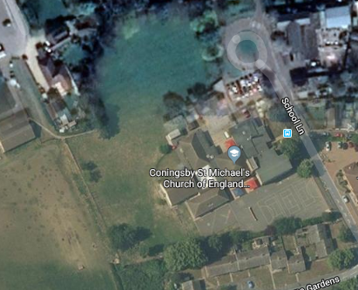
Geography:
Wednesday 11th November 2020
Can you create a bird’s eye view?

Slide 2
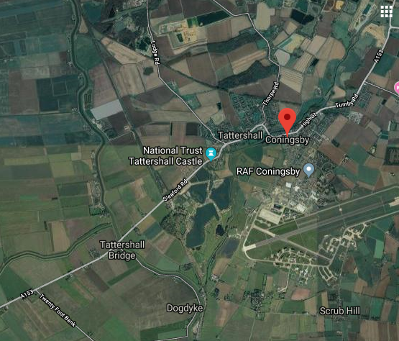
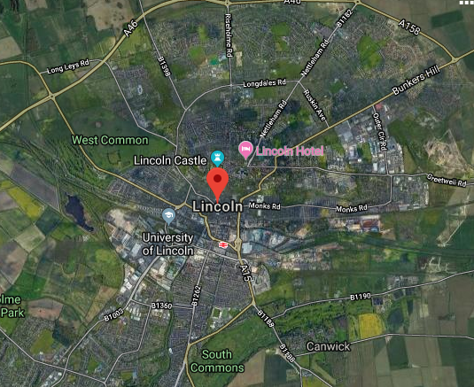
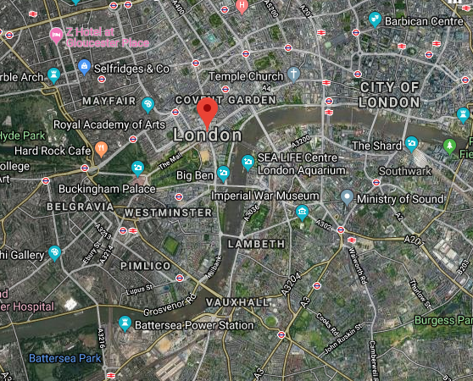
In geography this week we are looking at aerial views. Look at the following aerial views. What features can you spot in Coningsby, Lincoln and London? How do these three geographical areas differ and in what ways are they similar? Can you write some sentences comparing them?

Slide 3
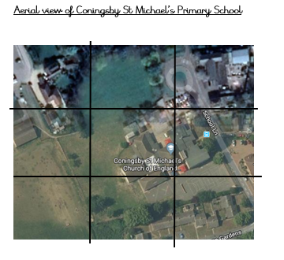
We are also going to create an aerial view (or bird’s eye view) of CSM primary school. You can use the template on the next slide to help you.

Slide 4
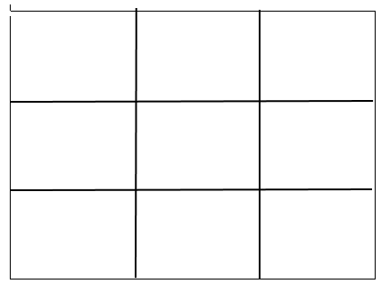
Create your aerial view of our school using this blank grid.

Slide 5
RE:
Thursday 12th November 2020
What is Your World View?
In RE this week we will be discussing the fact that people believe different things and that different people and events can influence your world view.
Discuss with a person in your house who or what influences you in how you choose to live your life. Look at the ‘World Views’ Powerpoint together. After this, use the next slide to choose the things that you think influence the way you live your life. If you are able to print these cut out the ones you choose and stick them onto the blank grid. If not, then copy them out onto plain paper, or simply discuss them.

Slide 6
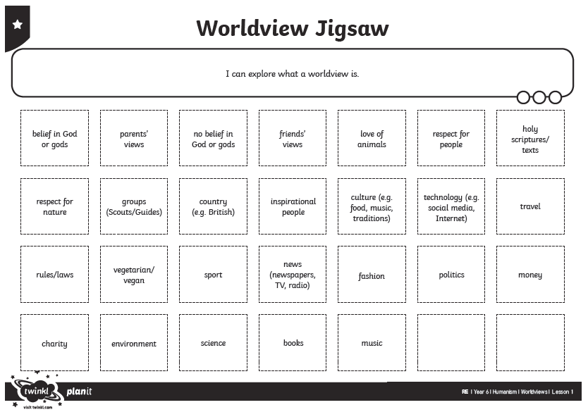

Slide 7
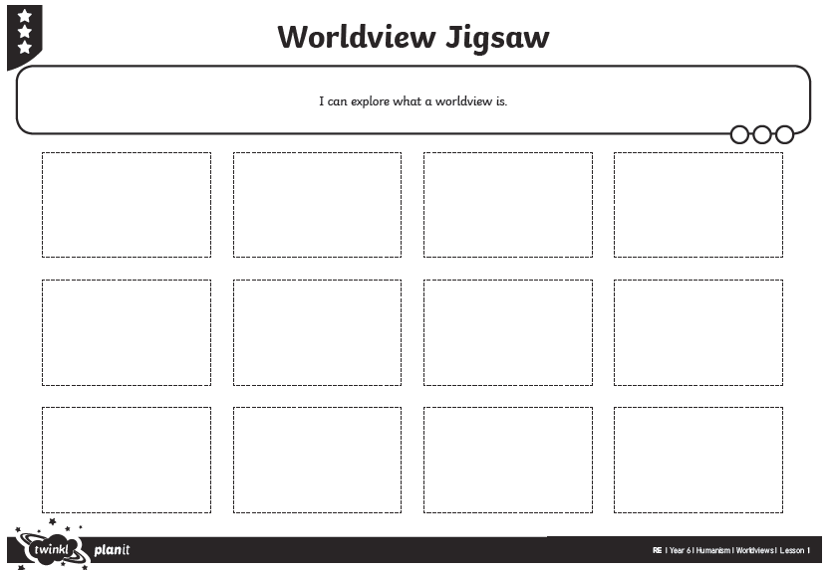

Slide 8
Why not think about these questions:
Who or what has the greatest influence on you?
Is your world view the same as your parents?
Do we all have to share the same views?
What do we do if we disagree on a person’s world view?
Can what you believe in mean that you are good or bad?

