Slide 1
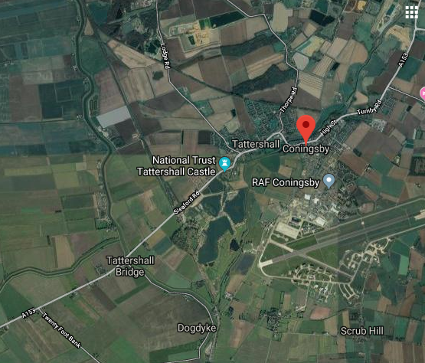
Geography:
Wednesday 18th November 2020
Can you create a bird’s eye view?

Slide 2
In geography this term we have been looking at aerial views. Can you use Google Maps to find an aerial view of your own house? You might need to ask an adult to help you. Use the blank grid on the next page to help you draw an aerial view of your house / street.
If you can’t find an aerial view to copy then why not imagine what your house / street would look like from the sky and draw that instead!

Slide 3
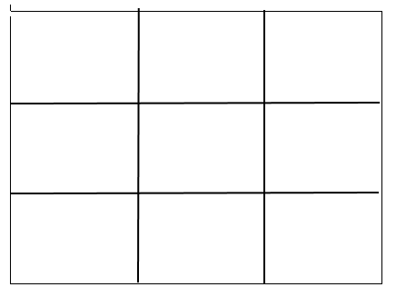
Create your aerial view of our school using this blank grid.

Slide 4
RE:
Thursday 19th November 2020
Why are these people good?
This week in RE we are going to find out more about Humanism.
Use the attached Powerpoint presentation about Humanism. Below are two information cards about influential thinkers. Read the information carefully and try to find 3 ideas that each of them believed in. Can you write these in the keys on the template below and then colour any matching beliefs the same?
Finally, talk to someone about what you have learnt today!

Slide 5
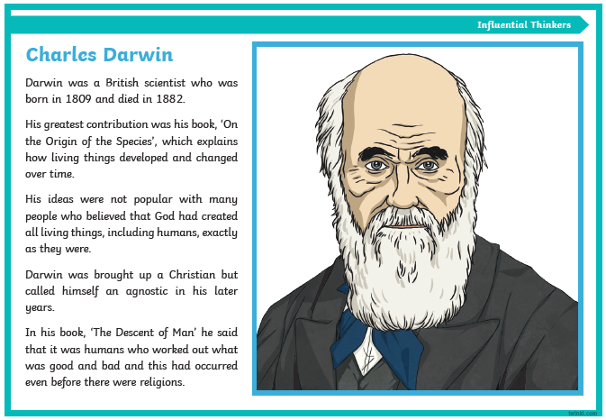

Slide 6
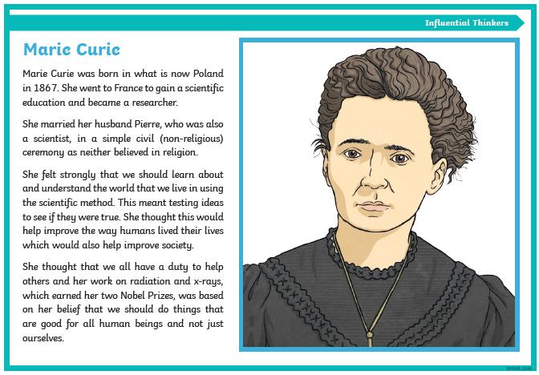

Slide 7
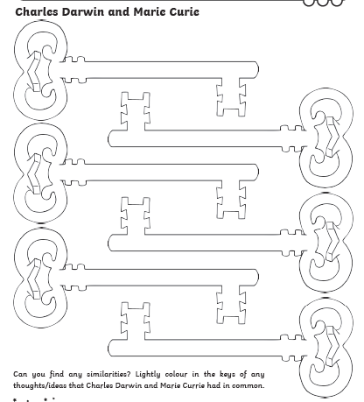

Slide 8
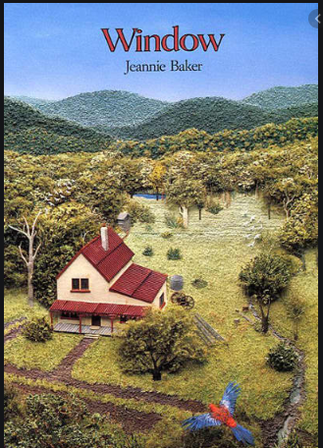
Big Write
Friday 20th November 2020
LQ: Can you give the story words?
During Big Write in week one we planned our ideas for a setting description using an image from the book ‘Window’.
In Big Write this week we will be using our plan to help us create a setting description. Don’t worry if you don’t have you plan available, just look at the image again and read the modelled example to help you. Imagine all the things you might see, hear and smell, as well as how the view might make you feel.
You can view the whole book here:
https://www.slideshare.net/MrsJuteau/windows-2992791

Slide 9
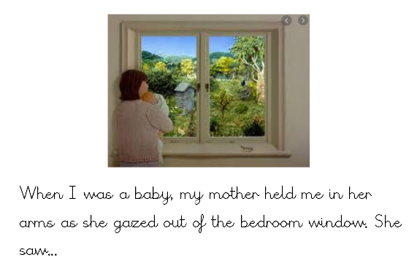
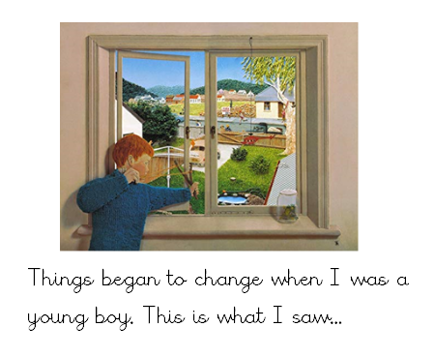
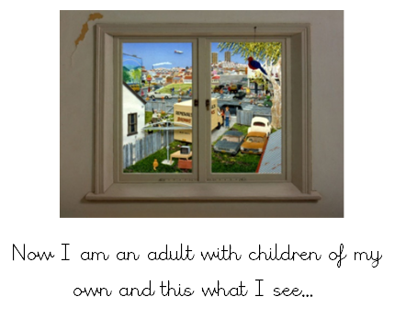
These are the three images. You should choose one of them to think about:

Slide 10


