Slide 1
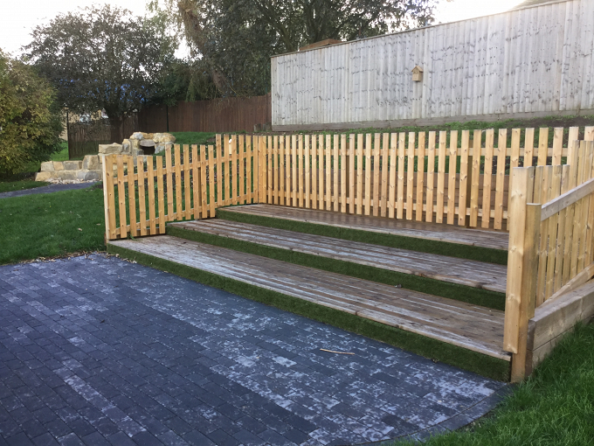
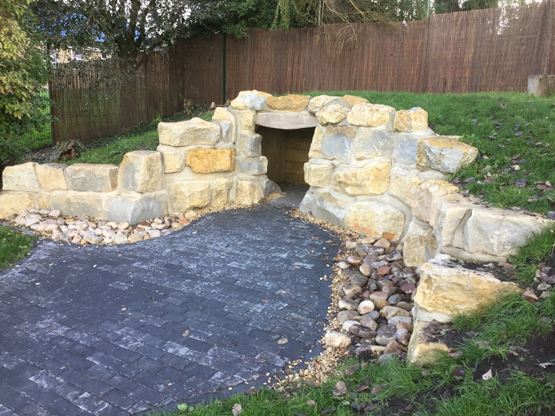
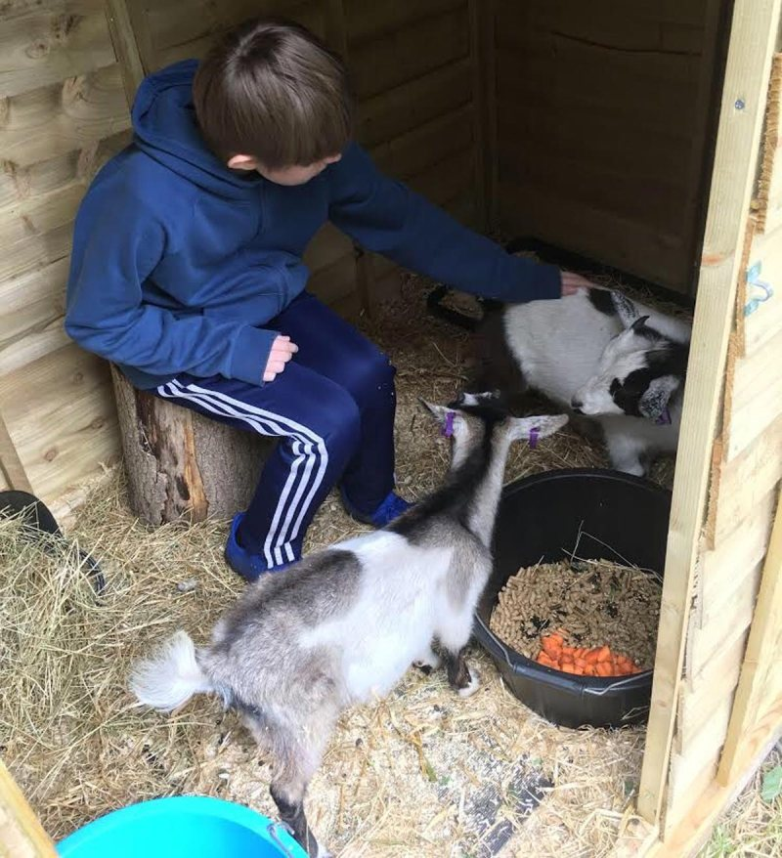
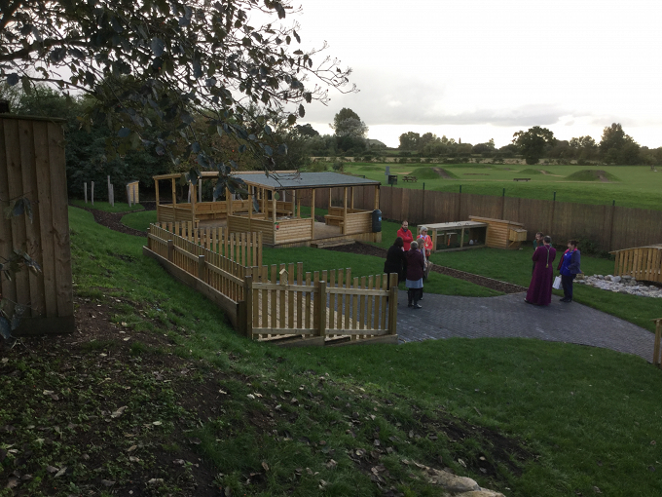
Geography:
Wednesday 25th November 2020
Can you create a map?

Slide 2
In geography this term we have been looking at maps and aerial views. Can you use your memory and the images provided to create an aerial view of the Mystical Garden at school?
Use the blank grid on the next page to help you draw an aerial view showing everything you can think of e.g. the cave, the goat enclosure, the woods, the bridge etc.
How much detail can you include?

Slide 3
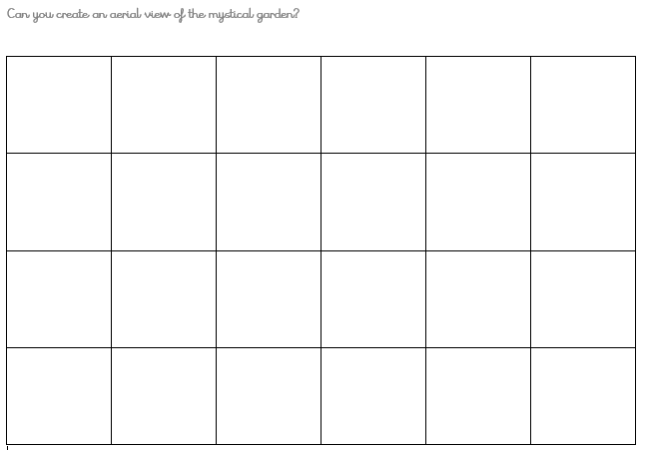

Slide 4
RE:
Thursday 26th November 2020
What are the main beliefs in Humanism?
This week in RE we are going to find out more about Humanism.
Watch the BBC bitesize information about Humanism. https://www.bbc.co.uk/bitesize/topics/znk647h/articles/zmqpkmn
There are also some belief cards on the following slides to give you more information. Can you record the information you find out about Humanist beliefs? You could design a poster, write an information leaflet or simply create a list of bullet points.
Finally, talk to someone about what you have learnt today!

Slide 5
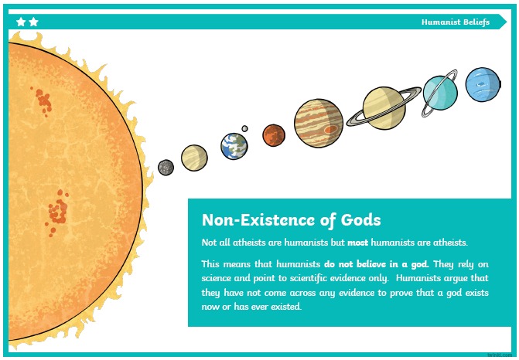

Slide 6
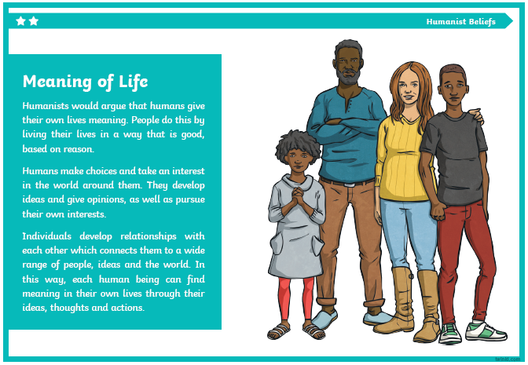

Slide 7
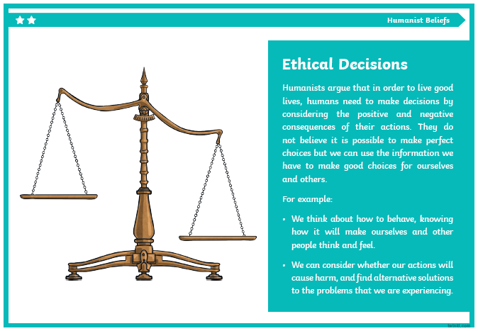

Slide 8
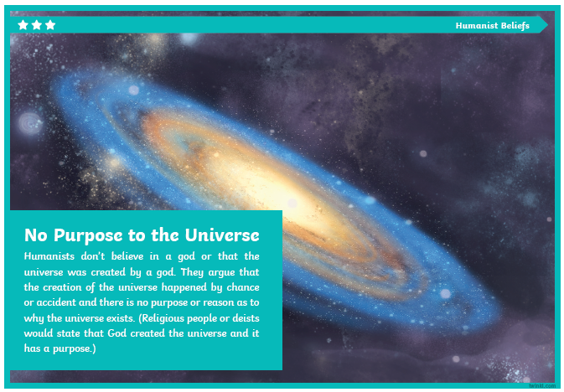

Slide 9
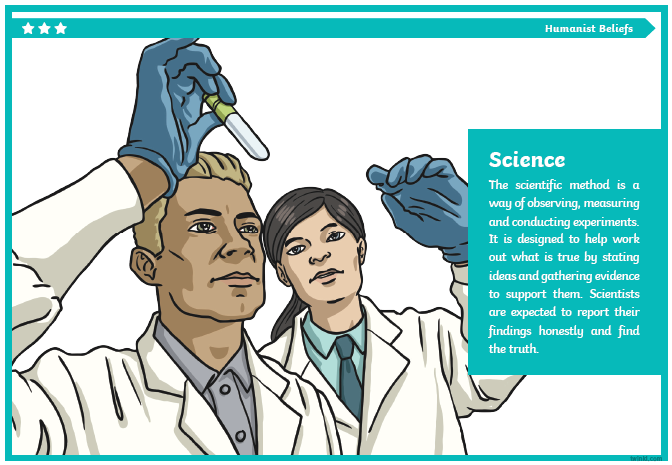

Slide 10
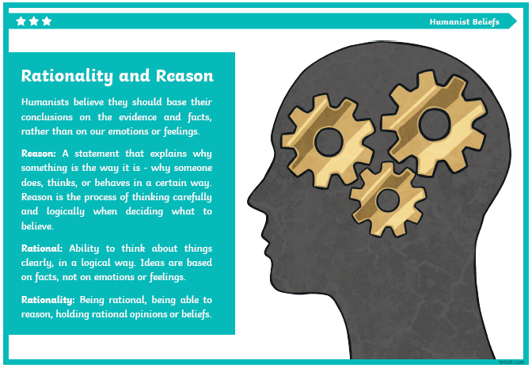

Slide 11
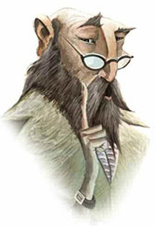
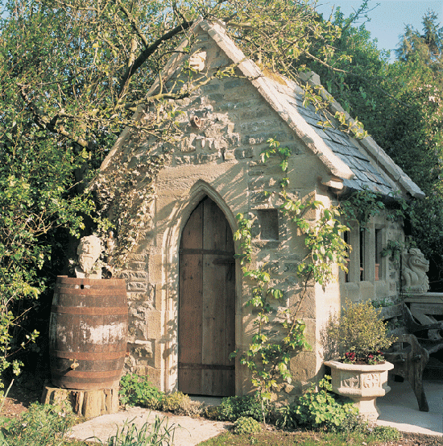
Big Write
Friday 27th November 2020
LQ: What would they say?
During Big Write this week we are thinking about using dialogue in our writing.
You can remind yourself on the rules of writing speech by looking at the following webpage. Why not tell an adult what you remember first?
https://www.youtube.com/watch?v=6-YFmLctwDY

Slide 12
Imagine you discover this mysterious building at the bottom of your garden. What is inside? Imagine it's magical inside, much bigger than it seems on the outside. Perhaps lit by candles, strange instruments on the tables, cobwebbed and dusty.
Behind you the door closes gently and you spy this man wearing emerald green robes, peering at you over his glasses, the candles flicker and die out. It's pitch black and he whispers....
What would the character say in your story? Why not jot down a few ideas before you start your writing?

Slide 13
Use the modelled example to help you write an opening paragraph to an adventure story. Make sure that it includes some dialogue.
Half hidden now by trees and brambles, I wondered why I had never seen this curious building before. It seemed as though the world had forgotten it existed. Drawn to it like a moth to a flame, I knew as soon as I saw it that I was going to explore inside…
Cautiously pushing open the ancient, wooden door I felt a sudden shiver. Was it cold or fear? Gently, the door creaked shut behind me. I was trapped!
Through the gloom I spied a figure. “Come closer,” he whispered, “We don’t have much time. I have something important to show you!”

