Slide 2
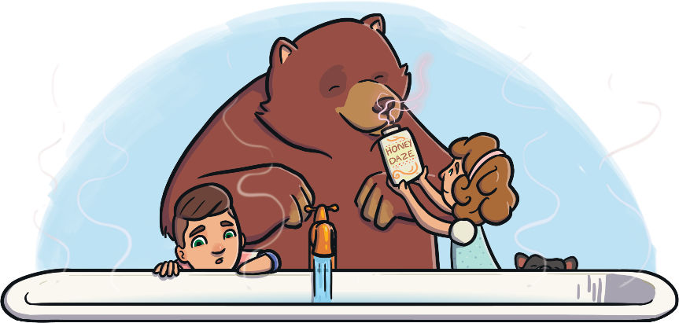
The Bear Who Came to Babysit
Read the book ‘The Bear Who Came to Babysit’
and look at the illustrations.
To see a question about the book, click this button:
?

Slide 3
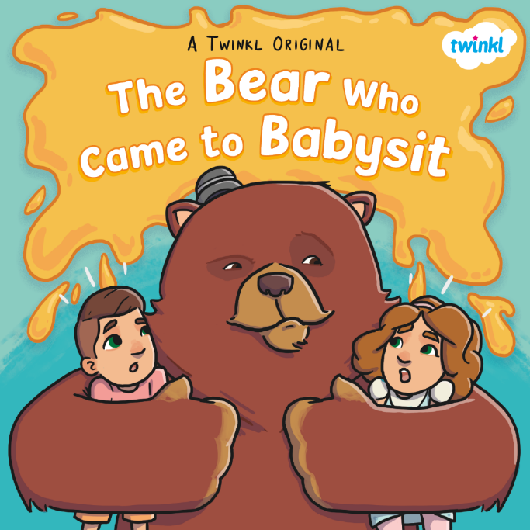
?
What do you think this book is going to be about?
?
Do you think it is fiction or non-fiction?
?
How do you think the two children are feeling?

Slide 4
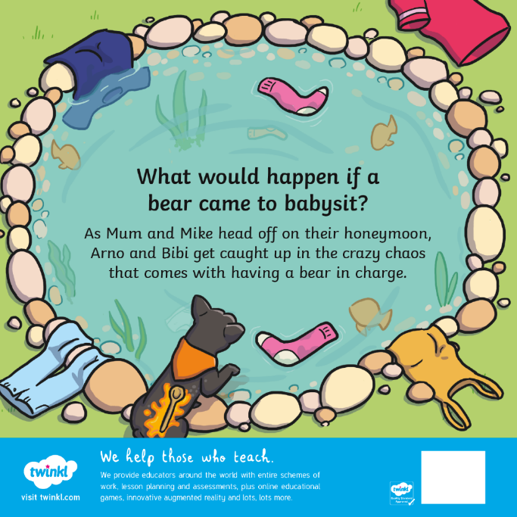
?
What do you think ‘chaos’ means?
Can you predict what might happen when the bear comes to babysit?
?

Slide 5
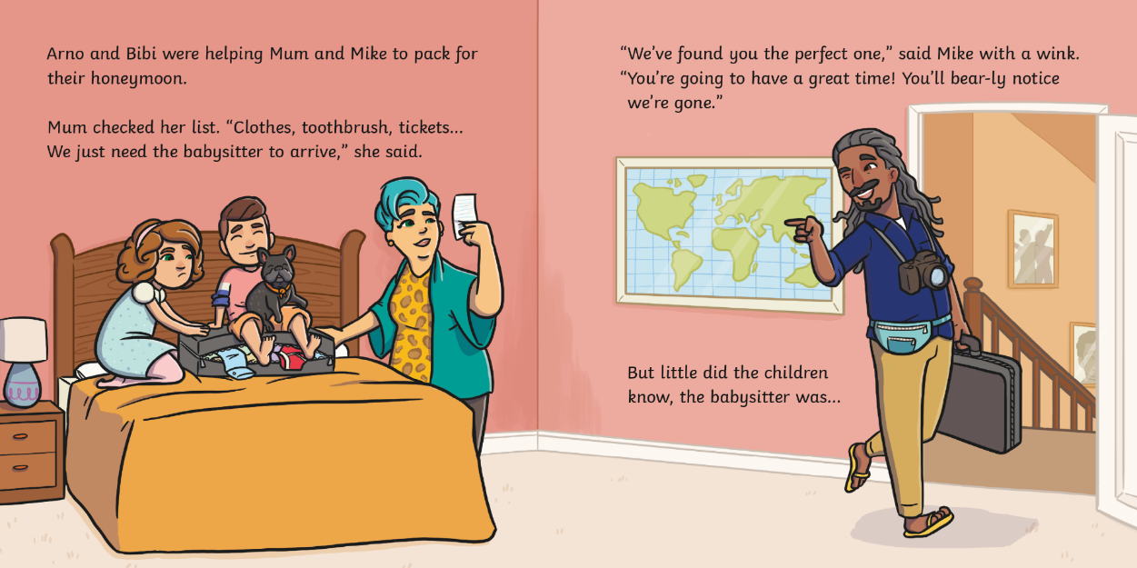
?
Why have Mum and Mike booked a babysitter?

Slide 6
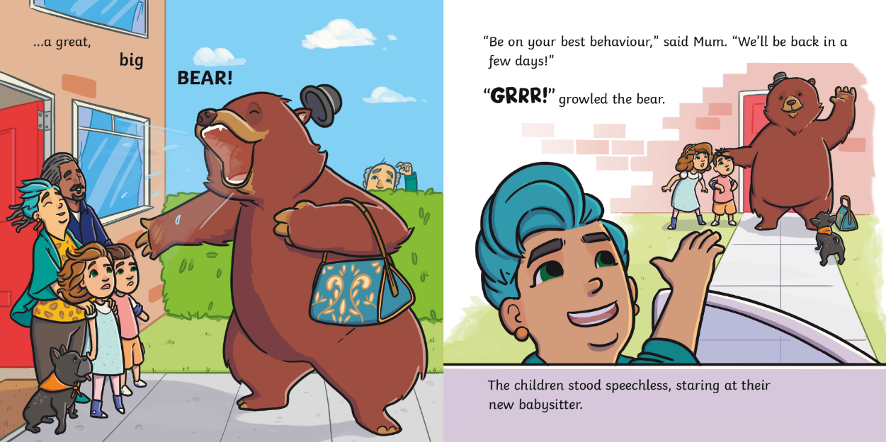
?
Why are the children ‘speechless’?

Slide 7
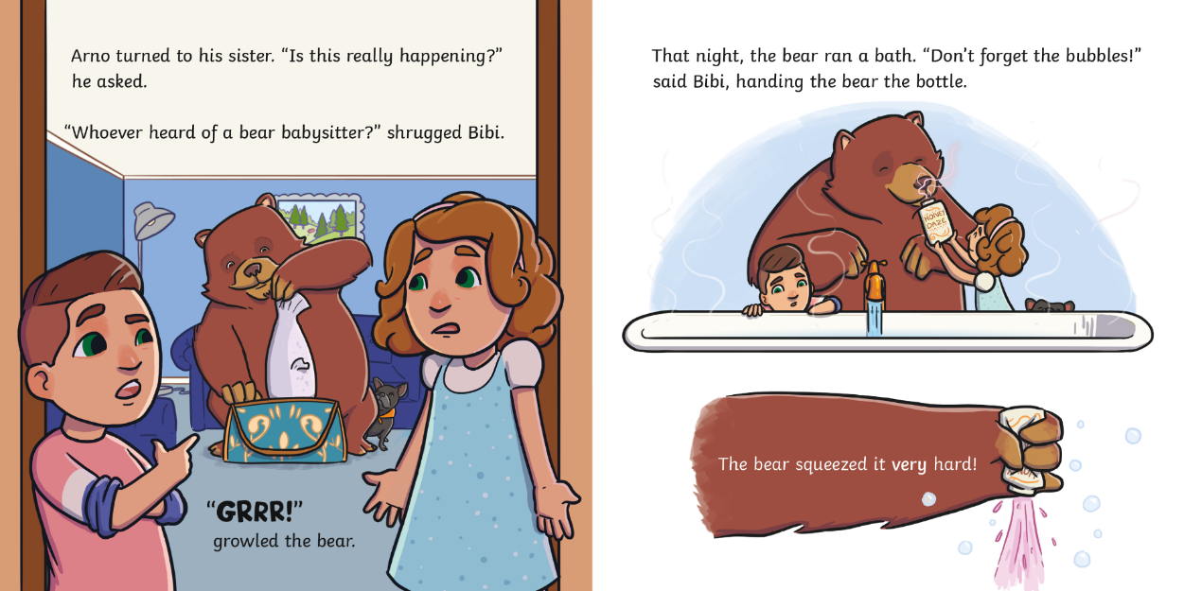
?
The bear squeezed the bottle very hard. What might happen next?

Slide 8
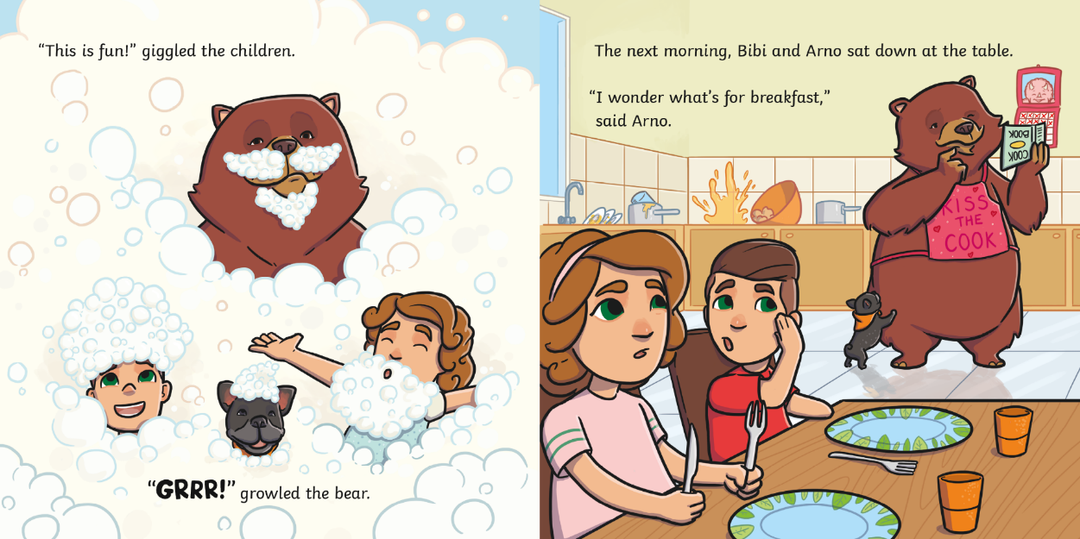
?
Do you think the bear knows how to cook?

Slide 9
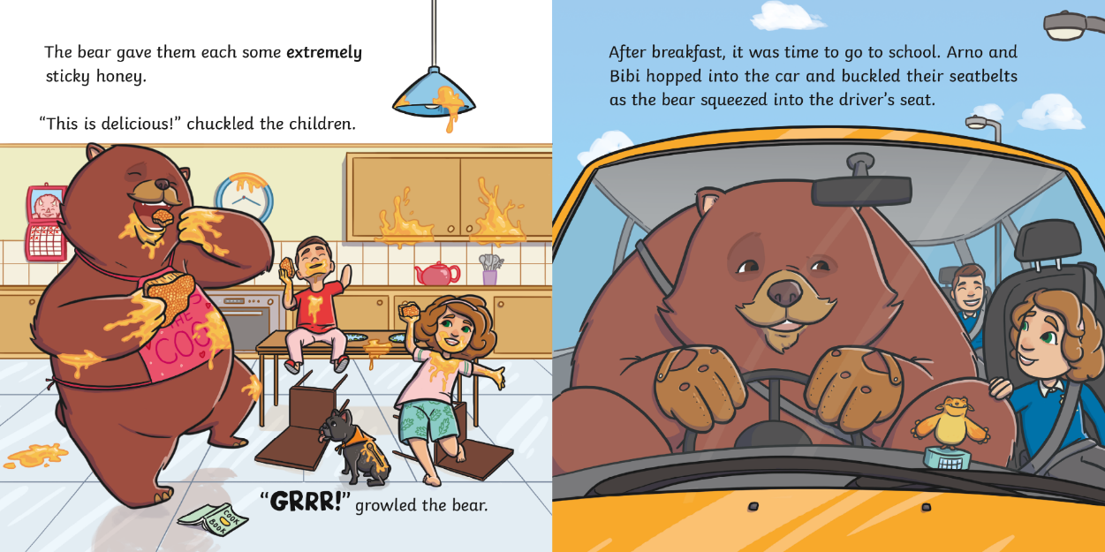
?
Do you think the children are scared of the bear? Why?

Slide 10
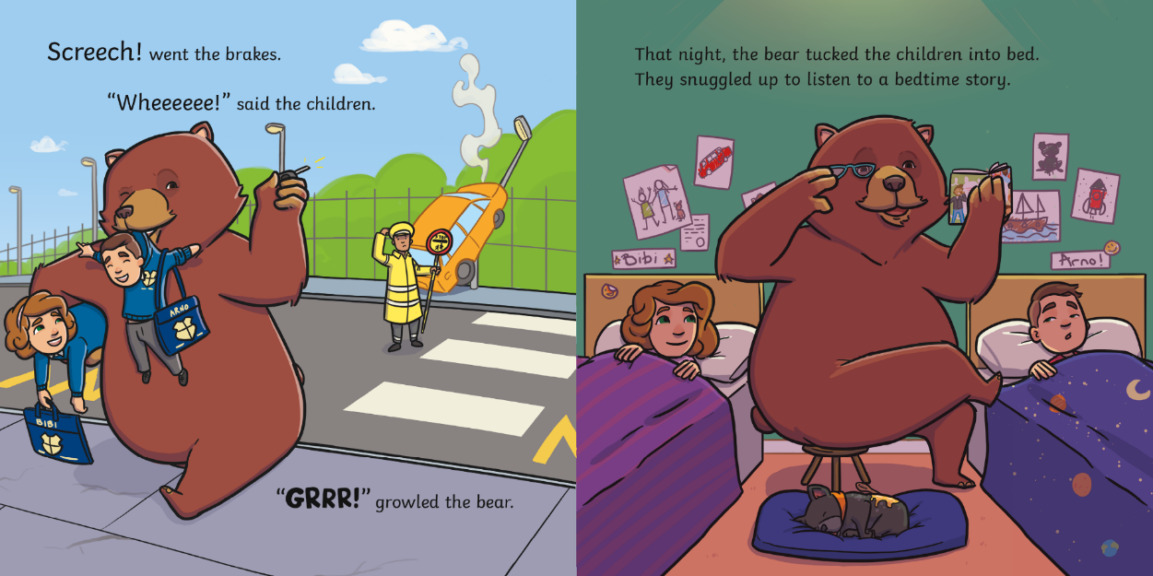
?
What do you think has happened to the car?

Slide 11
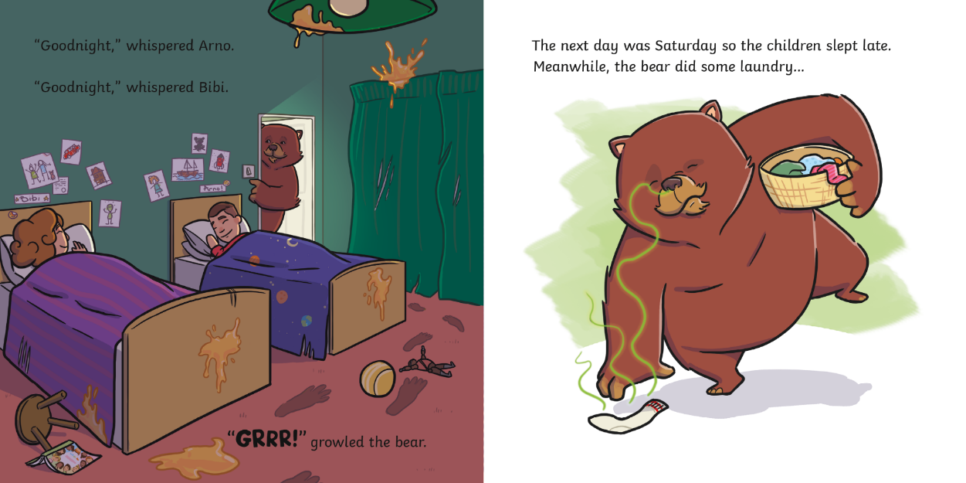
?
Where are the children when the bear is doing laundry?

Slide 12
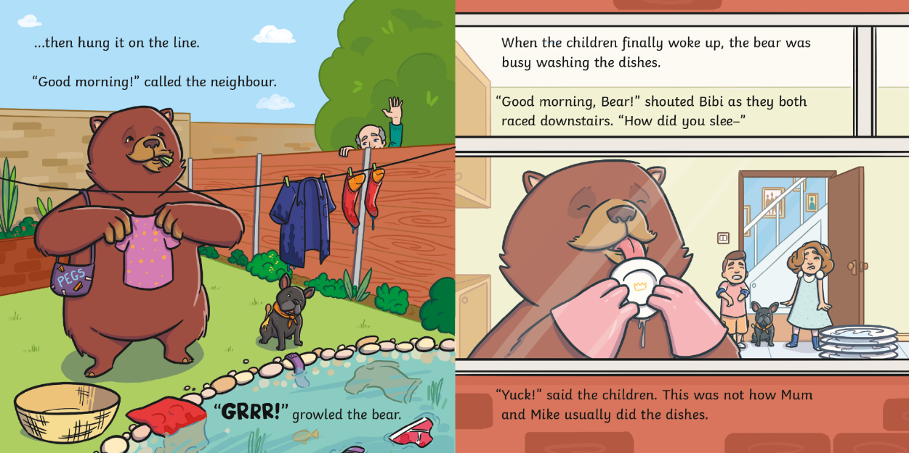
?
Is the bear doing a good job with the chores?

Slide 13
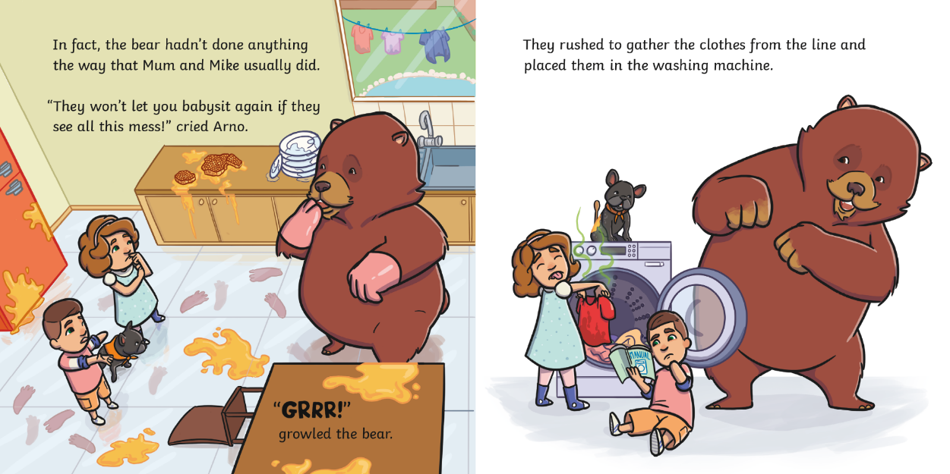
?
Why are the children worried about the mess?

Slide 14
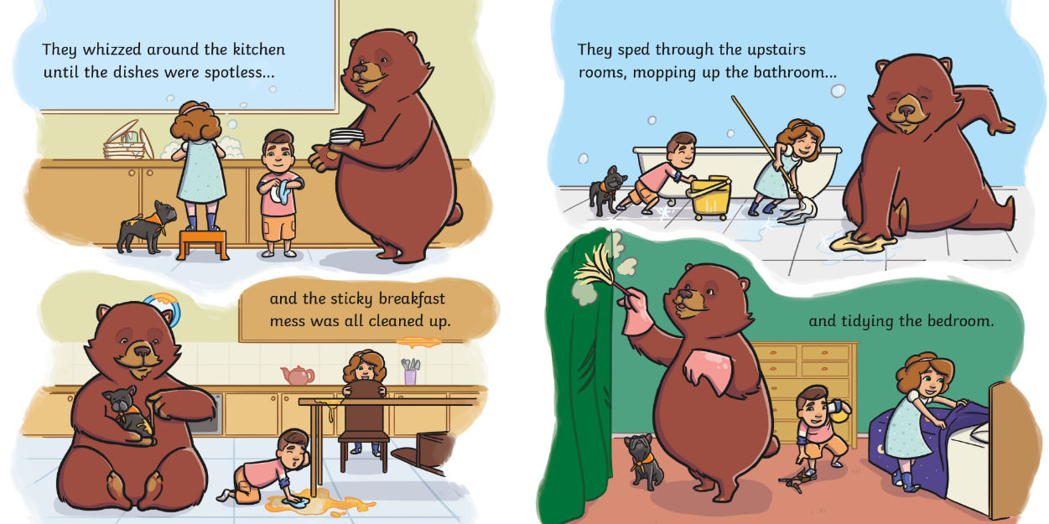
?
Which verbs in the text tell you that they worked quickly?

Slide 15
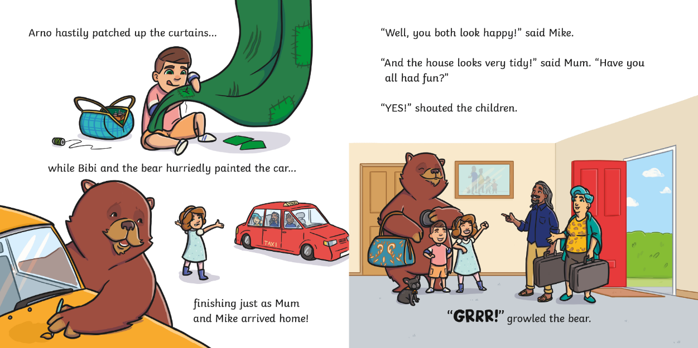
?
Do you think Mum and Mike know what happened while they were gone?

Slide 16
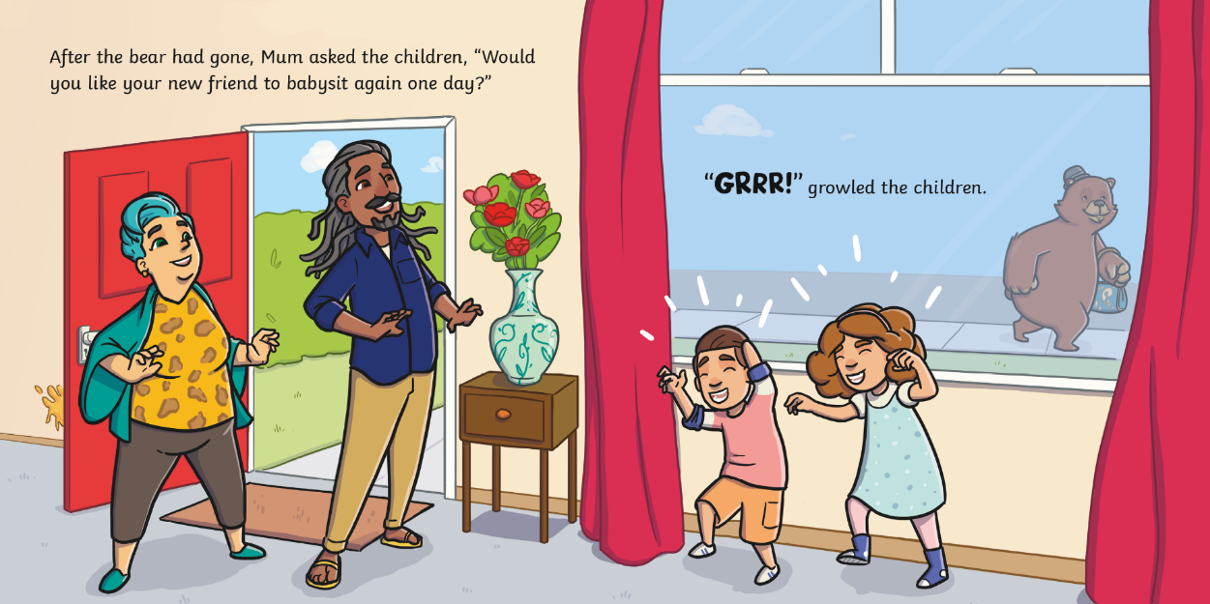
?
Where do you think the bear is going next?

Slide 17
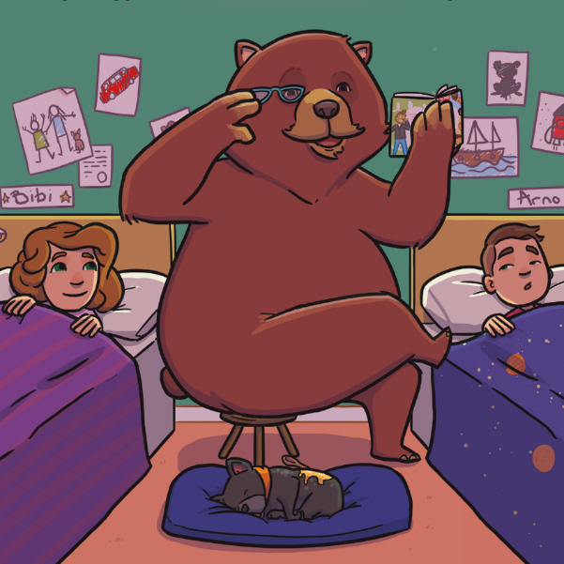
?
What was unusual about the babysitter in this story?

Slide 18
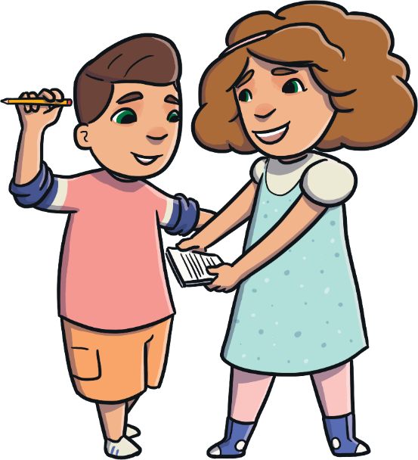
?
What are the children in this story called?
Arno and Bibi
Farno and Keely
Barno and Phoebe

Slide 19
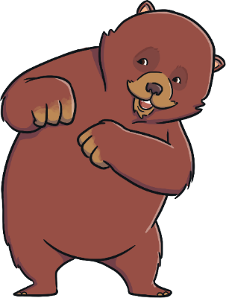
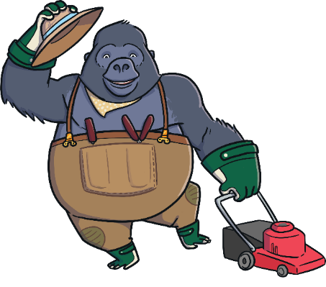

?
Which of these animals did you not see in the story?
a bear
a gorilla
a dog

Slide 20
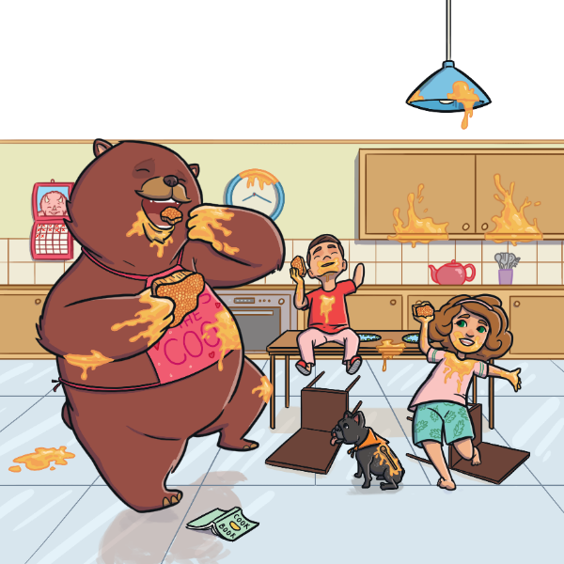
?
How do you think the children felt about having the bear as their babysitter?

Slide 21
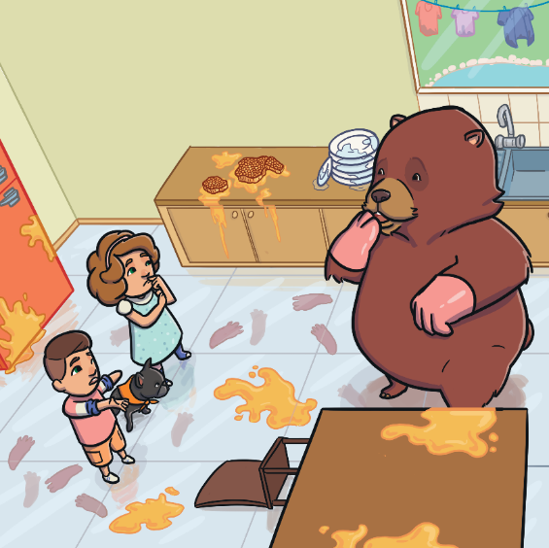
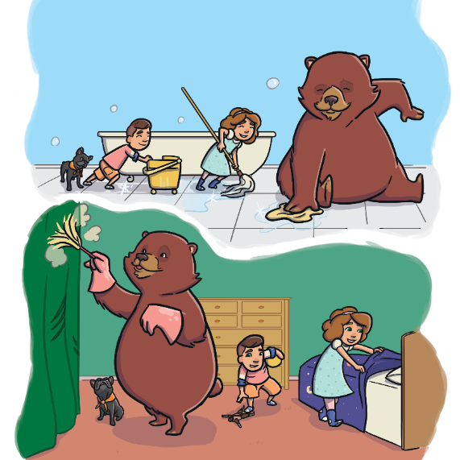
?
What was the problem in this story?
?
How was the problem solved?

Slide 22
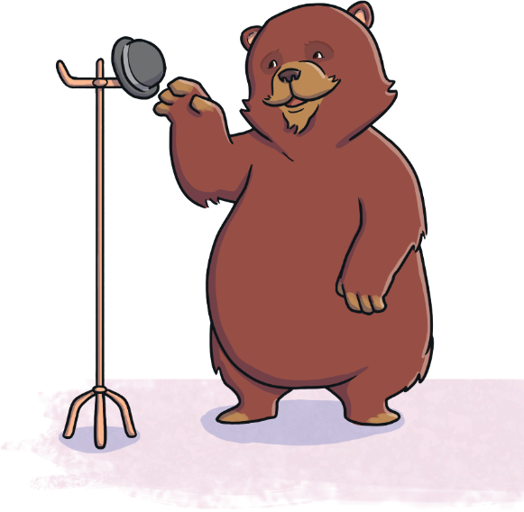
Do you think you would like to have the bear as your babysitter?
?
?
What do you think would happen?

Slide 23
?
Can you think of three adjectives to describe this book?
?
Would you recommend this book to a friend?

