Slide 2

Don’t Hog the Hedge!
Read the book ‘Don’t Hog the Hedge!’ and look at the illustrations.
To see a question about the book, click this button:
?

Slide 3
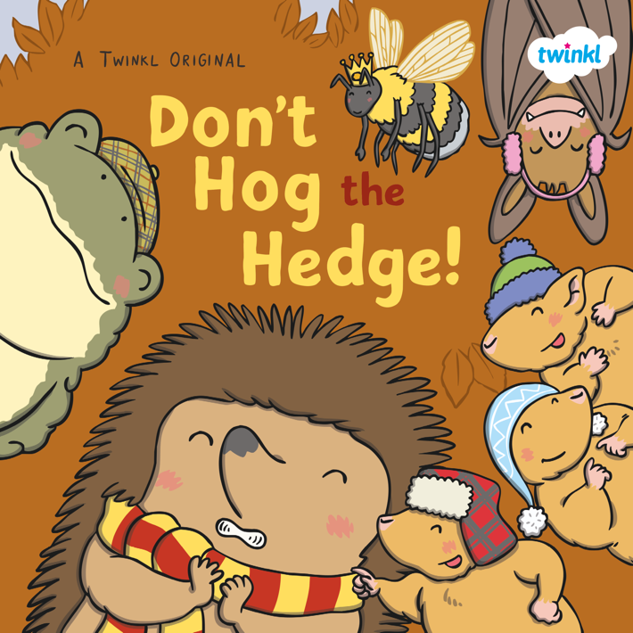
?
What do you think this book is going to be about?
?
Do you think it is fiction or non-fiction?
?
What characters do you think will feature in this book?

Slide 4
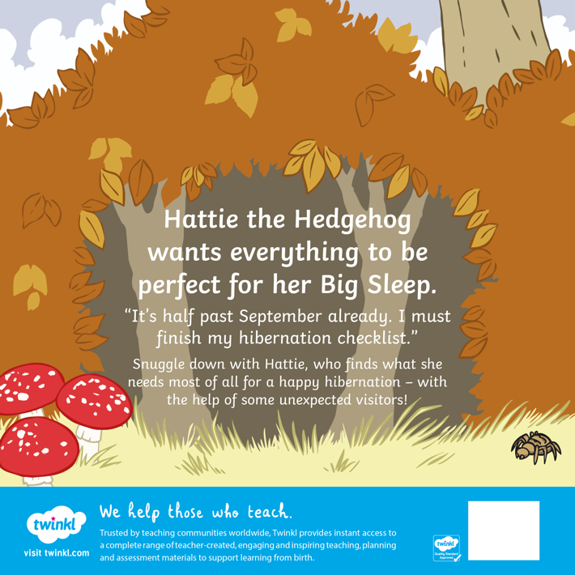
?
What is ‘hibernation’?
Have you heard this word before?
?
Who might the ‘unexpected visitors’ in the story be? Can you make a prediction?

Slide 5
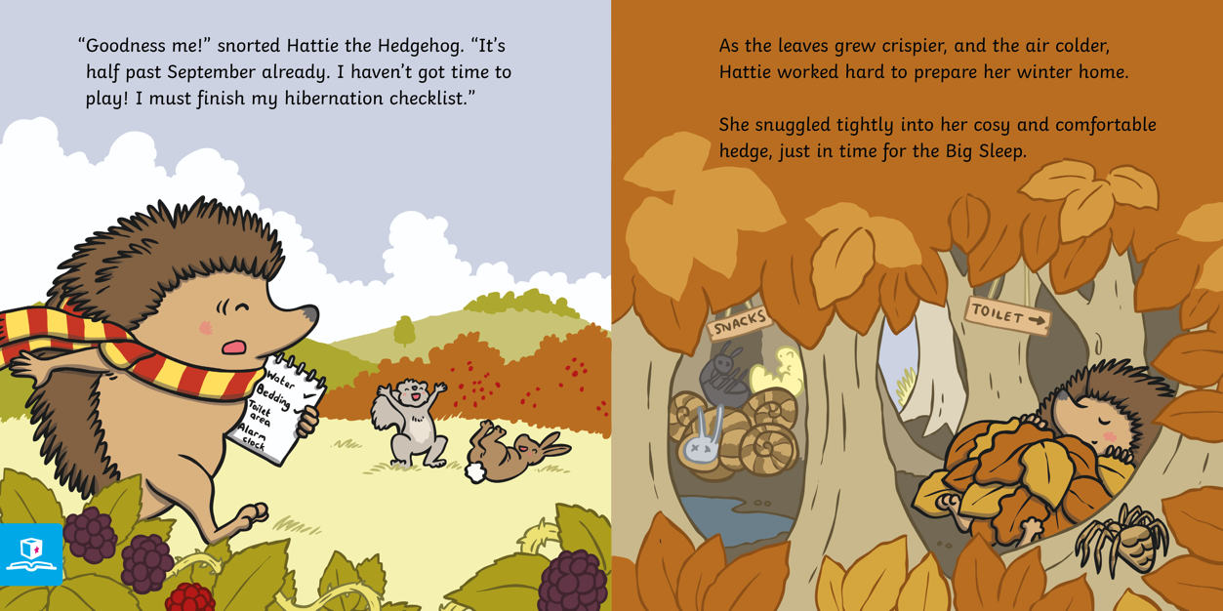
Look at the last sentence. Which words tell us that Hattie’s hedge is great for sleeping in?
?
Why hasn’t Hattie got time to play?
?

Slide 6
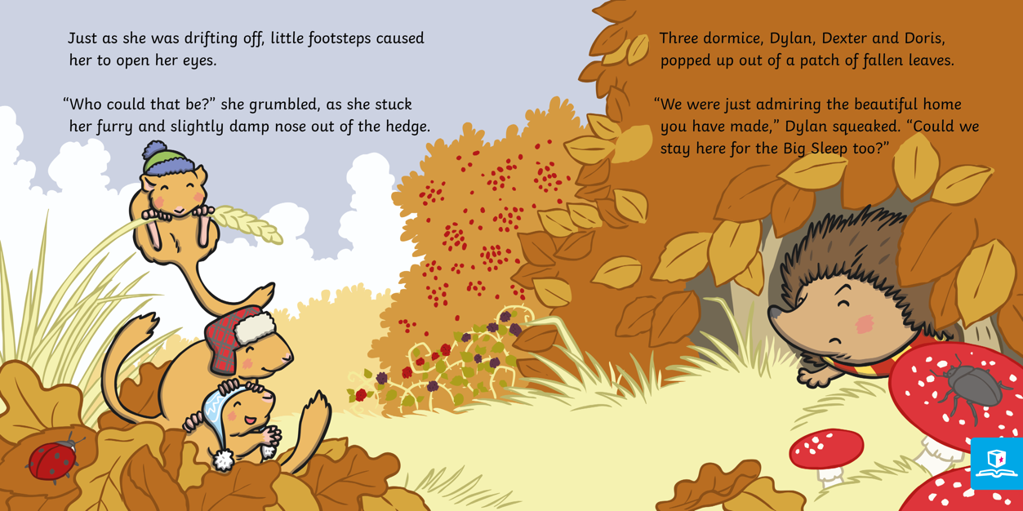
?
What does ‘drifting off’ mean?
?
Do you think Hattie is happy to see the dormice? Why?

Slide 7
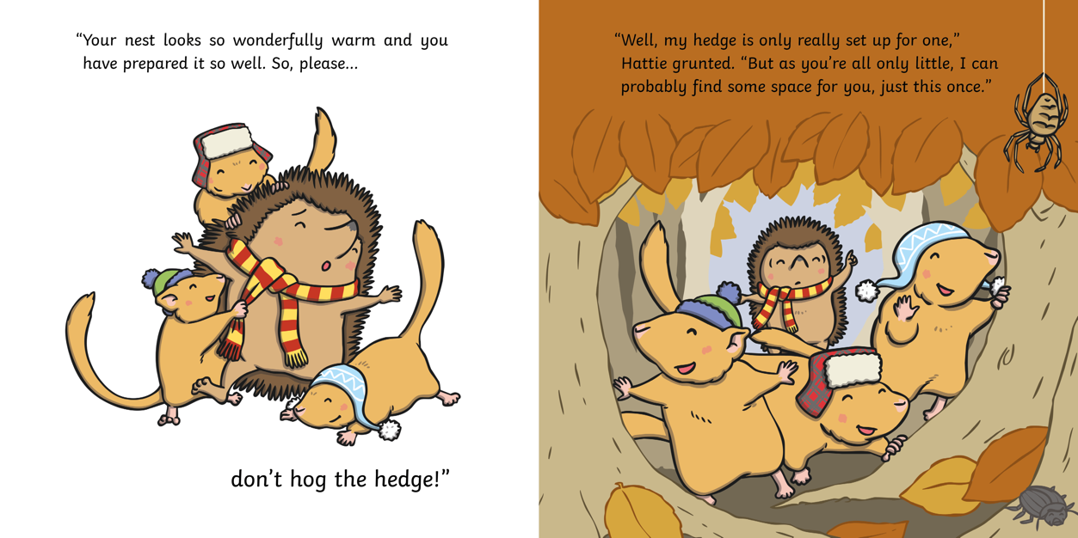
?
The dormice ask Hattie not to ‘hog the hedge’. What do they mean? Can you think of another way of saying this?

Slide 8
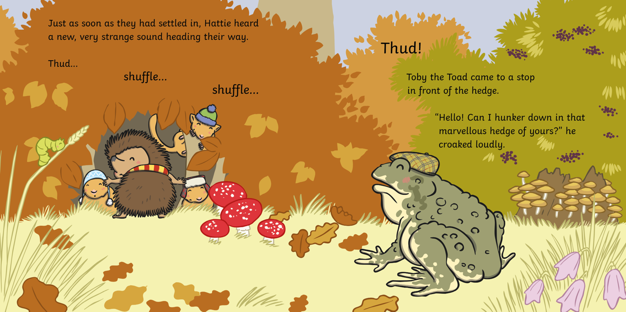
?
What does ‘hunker down’ mean?

Slide 9
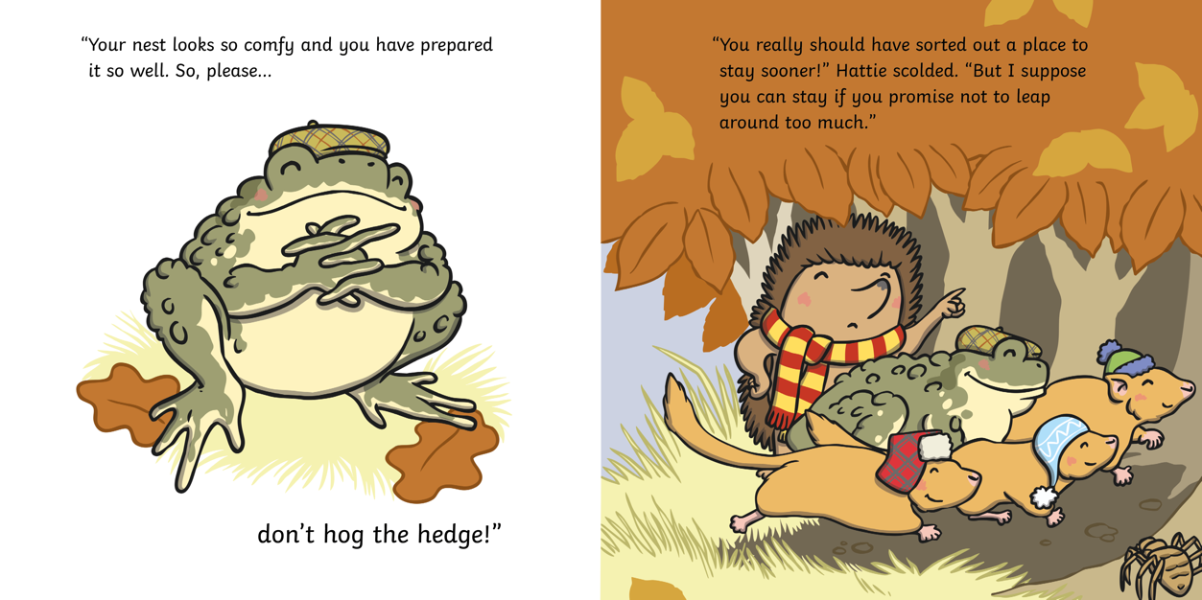
?
What does ‘scolded’ mean?

Slide 10
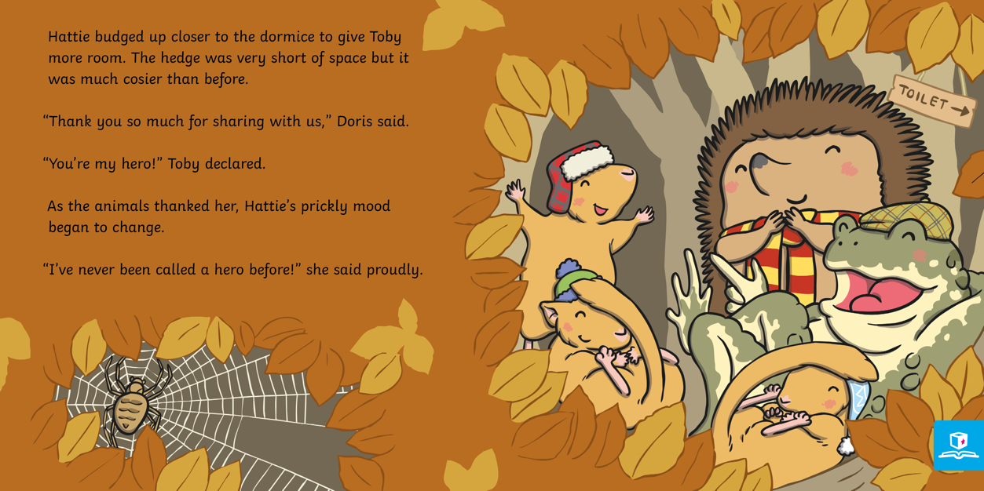
?
What do you think makes Hattie’s ‘prickly mood’ change?

Slide 11
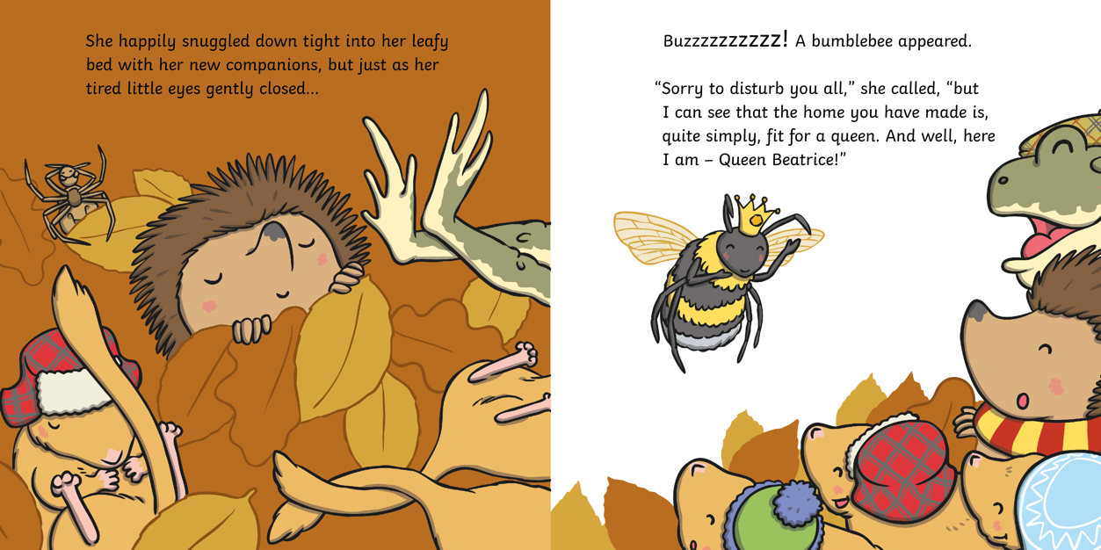
?
What is another word for ‘companion’?
?
Do you think that Hattie will let Queen Beatrice share her hedge? Why?

Slide 12
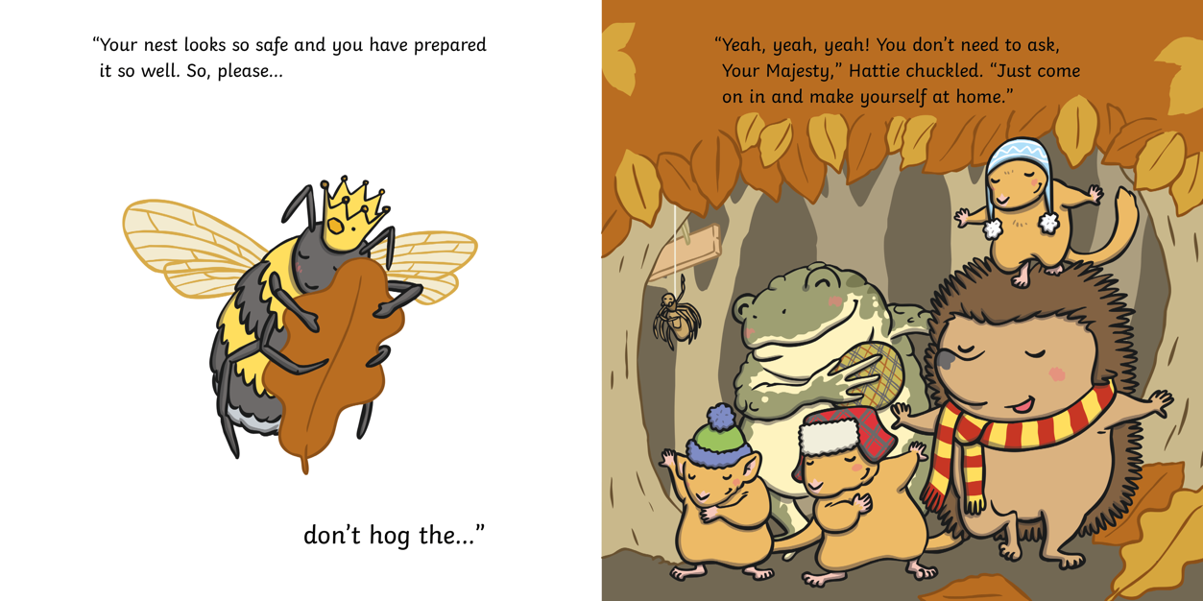
Why has the author used an ellipsis on this page? What word should be here? Why is it missing?
Which verb on this page tells us that Hattie is in a happy mood?
?
?

Slide 13
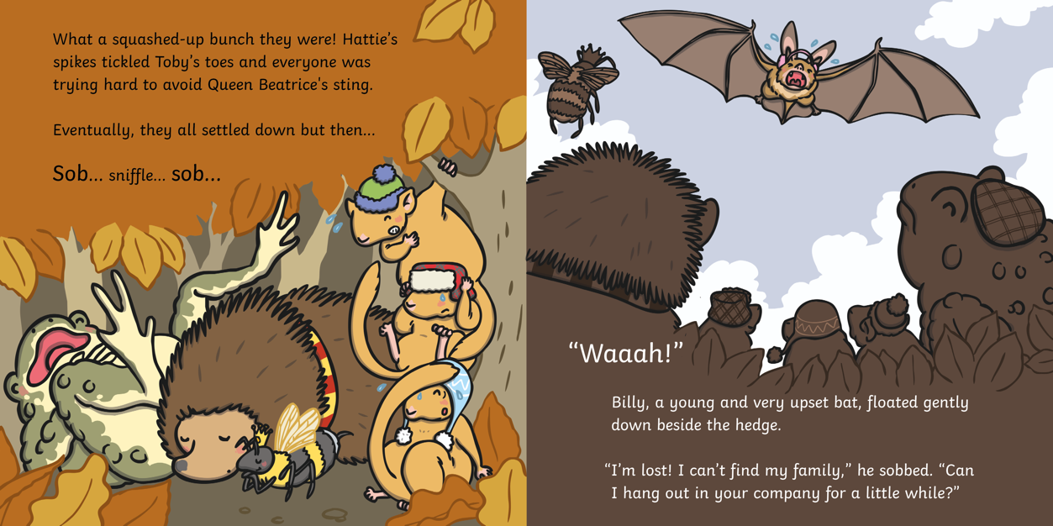
Can you spot the exclamation sentence on this page?
Why do you think the author has used the phrase ‘hang out’ in the bat’s speech?
?
?

Slide 14
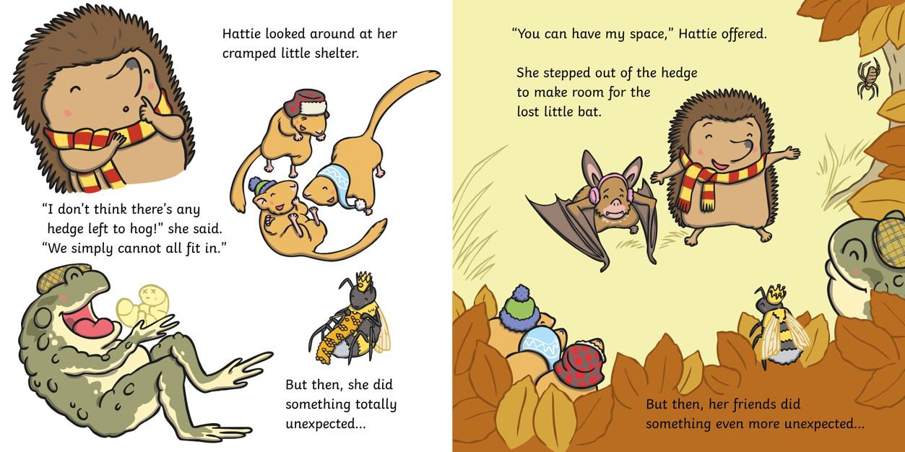
?
What do you think will happen next?

Slide 15
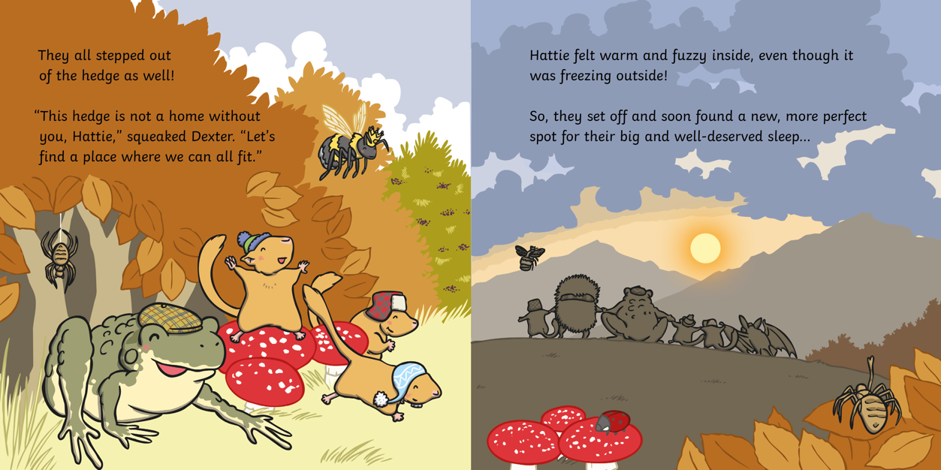
?
The author describes Hattie as feeling ‘warm and fuzzy inside’. What does the author mean?

Slide 16
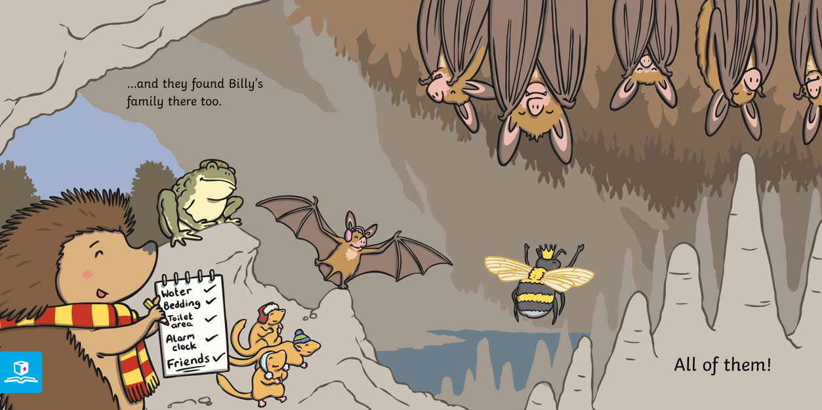
Hattie has added ‘Friends’ to the list of things she needs. Why do you think this is?
?
Where are Hattie and her friends now?
?

Slide 17

?
Where is the story set?
?
What season is it? How do you know?

Slide 18
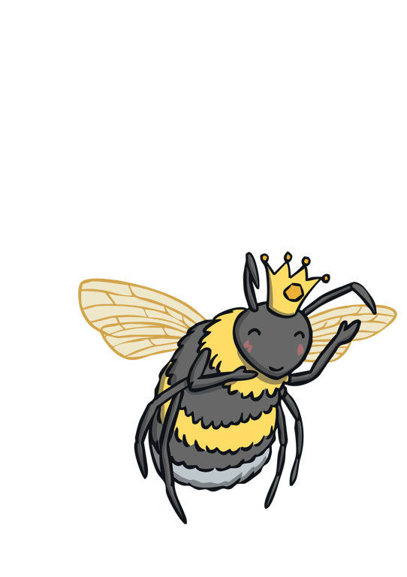

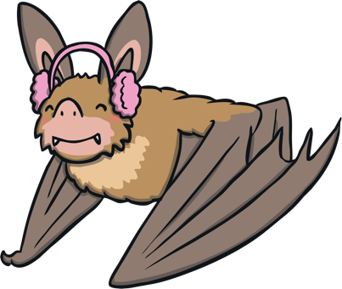
?
Who is the main character in this story?
Queen Beatrice
Hattie
Billy

Slide 19
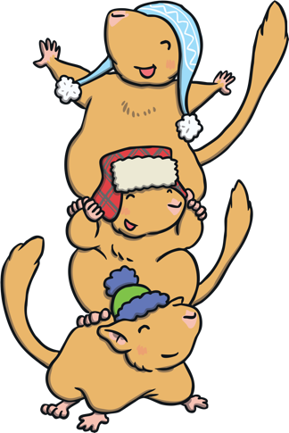
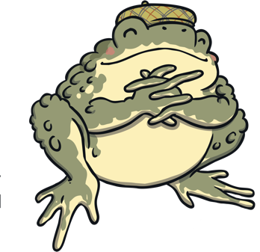
?
Who is first to visit Hattie’s hedge?
Toby
Queen Beatrice
Dylan, Dexter and Doris

Slide 20
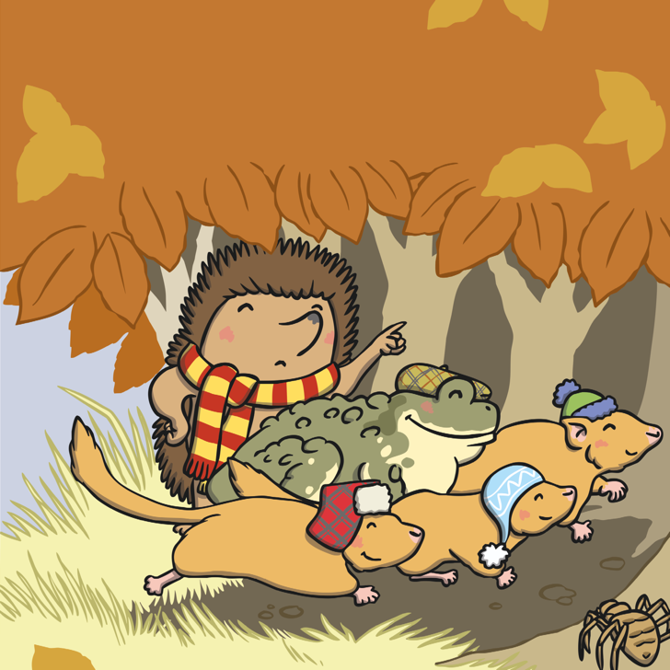
Hattie is a little bit cross with the other animals. She tells them, “You really should have sorted out a place to stay sooner!”
Do you think it is fair that the animals get to share Hattie’s hedge?
?

Slide 21
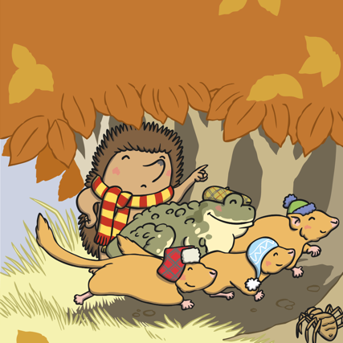
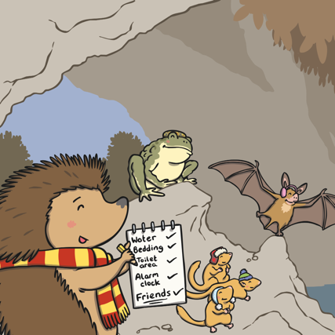
cranky
generous
selfish
lonely
happy
friendly
grumpy
busy
kind
cross
?
Which adjectives would you use to describe Hattie at the start of the story?
?
Which adjectives would you use to describe Hattie at the start of the story?

Slide 22
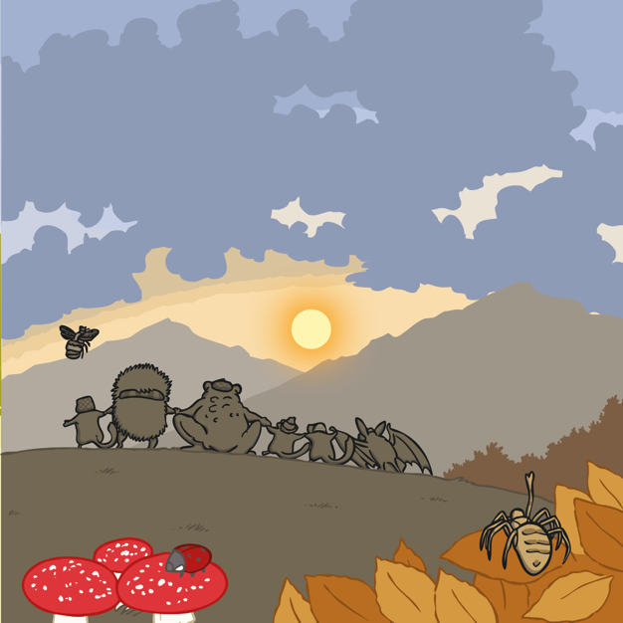
?
Do you think there is a message in this story? What do you think it might be?

