Slide 2
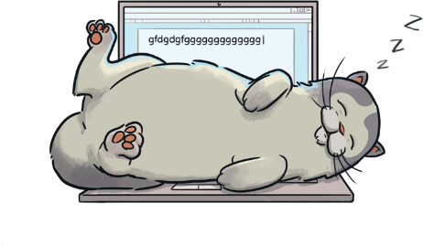
Harold’s Worst Nightmare
Read the book ‘Harold’s Worst Nightmare’
and look at the illustrations.
To see a question about the book, click this button:
?

Slide 3
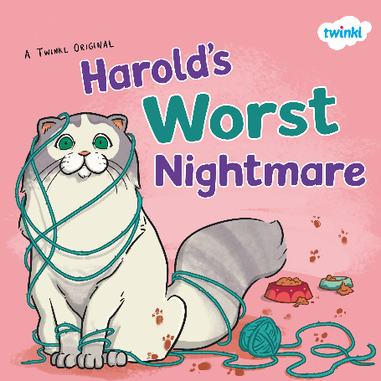
?
What do you think this book is going to be about?
?
Do you think it is fiction or non-fiction?
?
Who do you think Harold is?

Slide 4
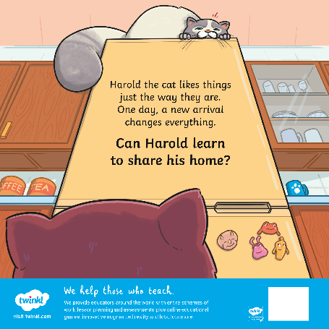
?
Who do you think the ‘new arrival’ will be?
?
What does ‘share’ mean?

Slide 5
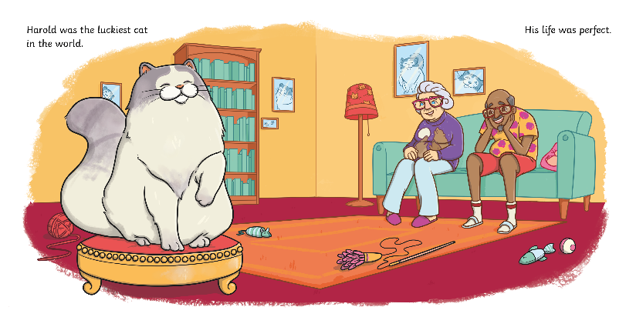
?
What do you think makes Harold’s life ‘perfect’?

Slide 6
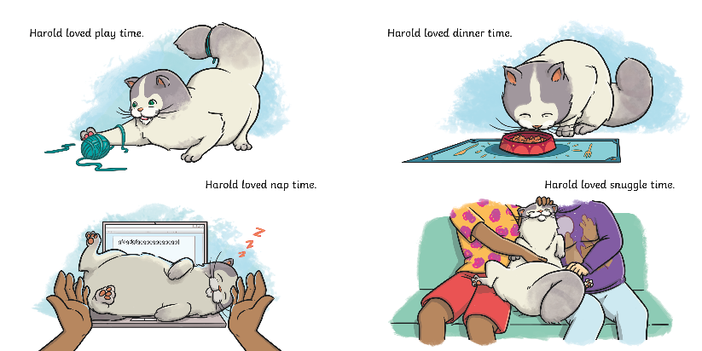
?
Do you think Harold is happy? How do you know?

Slide 7
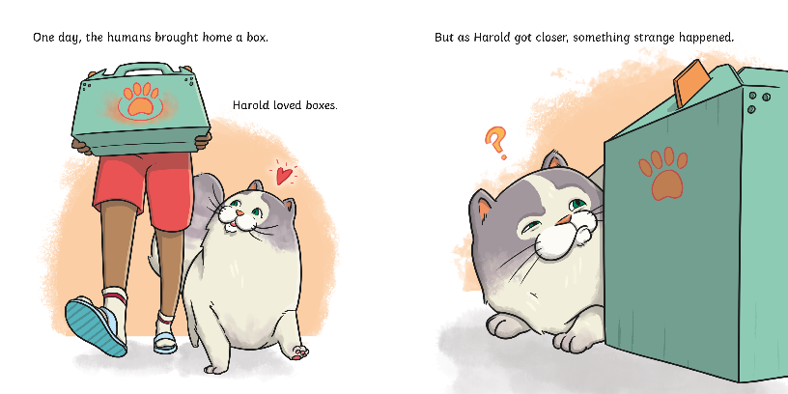
?
What might Harold think is inside the box?

Slide 8
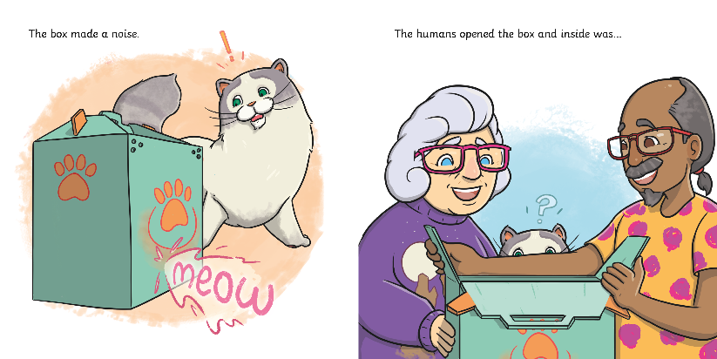
?
What do you think is inside the box?

Slide 9
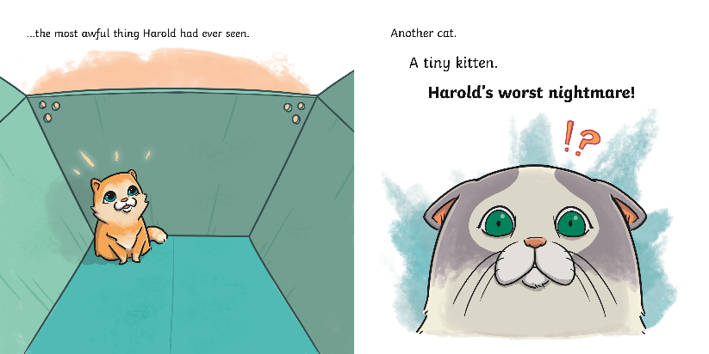
?
Which words in the text tell you that Harold is not pleased to see a kitten in the box?

Slide 10
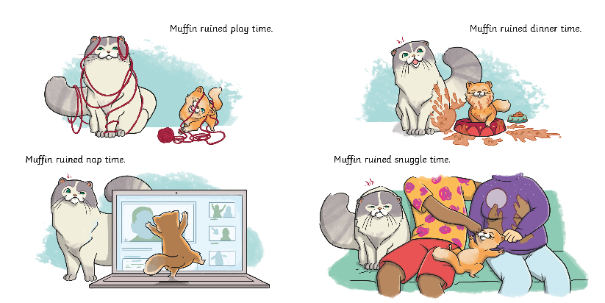
?
Harold is doing the same activities as he did before.
What is different about the activities now?

Slide 11
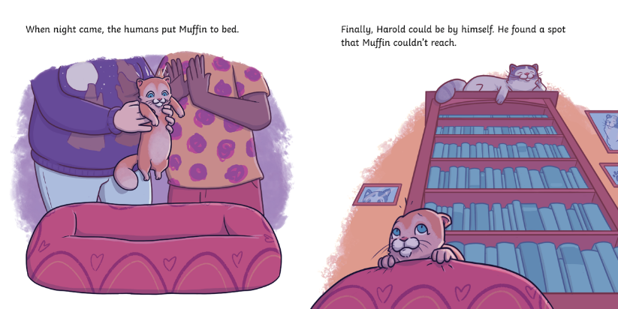
?
How do you think Muffin is feeling?

Slide 12
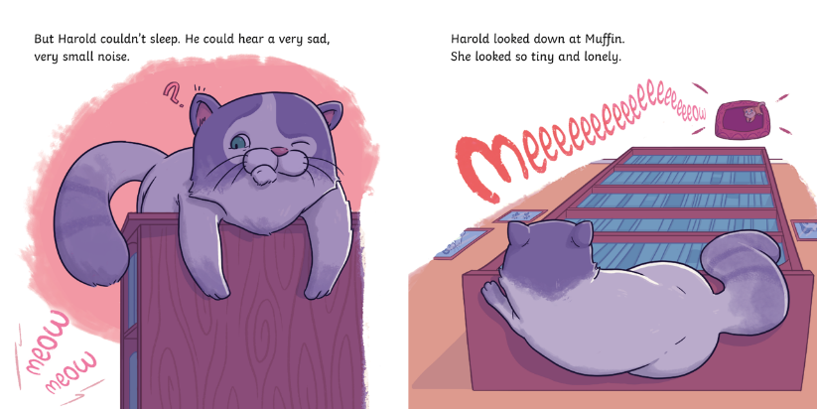
?
Why can’t Harold sleep?

Slide 13
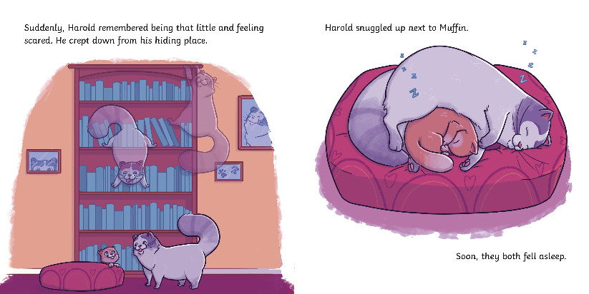
?
Why does Harold come down from his spot at the top of the bookcase?

Slide 14
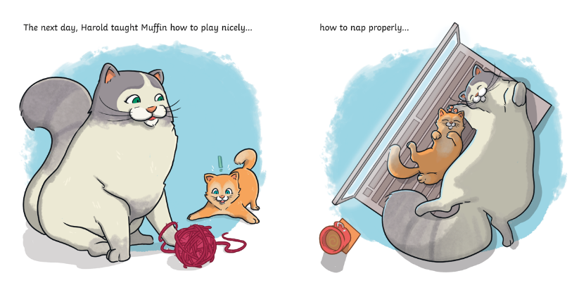
?
Muffin and Harold are doing the same activities as they did together before. What has changed?

Slide 15
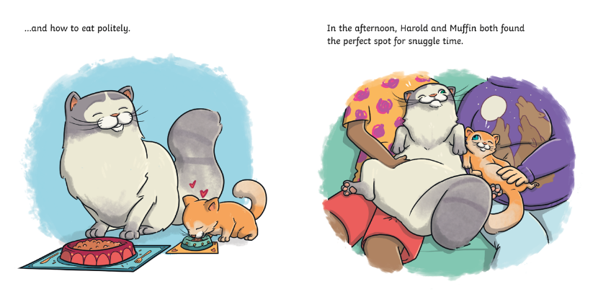
?
What does ‘politely’ mean?

Slide 16
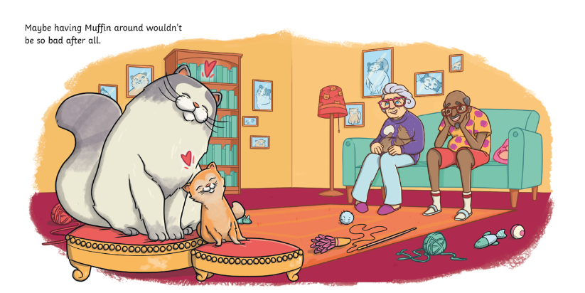
?
How do you think Harold and Muffin are feeling now? Do they both feel the same way?

Slide 17
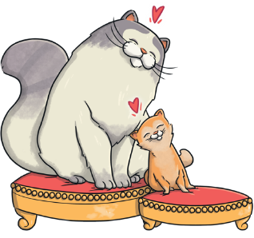
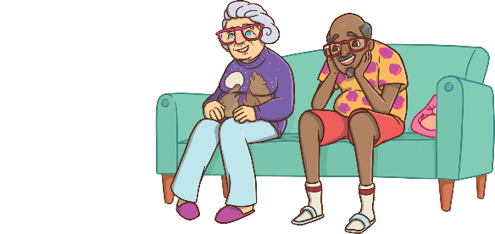
?
Who are the main characters in this story?
Harold and Muffin
Pam and Vik

Slide 18

?
What is ‘Harold’s worst nightmare’?

Slide 19
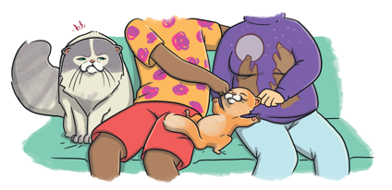
?
How does Harold’s life change when Muffin arrives?
?
Have you ever felt sad, left out or jealous?

Slide 20
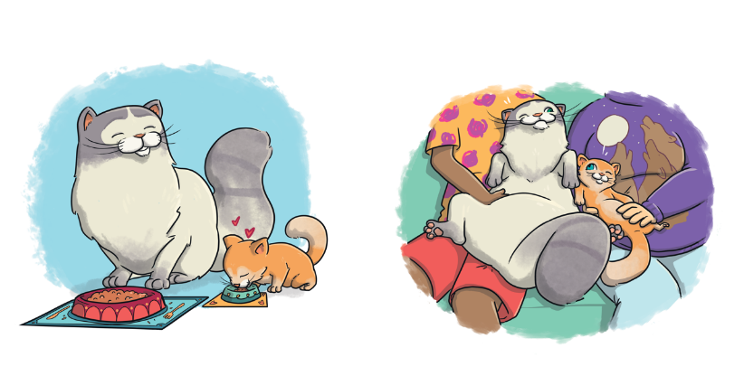
?
Soon, Harold and Muffin get on better. What do they both do differently?

Slide 21

?
What do you think Harold and Muffin will do next?

Slide 22

?
Did you enjoy this book?
?
What was your favourite part?

