Slide 2
Why is smoking bad for you?
Smoking is not a very healthy habit because of the chemicals like nicotine and tar it contains. Nicotine is very addictive which means that once you start it is very hard to stop. Nicotine and tar can be very bad for your heart, mouth, throat, lungs and stomach!

Slide 3
If a person smokes the nicotine from smoking causes their teeth to turn yellow.

Slide 4


People who smoke can make look old faster and have more wrinkels.

Slide 5
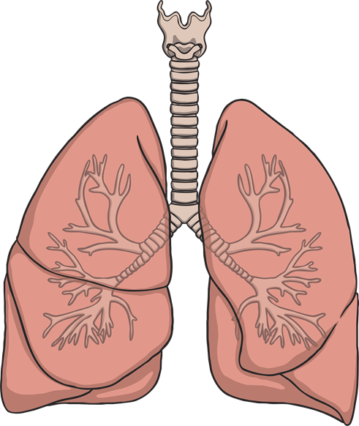
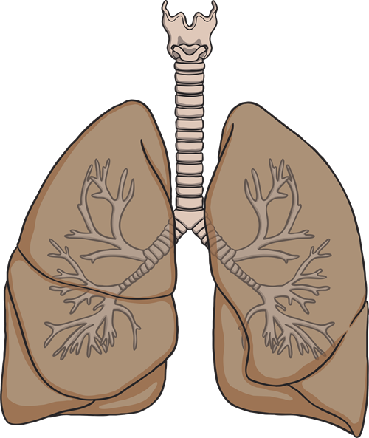
Smoking fills your lungs with tar making it hard to breathe.
healthy lungs
the damaged lungs of a smoker

Slide 6
Smoking leads to cancer. Cancer kills millions of people every year.

Slide 7
Smoking is illegal for children.
It is illegal for people under 18 to smoke. You should not be around people who smoke as it can affect your health. Other types of smoking, like pipes, Hubbly Bubblies and Vapes, are also very bad for your health and can damage your mouth, throat and lungs.

Slide 8


Some Questions
How do you feel
about smoking?
What would you do if your friend offered you a cigarette or Vape?

