Slide 1
Monday

Slide 2
Morning Task
What is…
1 more than
14 16 18 24 28
1 less than
17 12 26 22 19 23

Slide 3
Counting
Can you count to 90 in 5s and back again?

Slide 4

Monday’s Mental Maths Skill
Use the number line to solve the following..
7 - 6
9 - 4
8 - 2
16 - 5
19 - 7
Have a go at making up a number sentence for a friend to solve.

Slide 5
Tuesday

Slide 6
Morning Task
What is…
9 + 6 18 – 4 15 + 4
7 + 8 16 – 2 19 - 3

Slide 7
Counting
Can you count to 20 in 2s and back again?

Slide 8
Use your number line to work out
8-6 15-8 19-4 17-9
Tell me a fact family for
9 – 3 = 6
What is double…
6
4
10
Find the missing numbers
20, 19, 18, _, _, 15, _, _, 12, 11, _

Slide 9
Wednesday

Slide 10
Morning Task
Name the shapes and describe them to your friend.

Slide 11
Counting
Can you count backwards from 20?
Can you start on different numbers?

Slide 12
Show me the number..
two
eight
zero
Use a number line
What is..
5 - 2 =
7 - 2 =
10 - 2 =
What is 2 more than …
three
five
nine
What is 2 less than
two
five
eight

Slide 13
Thursday

Slide 14
Morning Task
Use < = > to compare the numbers.
17 24 19 8 14 22
6+4 10 9+2 15 18+2 20

Slide 15
Counting
Can you count forwards to 20 in 2s starting on 3?

Slide 16
Use your number line to work out
17 – 5
14 – 8
20 – 11
16 - 9
What is…
7 – 1 =
5 – 1 =
10 – 1 =
Can you make 10?
6 + ___ = 10
2 + ___ = 10
Half of 4 is
Half of 6 is
Half of 2 is
Half of 12 is

Slide 17
Friday

Slide 18
Counting
Can you count backwards from 20 in 2s?

Slide 19
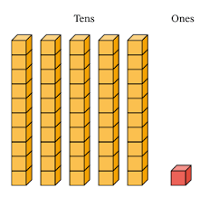
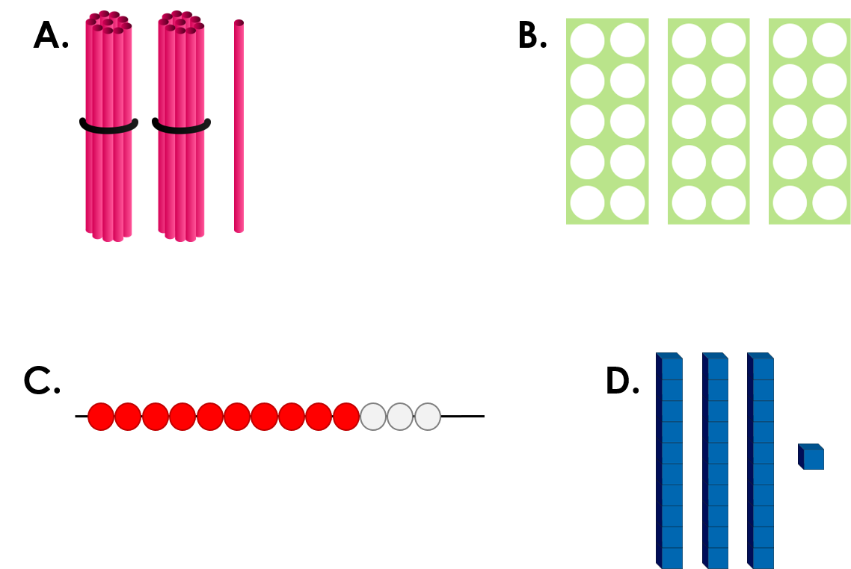
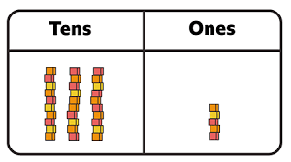
Assessment task – What numbers are shown below?

