Slide 1
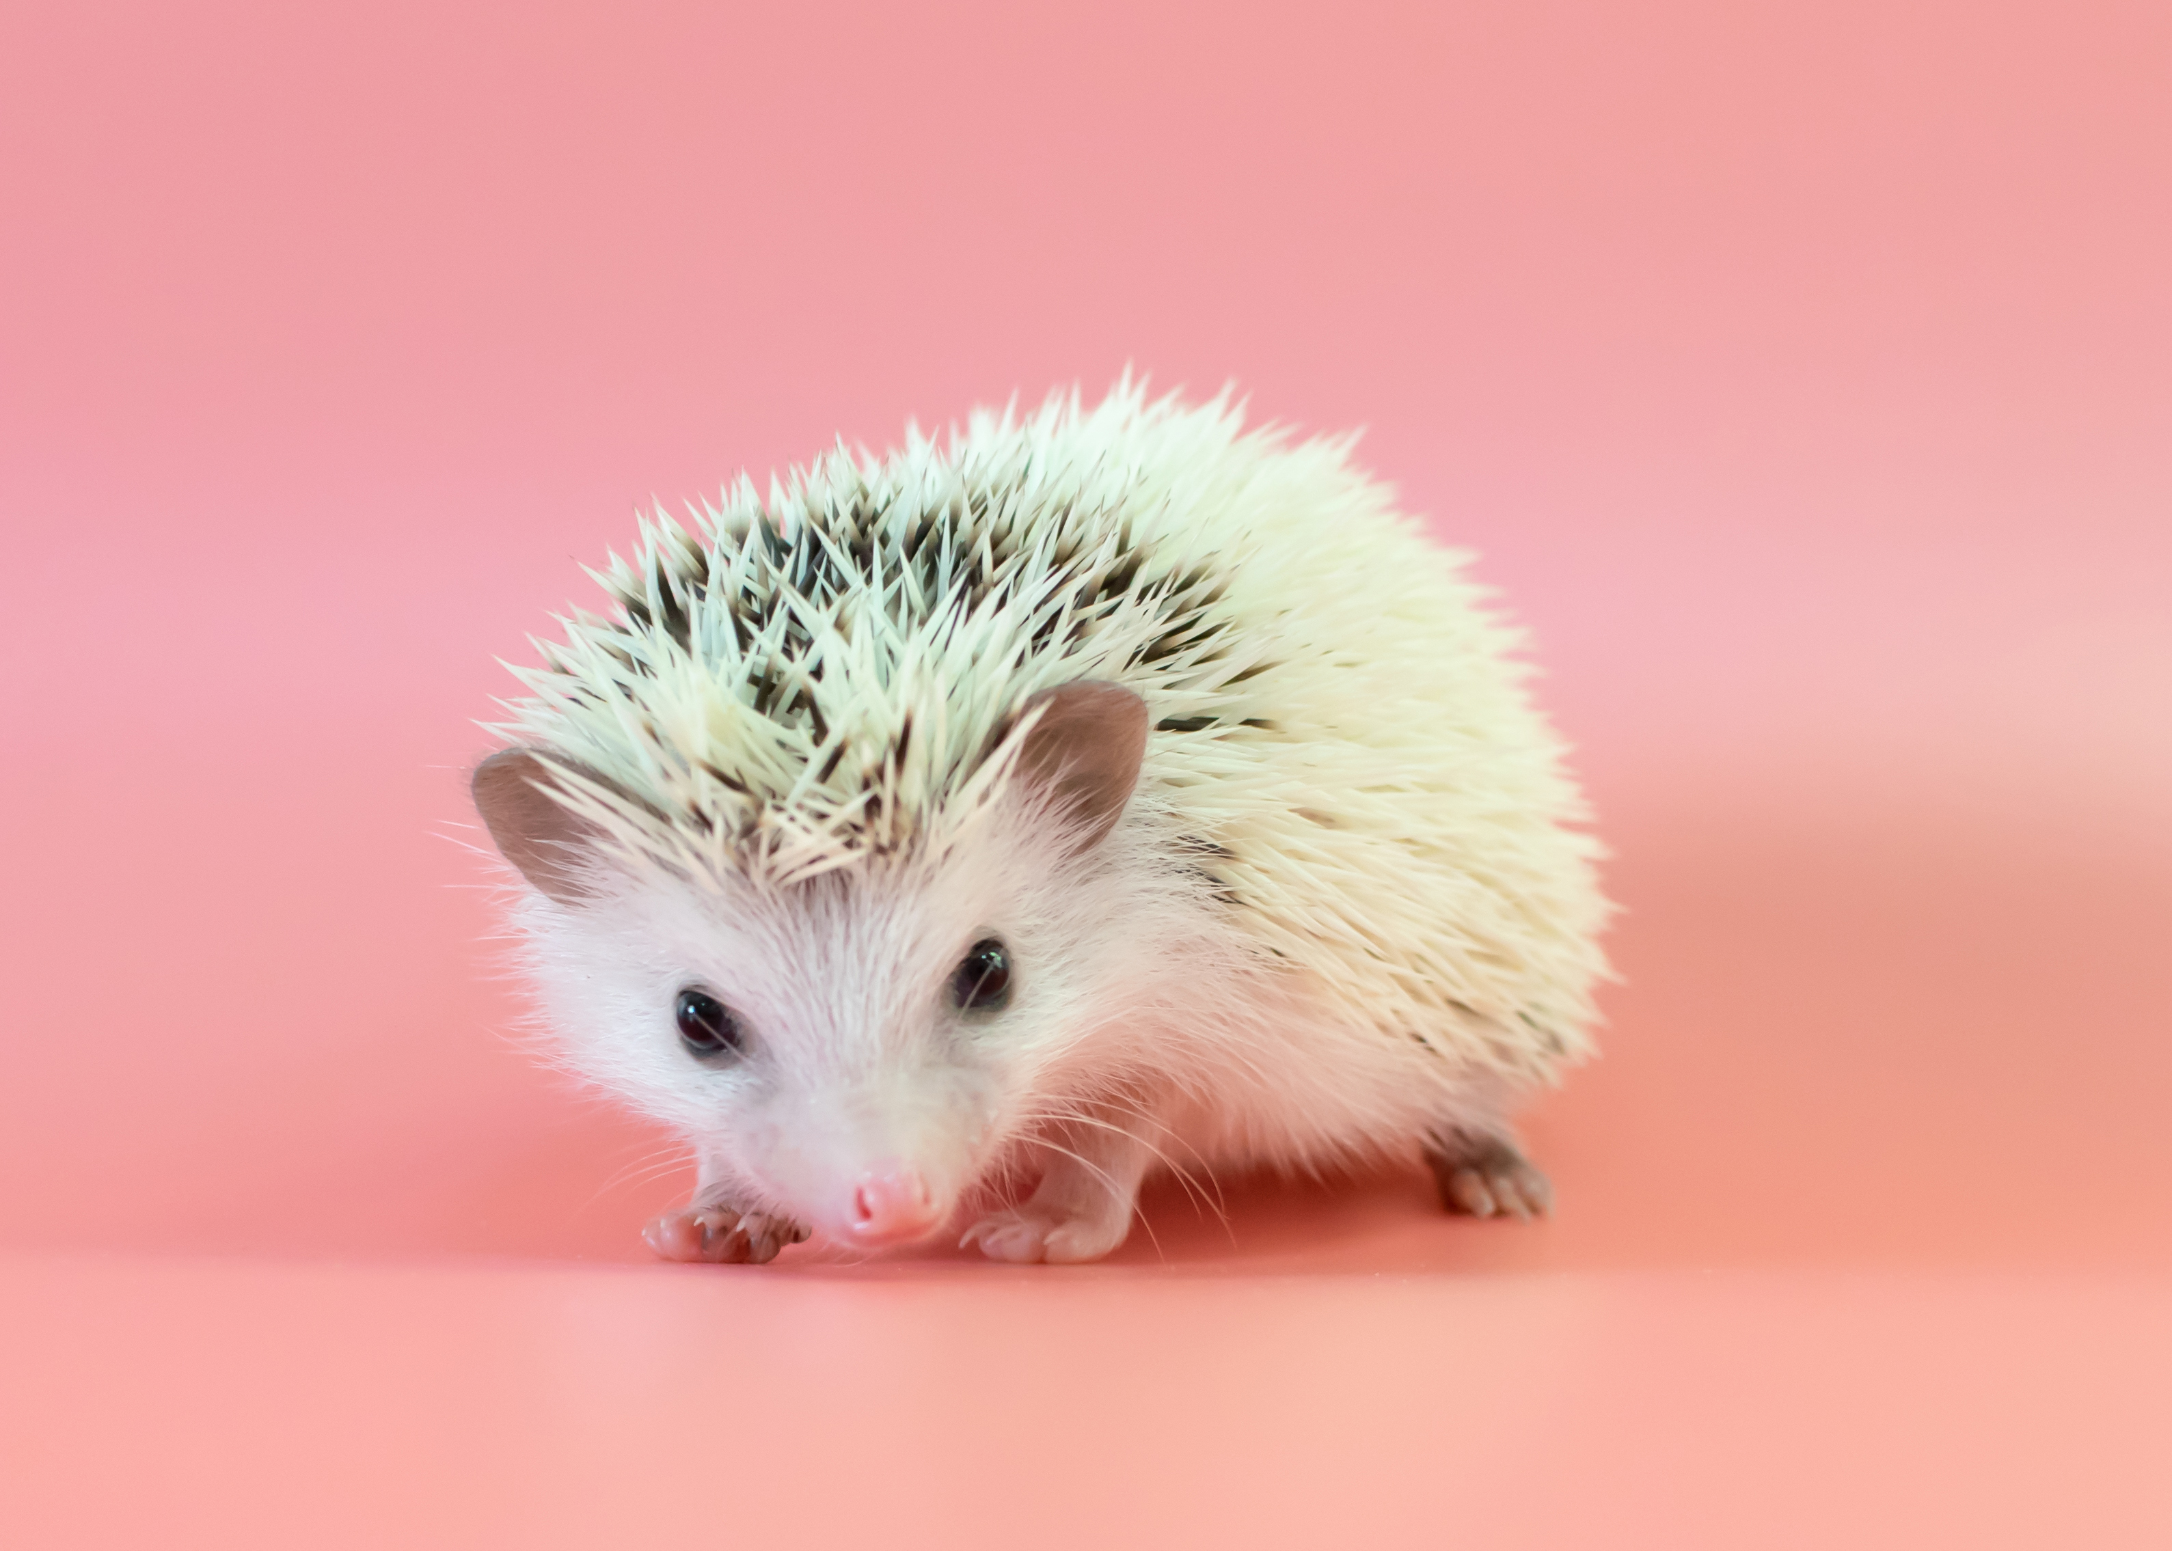
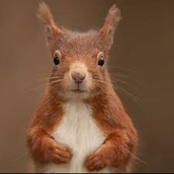
Welcome to Year 1/2

Slide 2
Hedgehogs!
I am Mrs Pobjoy and Mrs Perry will be with us on Fridays.
Squirrels!
I am Mrs Couchman and we’re very pleased to meet you all.

Slide 3
Our day!

Slide 4
Morning
We line upon the playground and then come inside and put our things in our locker.
There will be a task on your table for you to do.
Then we go to Collective Worship in the hall.
After Worship we will go to our phonics or English group.
Then it will be play time.

Slide 5
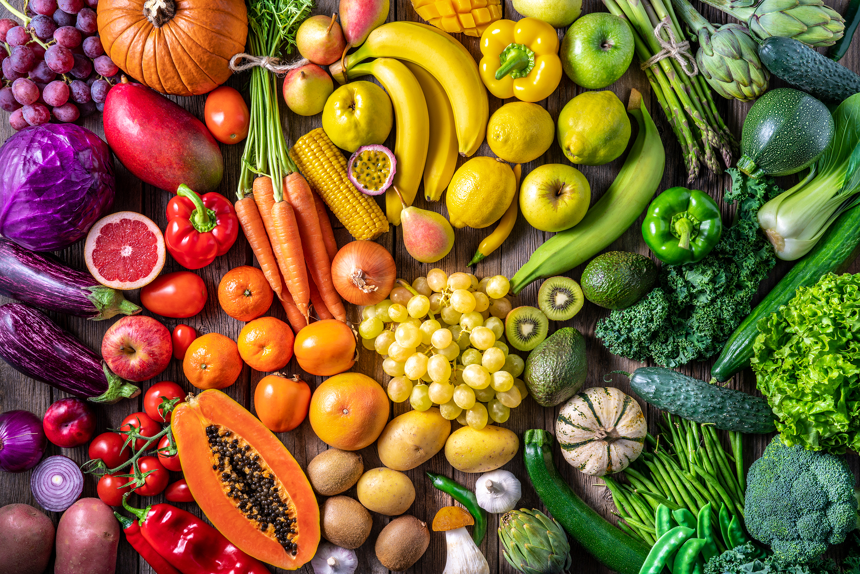

Play time
Snack is provided but you can bring your own.
Fruit, vegetables sticks or breadsticks are a suitable healthy snack.
Water bottles should be filled with water only.
We’re trying our hardest to look after your teeth!

Slide 6
After play
We line upon the playground and then come inside and put our things back in our locker.
We will then have our Maths lesson.
After that we will do our English lesson.
Then it is time for lunch.

Slide 7
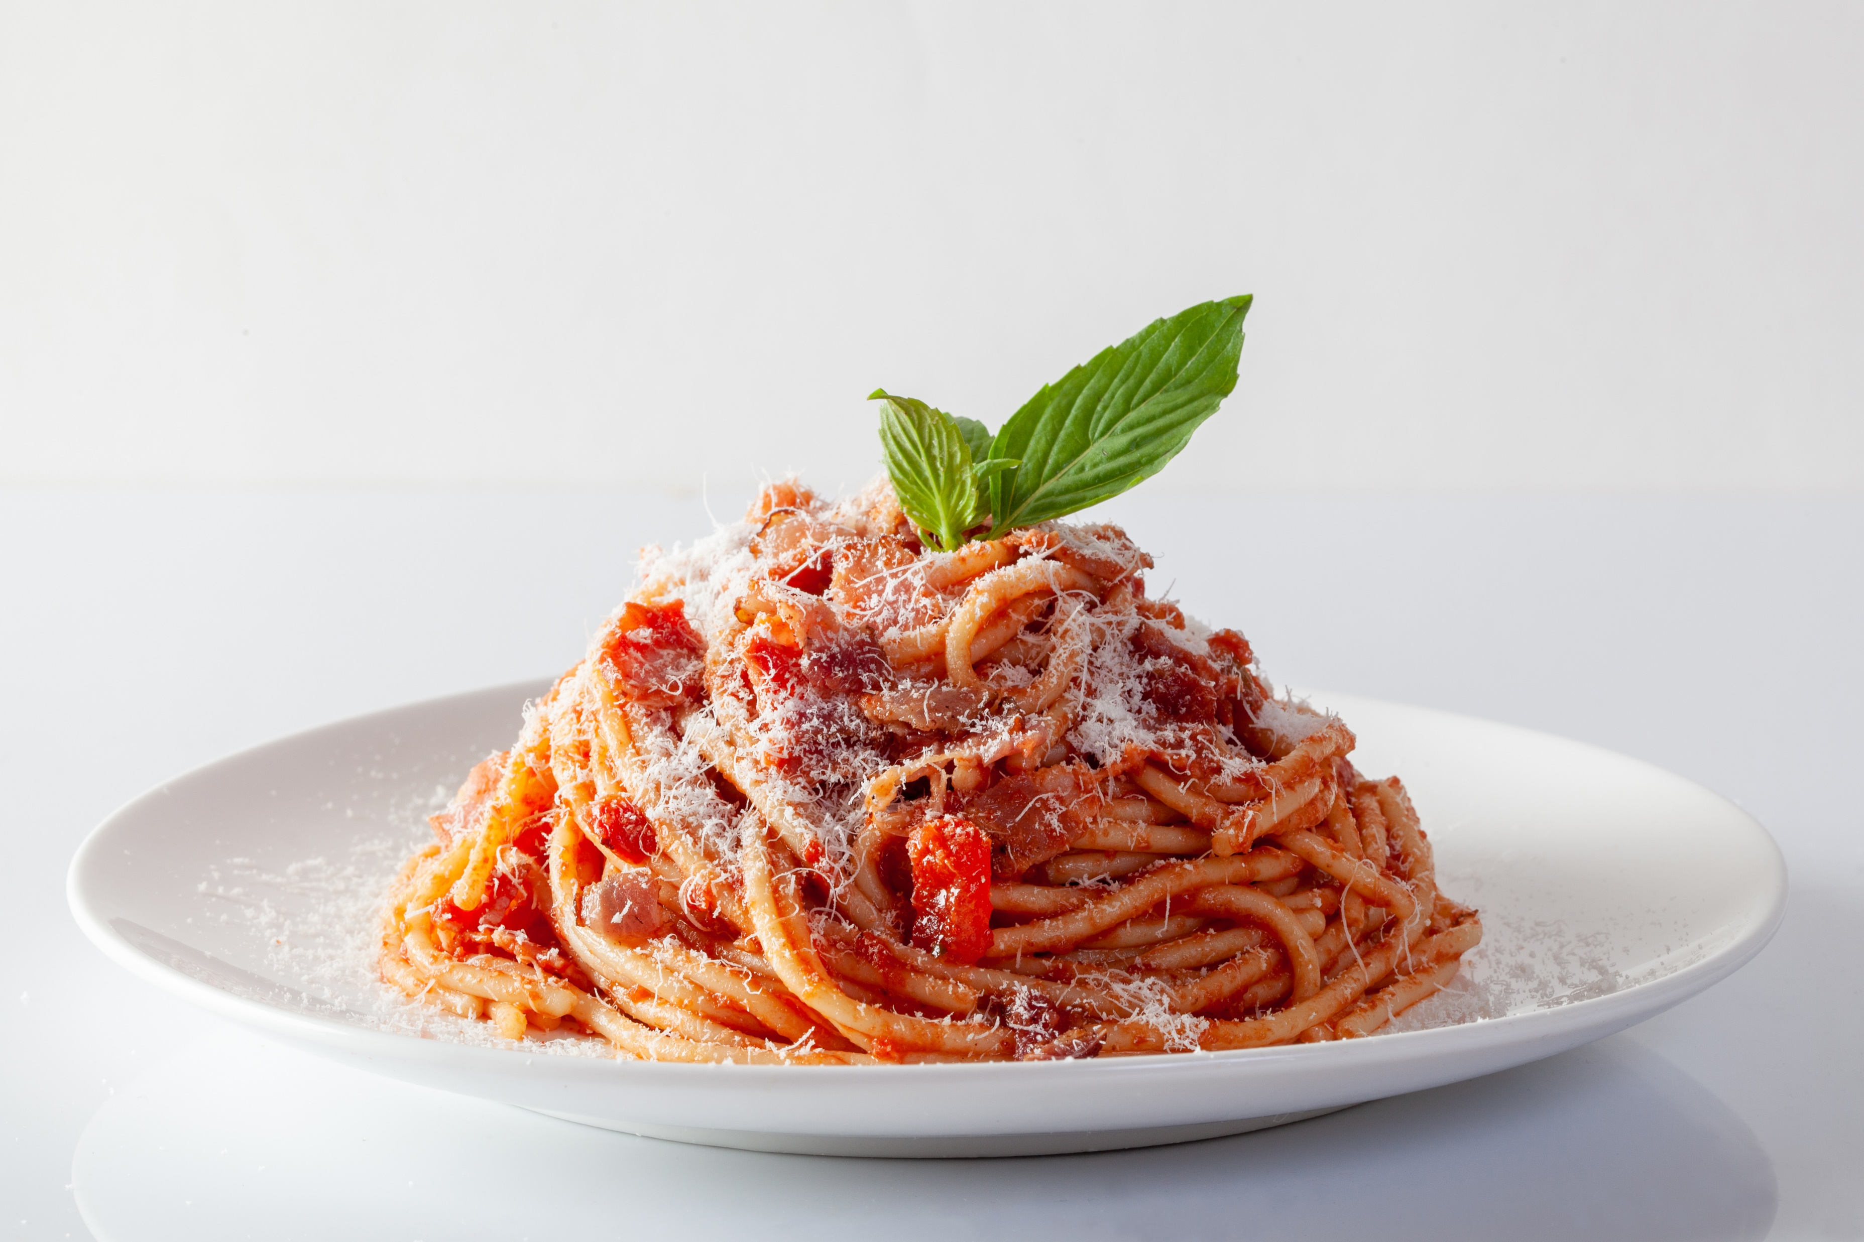
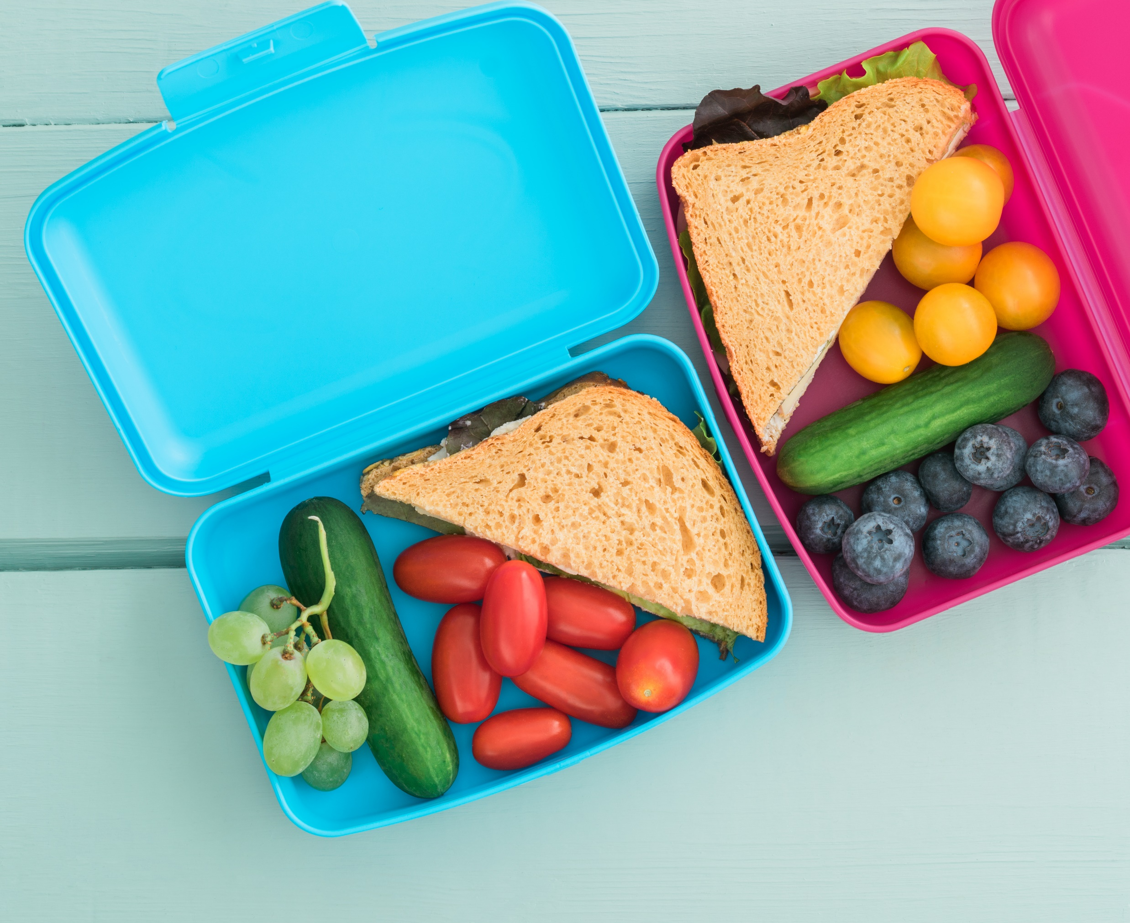
Lunch time
We will line up together and head up to the hall for our hot dinner or packed lunch.
Once we have finished eating we will head outside to play.
At the end of lunch we will meet you out on the playground.

Slide 8
Afternoons
Our afternoons start with some more mental maths or handwriting and spelling.
We then move on to subjects like Art, Music, Science, Geography, History, PE, computing etc.
One afternoon a week we will have either Forest School or a PE lesson whilst Mrs Pobjoy and Mrs Couchman get some jobs done. This term that is Wednesday.

Slide 9
Afternoons
Our afternoons start with some more mental maths, handwriting and grammar.
We then move on to subjects like Art, Music, Science, Geography, History, PE, computing etc.
One afternoon a week we will have either Forest School or a PE lesson whilst Mrs Pobjoy and Mrs Couchman get some jobs done. (We will let you know when we know!)

Slide 10
Homework
Homework will be available on the website at the start of each term.
Reading is the key to all learning! Please hear your child read every day, even if it’s just for 5 minutes!
We will send out login details for Numbots for Year 1 children and Times table rock stars for Year 2 once we have taught them multiplication. This is a safe way to practise maths online.

Slide 11
Website
Our school website is a wealth of information and our class pages will be regularly updated to keep you in the loop with what we are up to in school.

Slide 12
Team points
We now have team points instead of Dojo’s. All children will be put into groups, they are either in Red, Yellow, Green or Blue House. When they earn a team point, they will put a coin in their team jar.
The highest scoring team will earn a reward at the end of each half term.

Slide 13
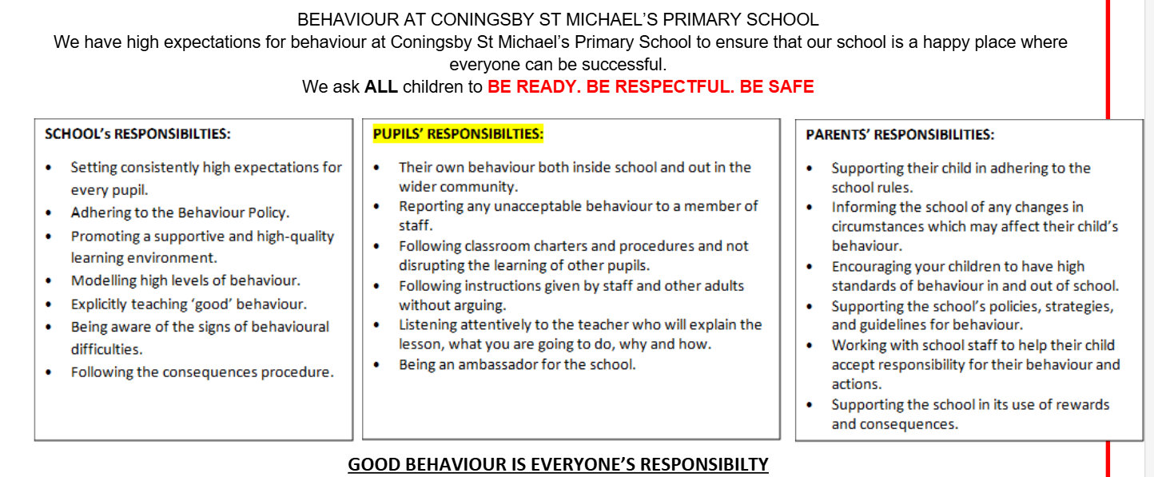

Slide 14
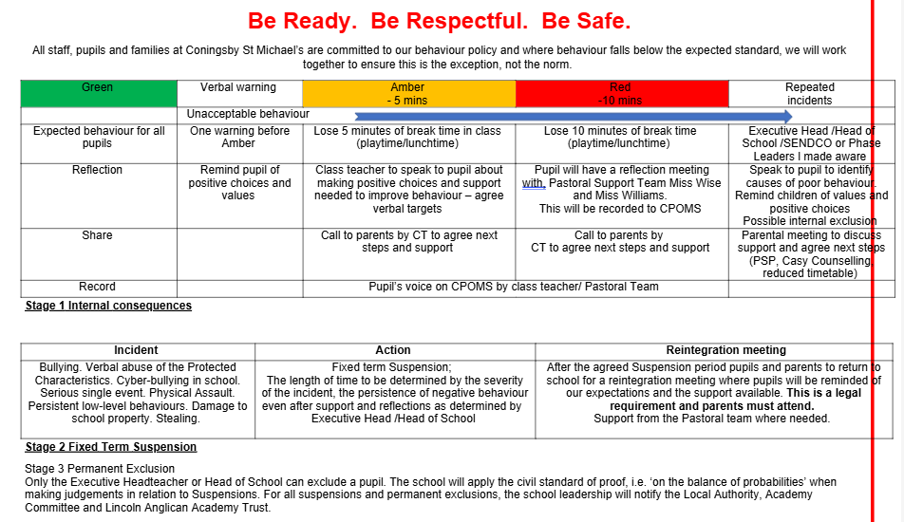

Slide 15
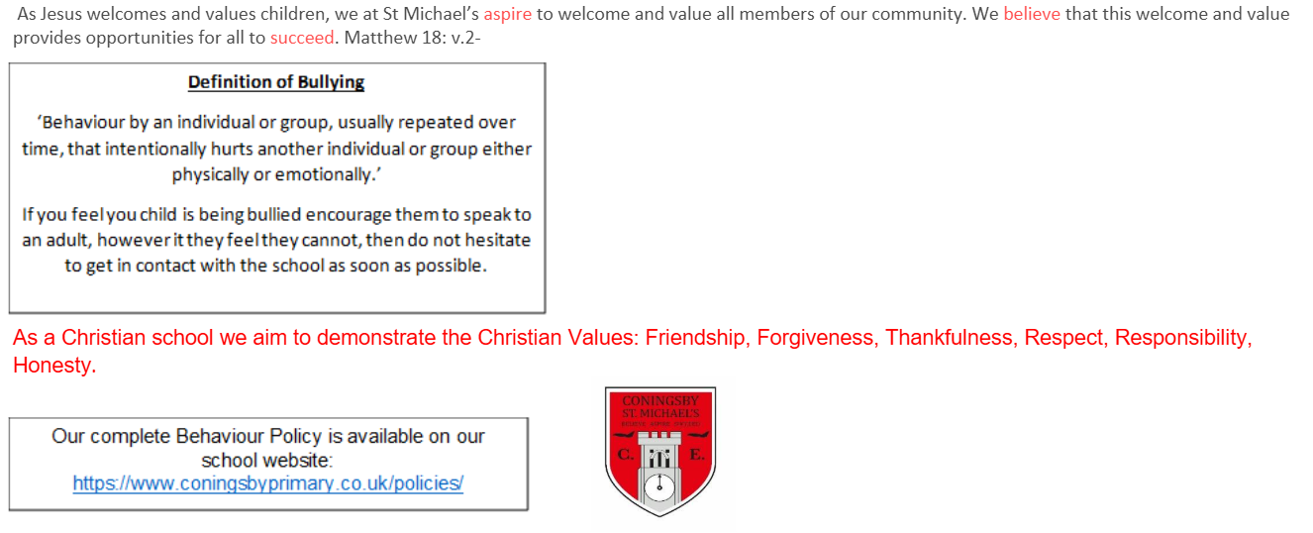

Slide 16
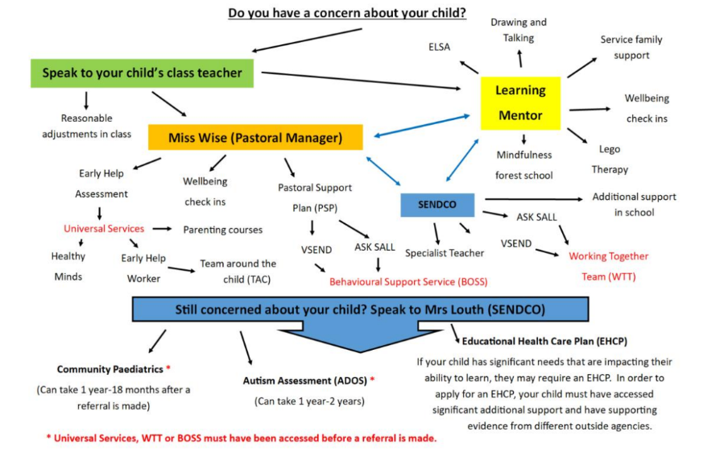

Slide 17
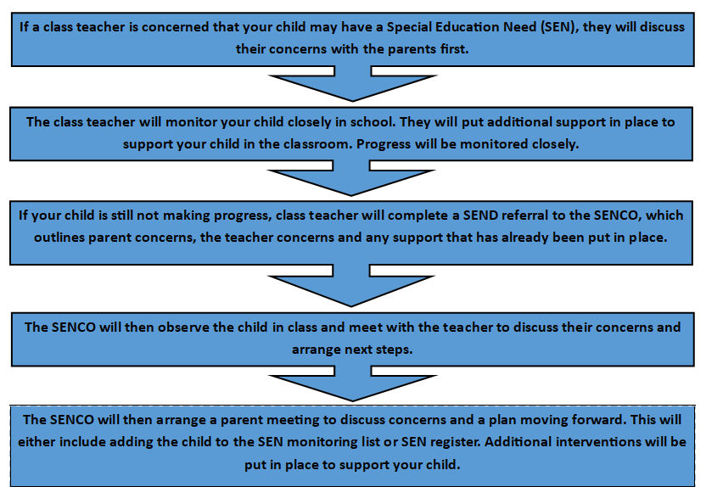

Slide 18
Any Questions?

