Slide 1
What is Humanism?
Age 7-11

Slide 2
Humanists…
Believe science provides the best way to understand the world
Don’t believe there is a god, or believe we can’t know if there is a god
Don’t believe in an afterlife, and therefore we should make the most of the one life we know we have, and respect different peoples choices and ways of life
Believe we should use reason and empathy when deciding how to behave
Value humanity and celebrate human achievements

Slide 3
‘A wise man proportions his belief to the evidence.’
David Hume, philosopher (1711–1776)

Slide 4

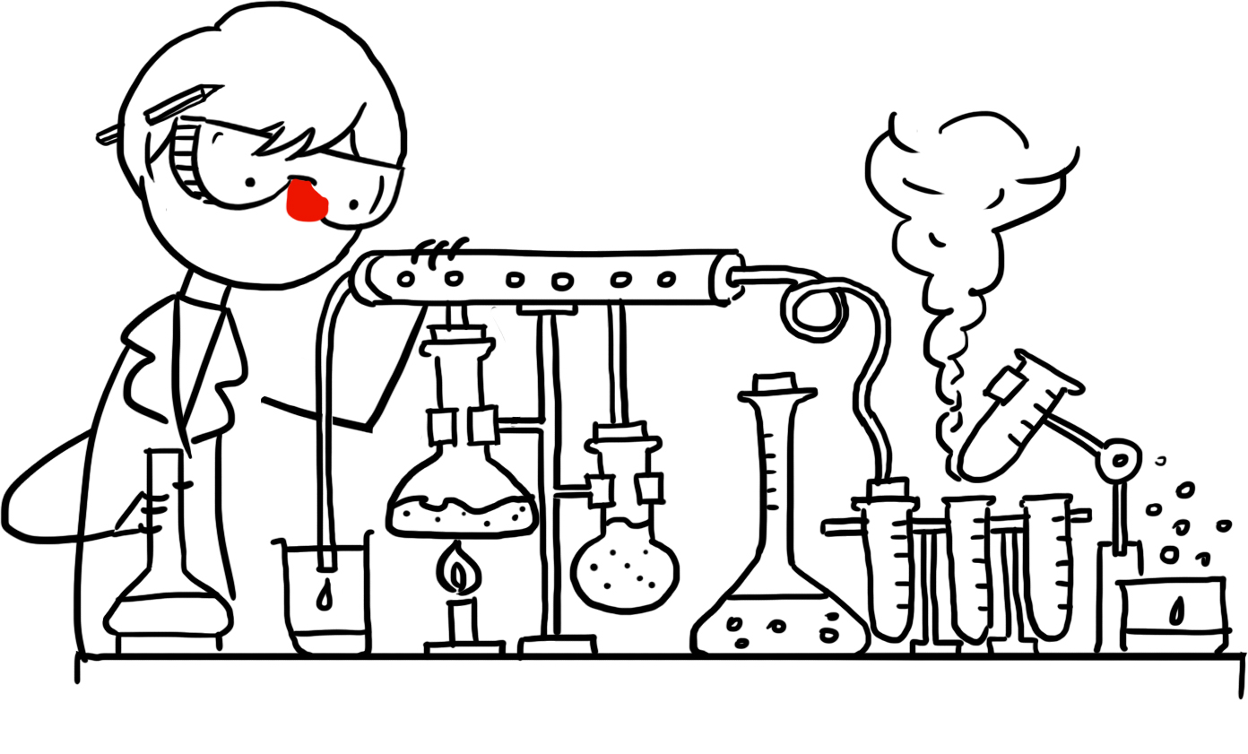
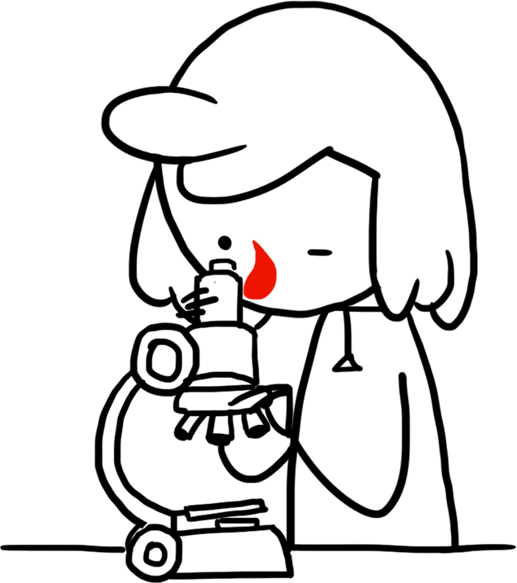
Understanding the world
Humanists believe the material world is the only one we can know exists and will always try to look for natural explanations rather than supernatural ones.
How can we know what is true?
Reason
Evidence
Science

Slide 5
“We are all atheists about most of the gods that humanity has ever believed in. Some of us just go one god further.”
Richard Dawkins,
scientist and humanist

Slide 6
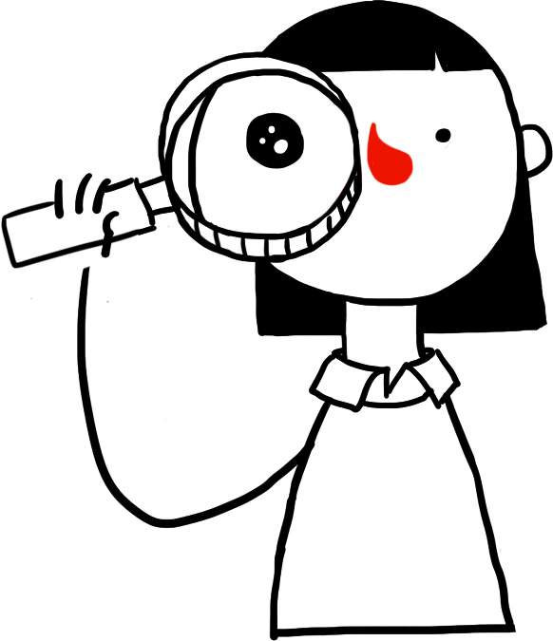
Humanists don’t believe in a god or gods
Humanists don’t see any good evidence that a god or gods exist.
Atheists: don’t believe in a god or gods.
Agnostics: believe we can’t know if a god or gods exist.
Humanism is more than just not believing in a god.
For humanists, the most important thing is not whether you believe in a god or not, but how you live your life.
Humanists believe we can be good and happy without the need for gods or religion.

Slide 7

What does this picture look like?

Slide 8

Different ways to be happy
We have only one life.
We should make the most of it.
We should respect different peoples different ways of life.

Slide 9
‘Happiness is the only good.
The place to be happy is here.
The time to be happy is now.
The way to be happy is to make others so.’
Robert Ingersoll (1833– 1899)

Slide 10
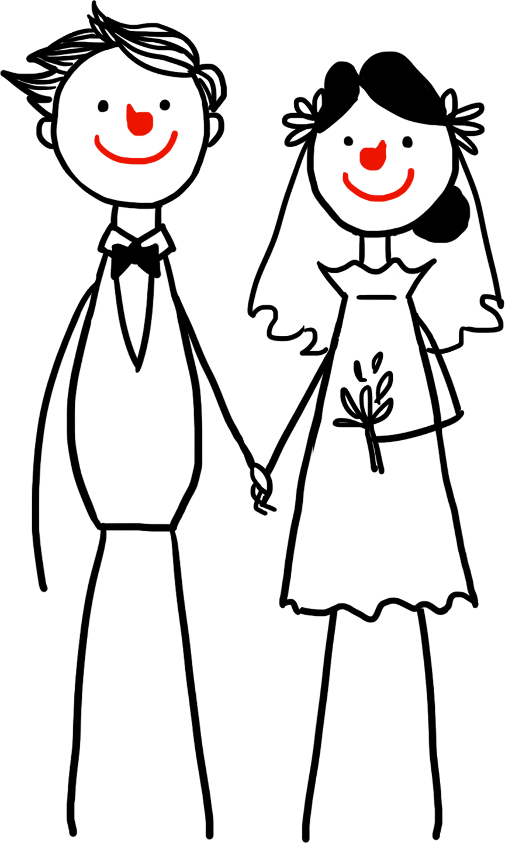

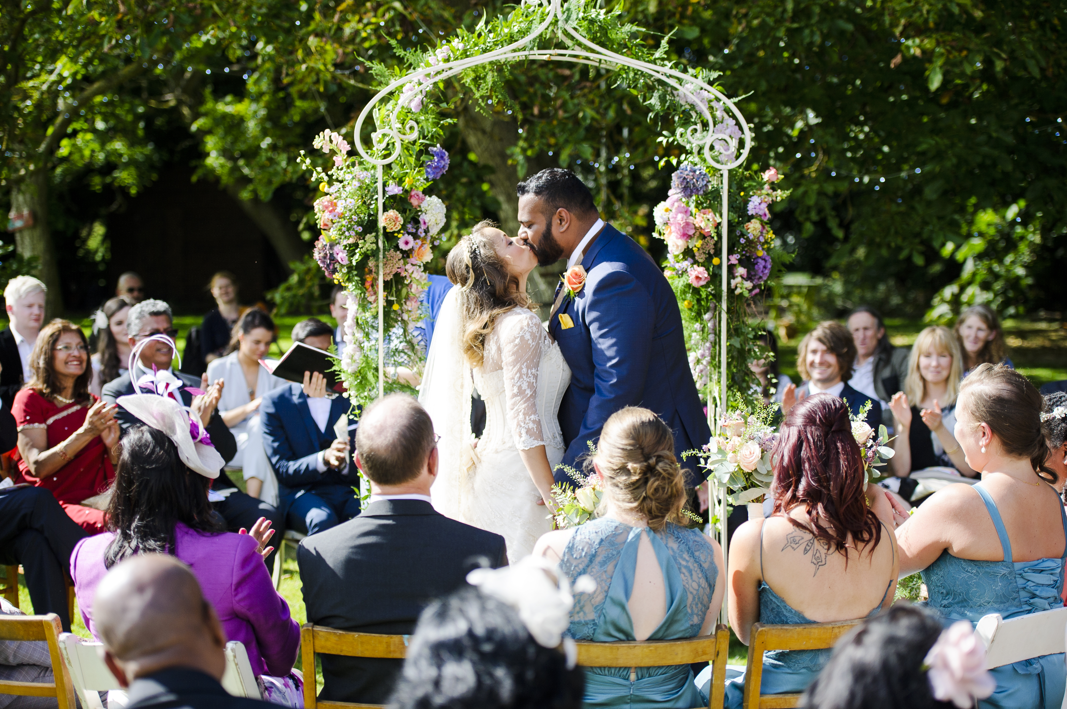
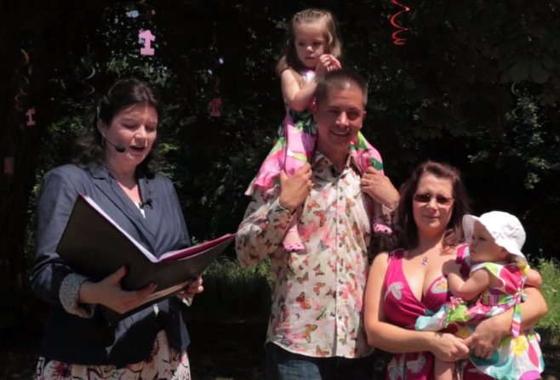
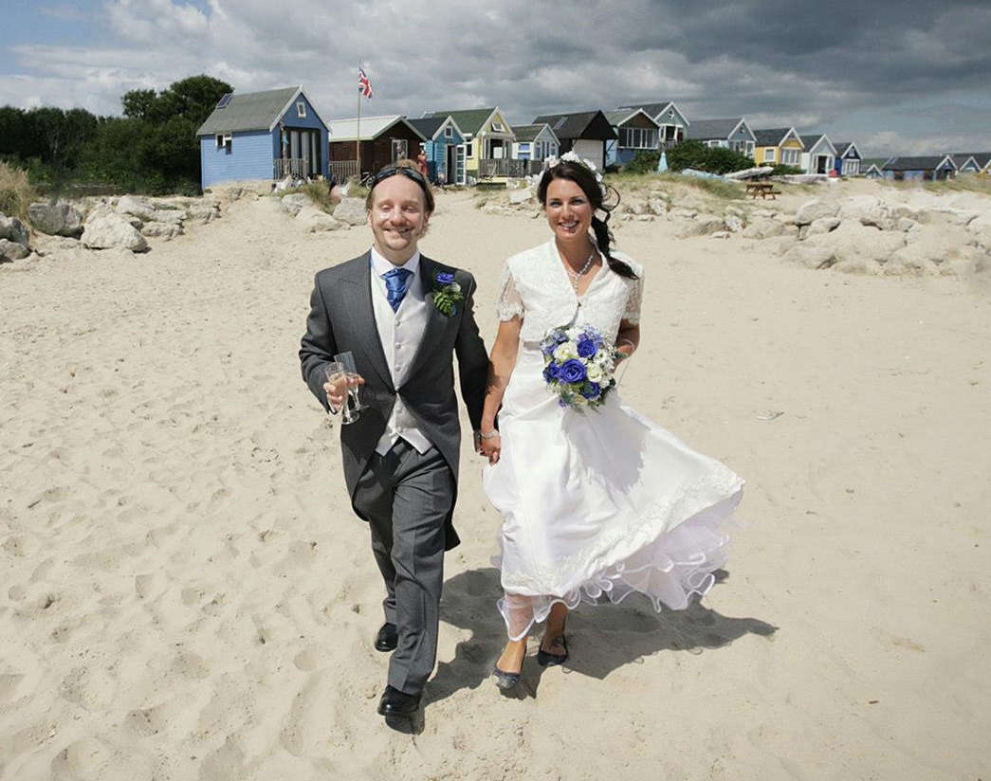
Ceremonies
Some humanists will celebrate:
Humanist naming ceremonies
Humanist weddings
The love and support of other people and our relationships with them are very important

Slide 11
‘Wear a smile and have friends; wear a scowl and have wrinkles. What do we live for if not to make the world less difficult for each other?’
Mary Ann Evans (George Eliot), novelist (1819 – 1880)

Slide 12
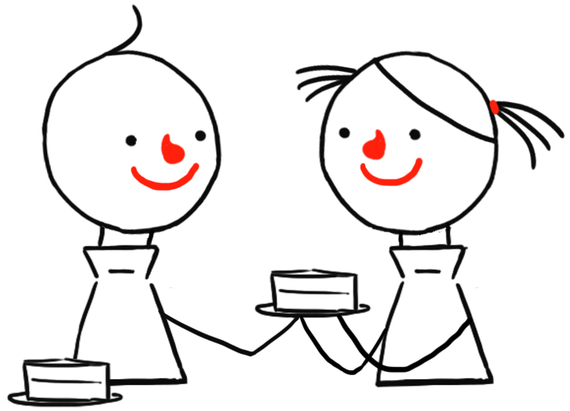


Being good
Why should we be good to other people?
Making other people happy
Making the world a better place
Making ourselves happy
How can I know what is the right thing to do?
Humanists have no holy books, religious leaders, or commandments. They use...
Reason: Considering the evidence and thinking about the consequences
Empathy: Thinking about how others will feel
The Golden Rule
Treat others as you would like to be treated yourself.
Do not treat others in a way you would not like to be treated yourself.

Slide 13
‘[Humanism] is a positive view of humanity even if, at times, it is idealist. You are what you make of yourselves. Aim high, aim for the stars, and you may yet clear the rooftops. You will need courage, tenacity, motivation and a good sense of humour on the route.’
Jeaneane Fowler

Slide 14
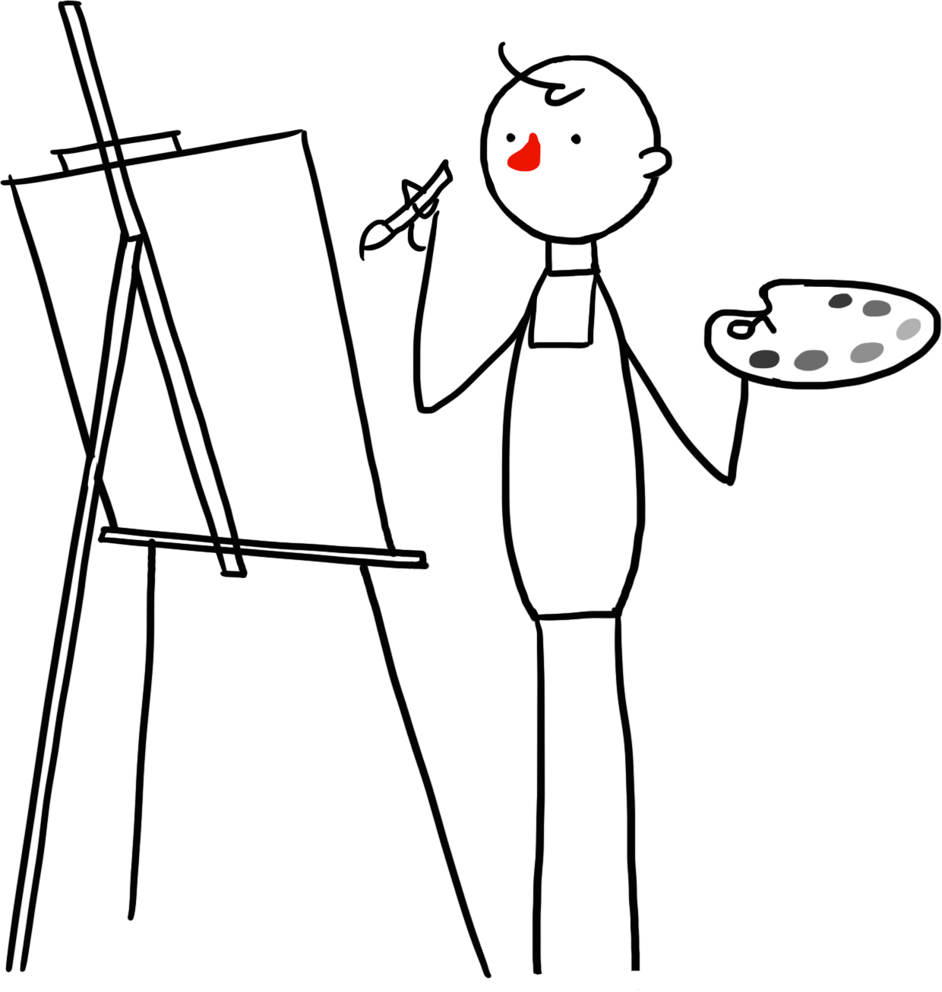
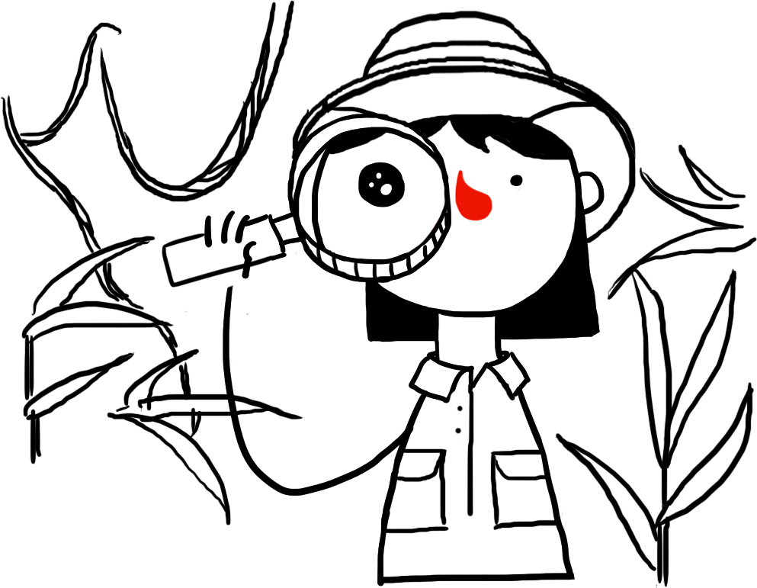
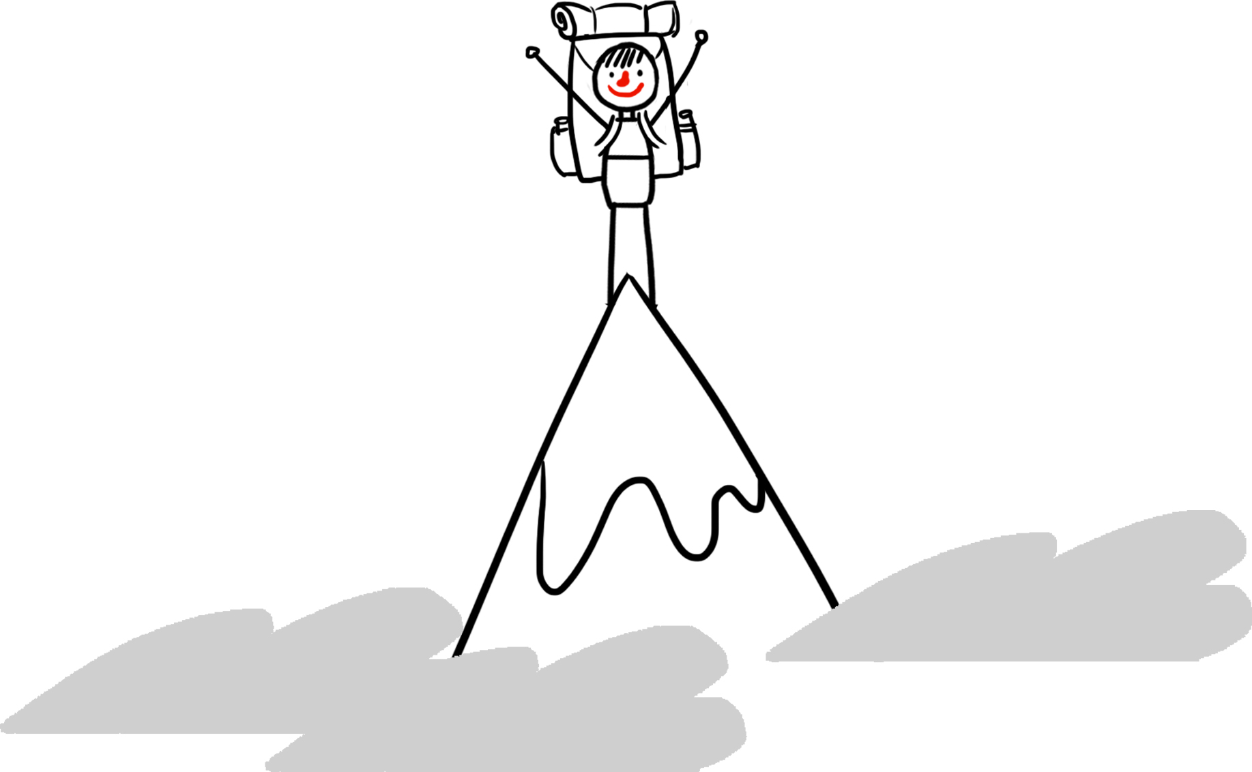
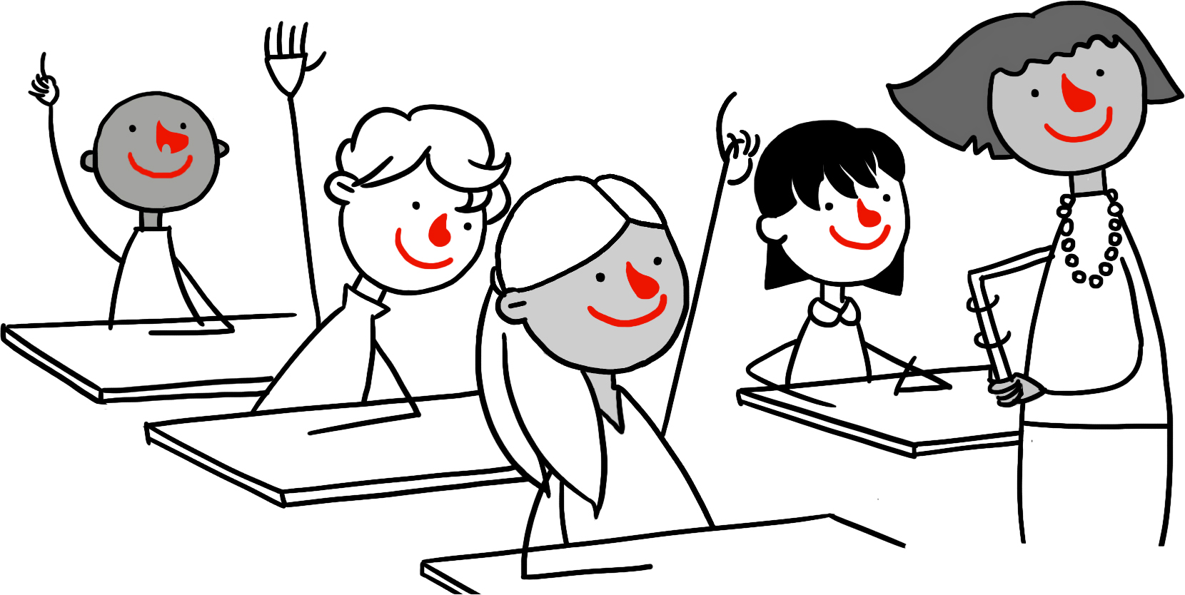
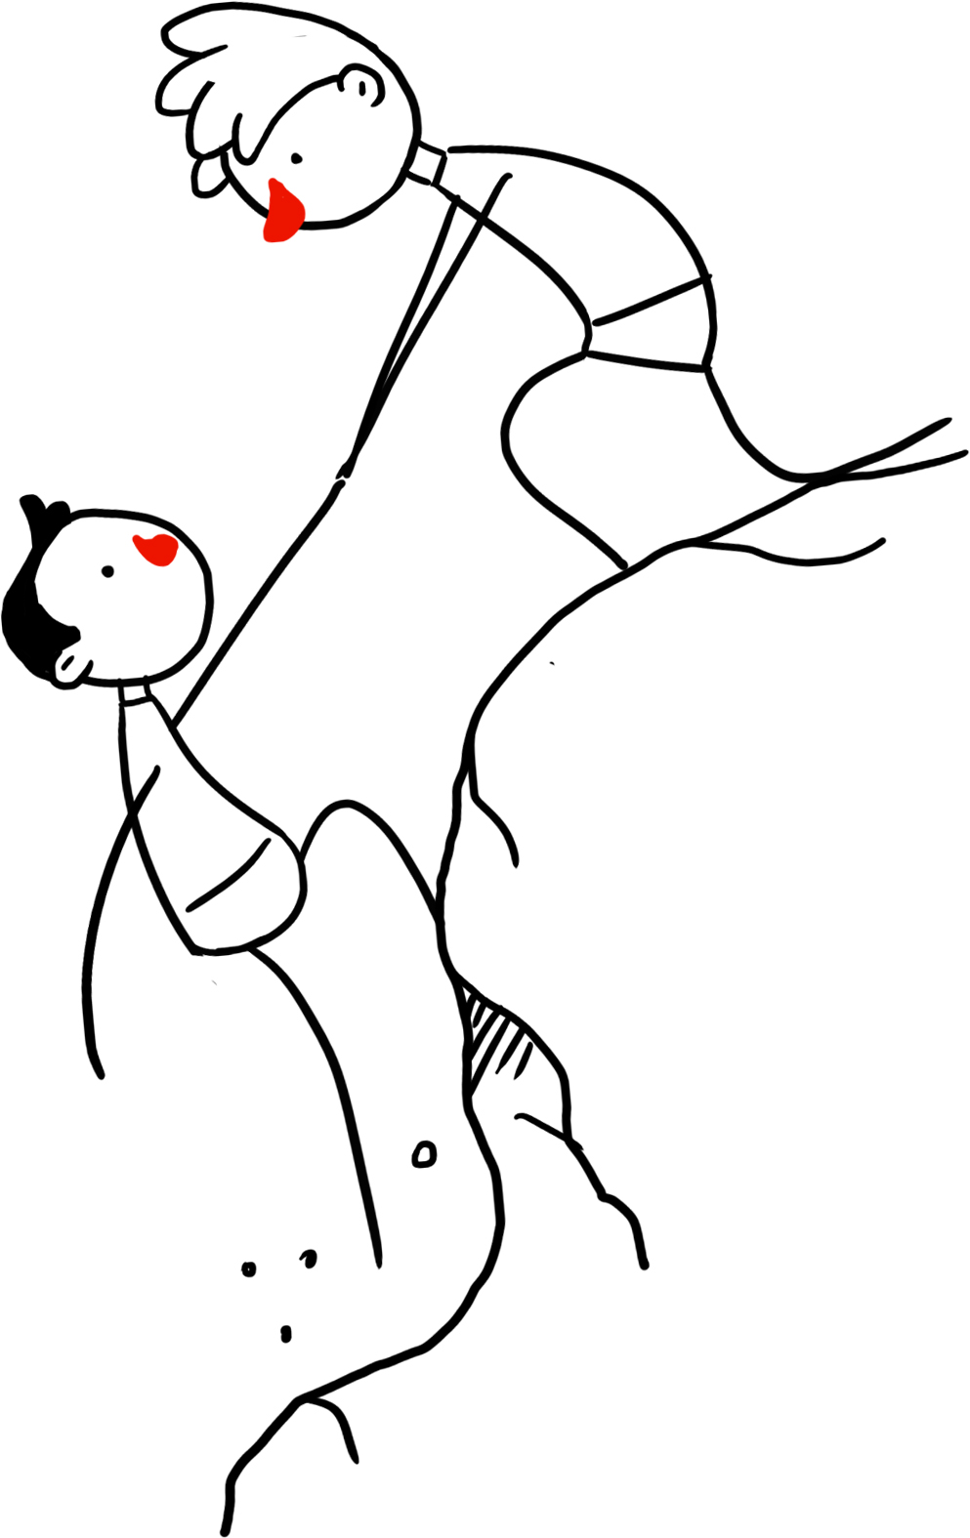
Valuing human achievements and capabilities
Human beings are capable of great things.
Humanists celebrate the many things human beings have achieved.
What can we celebrate about being human?
What great things have human beings achieved?

Slide 15
Question 1
A humanist is…
Somebody who just doesn’t believe in a god.
Somebody who believes in a god.
Somebody who doesn’t believe in a god, but also believes we can lead a good and happy life without one.

Slide 16
Question 1
A humanist is…
Somebody who just doesn’t believe in a god.
Somebody who believes in a god.
Somebody who doesn’t believe in a god, but also believes we can lead a good and happy life without one.

Slide 17
Question 2
Humanists believe...
Science is the best method for understanding the world.
Religion gives us the best answers to explain our world.

Slide 18
Question 2
Humanists believe...
Science is the best method for understanding the world.
Religion gives us the best answers to explain our world.

Slide 19
Question 3
Humanists believe...
After we die we will have an afterlife.
This is the only life we have and so we should make the most of it.
This life is just one of the many lives that we will live.

Slide 20
Question 3
Humanists believe...
After we die we will have an afterlife.
This is the only life we have and so we should make the most of it.
This life is just one of the many lives that we will live.

Slide 21
Question 4
Humanists believe...
We can do anything we like that makes us happy.
We are all free to find our own way to be happy as long as we don’t harm other people.
There is only one way to be happy.

Slide 22
Question 4
Humanists believe...
We can do anything we like that makes us happy.
We are all free to find our own way to be happy as long as we don’t harm other people.
There is only one way to be happy.

Slide 23
Question 5
At humanist naming ceremonies and weddings...
The parents / couples are free to write their own promises.
There are specific words that people must say.

Slide 24
Question 5
At humanist naming ceremonies and weddings...
The parents / couples are free to write their own promises.
There are specific words that people must say.

Slide 25
Question 6
Humanists think we should be good because…
We will be punished if we don’t.
We should treat other people the way we would like to be treated.

Slide 26
Question 6
Humanists think we should be good because…
We will be punished if we don’t.
We should treat other people the way we would like to be treated.

Slide 27
Question 7
Humanists believe we can work out how to behave by...
Following rules in books.
Using reason and empathy to think about the consequences and how other people will feel.

Slide 28
Question 7
Humanists believe we can work out how to behave by...
Following rules in books.
Using reason and empathy to think about the consequences and how other people will feel.

Slide 29
Question 8
Humanists believe…
The Golden Rule evolved naturally from living together in communities.
The Golden Rule was given to us by a god.

Slide 30
Question 8
Humanists believe…
The Golden Rule evolved naturally from living together in communities.
The Golden Rule was given to us by a god.

Slide 31
Possible ingredients of happiness
Food and drink
Friends
Family
Money
Gifts, games, and gadgets
A big house
Exploring the world
Music
Being kind to others
Learning new things
Completing something difficult
Good health
Your religion or beliefs

Slide 32



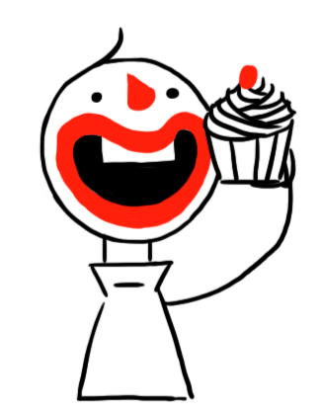

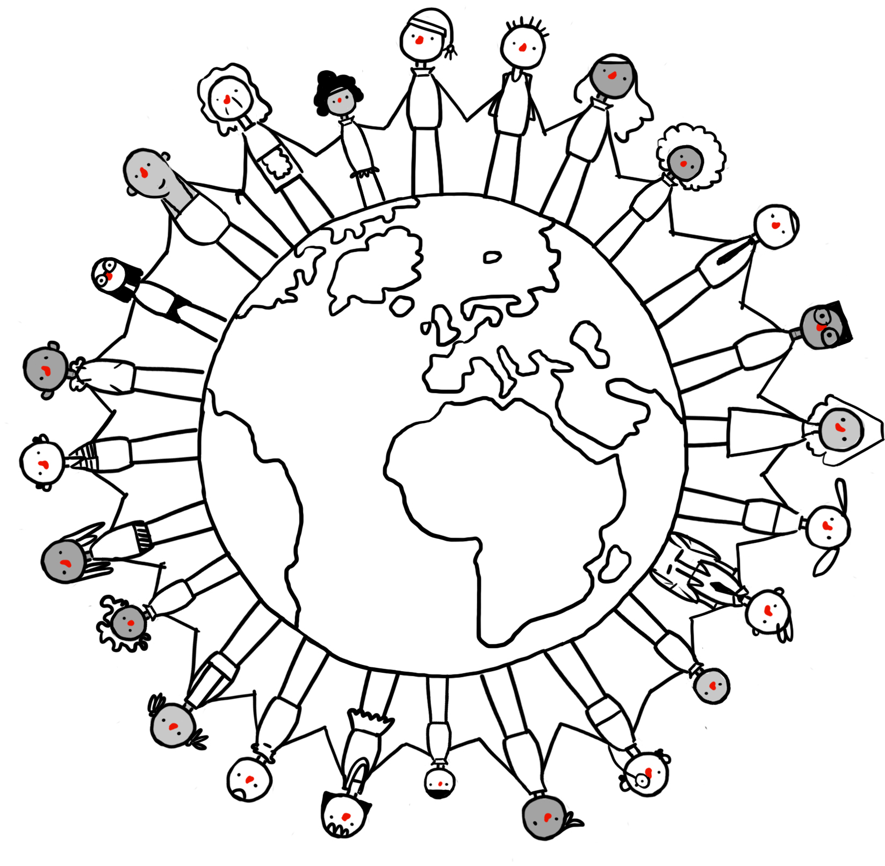

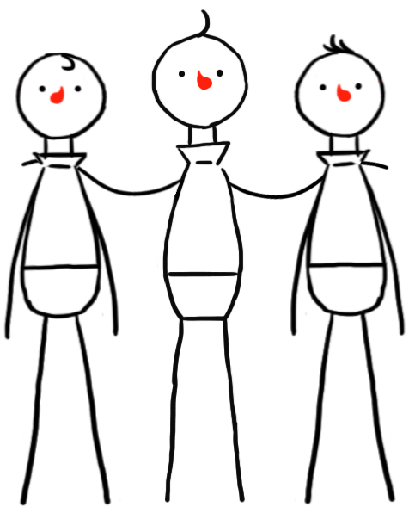

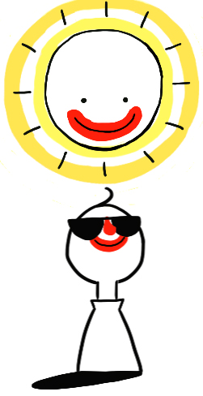
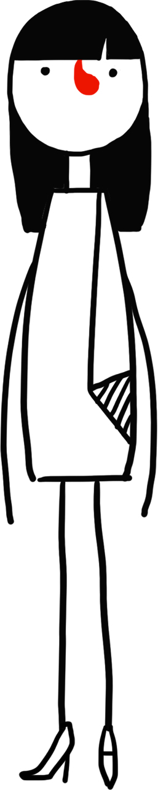



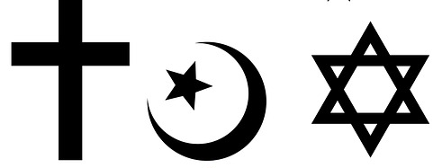
Possible ingredients of happiness
£

Slide 33
understandinghumanism.org.uk
Understanding Humanism
39 Moreland Street
London
EC1V 8BB
British Humanist Association (registered charity 285987) ©2016

