Slide 1
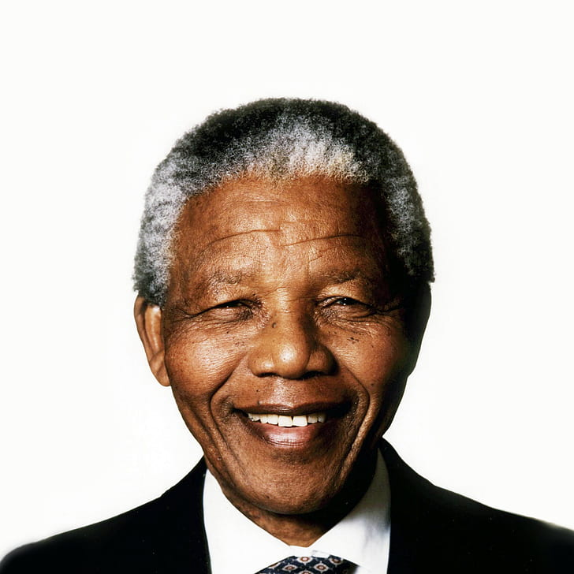
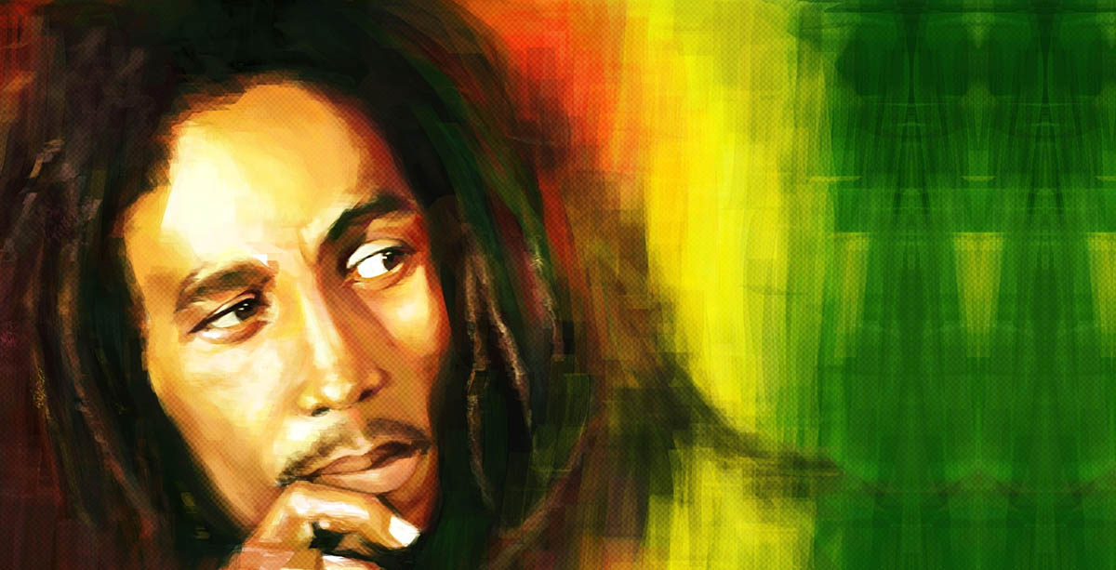
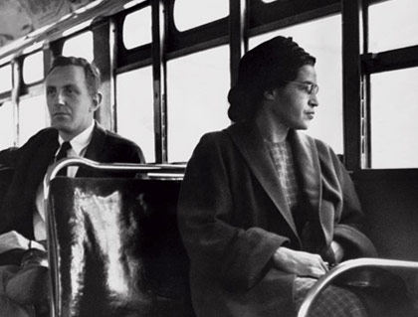
Black History Week
By Year 6

Slide 2
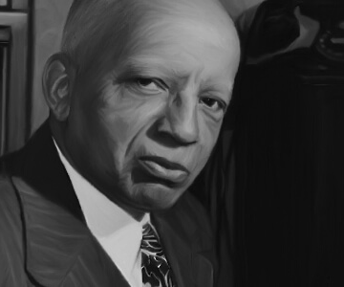
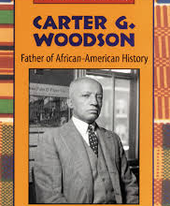
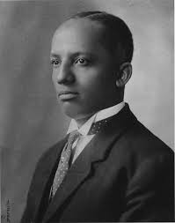
What is Black history week?
Black history week is a week dedicated to admire people of all colours, religions and backgrounds. The person who is responsible(in a good way) is someone called Carter .G. Woodson. Carter was a scholar who Celebrated The historic Contributions of Black people lead to the establishment of Black History month. He also invented the Negro History Bulletin.
This Photo by Unknown author is licensed under CC BY-NC-ND.

Slide 3
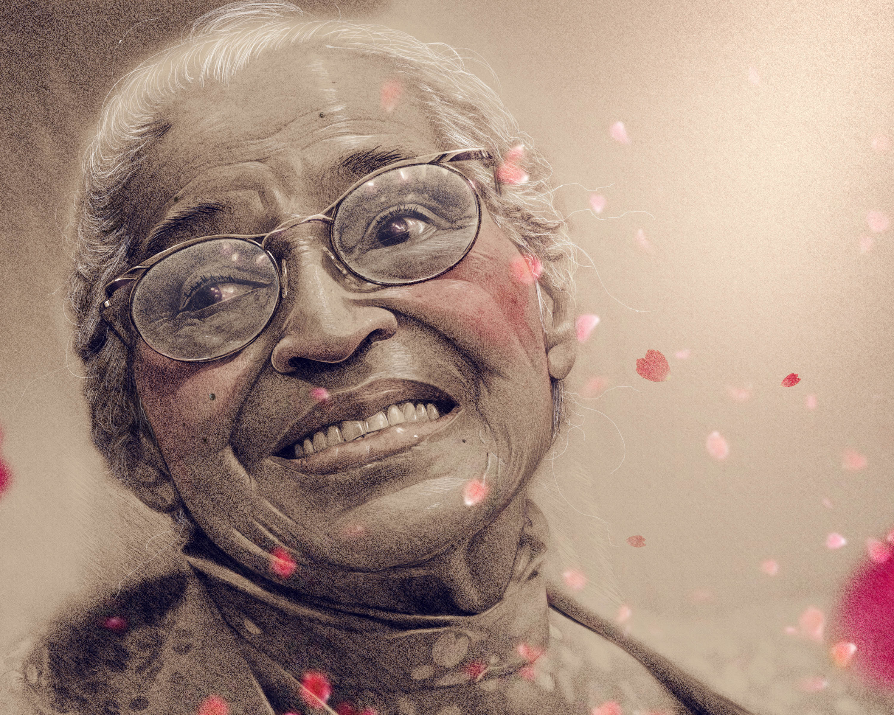
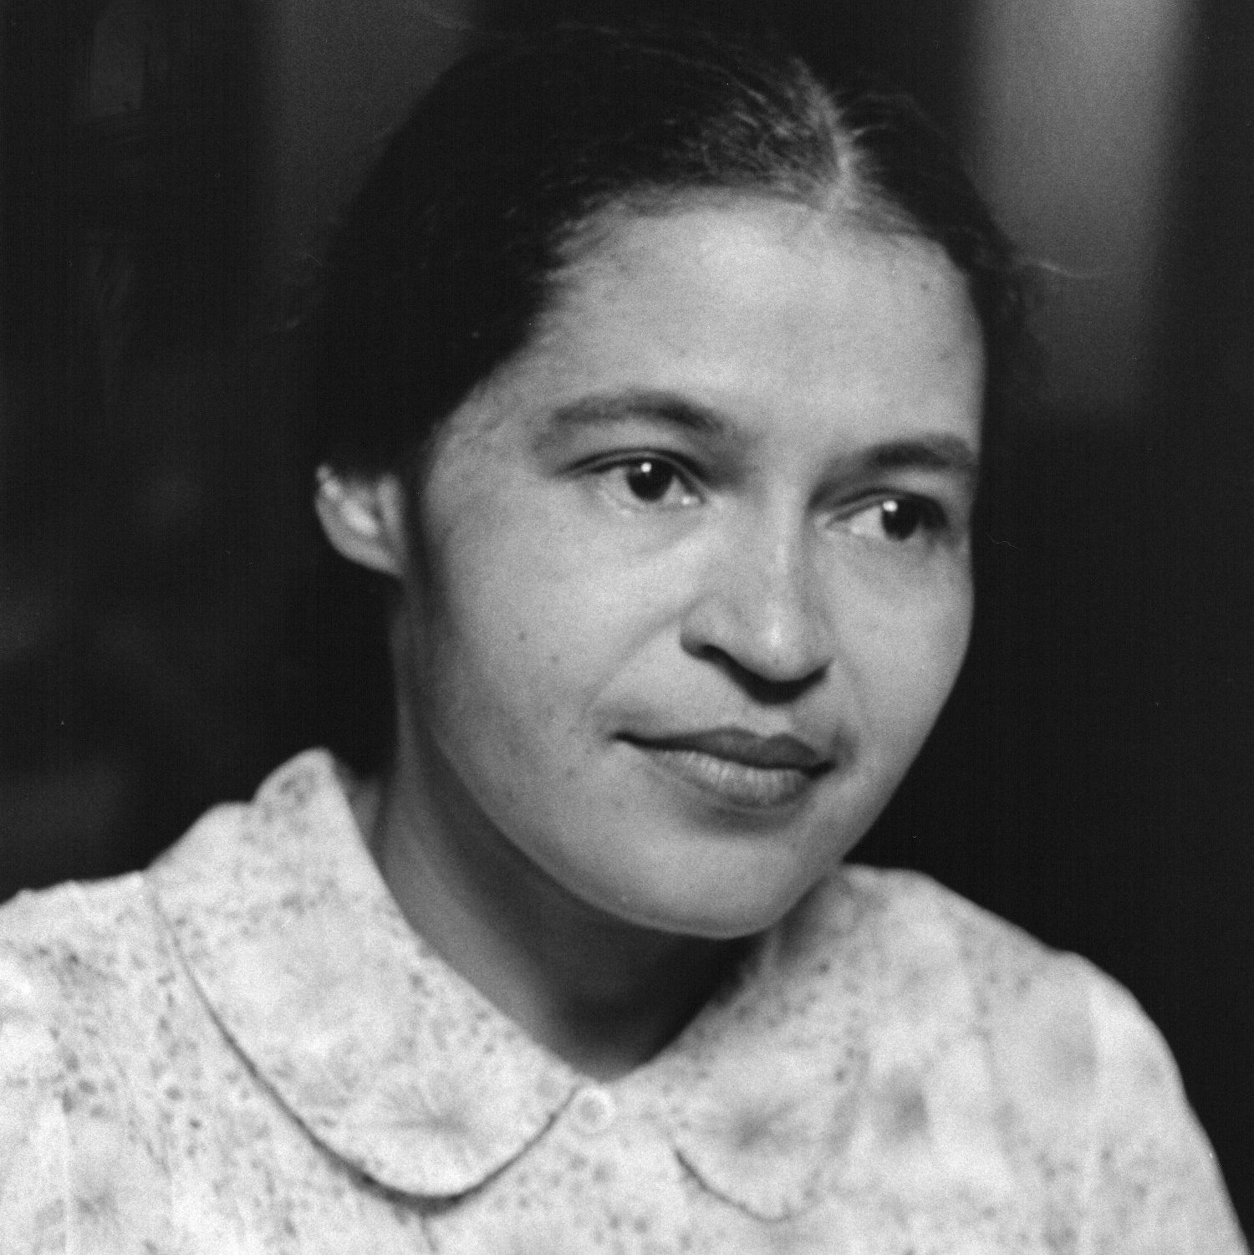
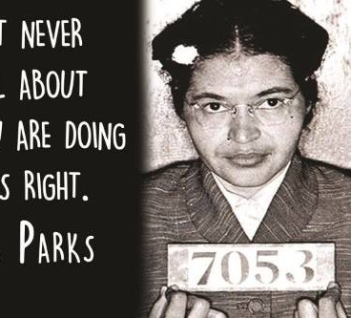
Rosa Parks
Rosa Park's invigorated the struggle for racial equality when she refused to give up her bus seat her to a white man in Montgomery Albama.
Parks was arrested on December 1st 1955 this led to the launching of the Montgomery Bus boycott by 17,000 black citizens.
This Photo by Unknown author is licensed under CC BY.
This Photo by Unknown author is licensed under CC BY-NC-ND.
This Photo by Unknown author is licensed under CC BY-ND.

Slide 4
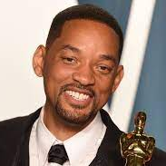
WILL SMITH
Will Smith is a very famous singer who sang my favourite song, 'Fresh Prince of Bel Air.'
This song was released in 1968 and this is a hip hop type of song.

Slide 5
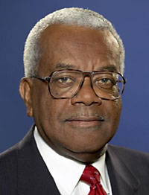
Sir Trever Mc Donald
Sir Trevor Mc Donald was born in Trinidad in the 1960's
Trevor Mc Donald was promoted in 1992 as the presenter of News at Ten.
Trevor is 83
In 1999 he received a knighthood for his work in journalism
Trevor McDonald is the most respected broadcaster In the world
This Photo by Unknown author is licensed under CC BY-SA-NC.
This Photo by Unknown author is licensed under CC BY-SA-NC.

Slide 6
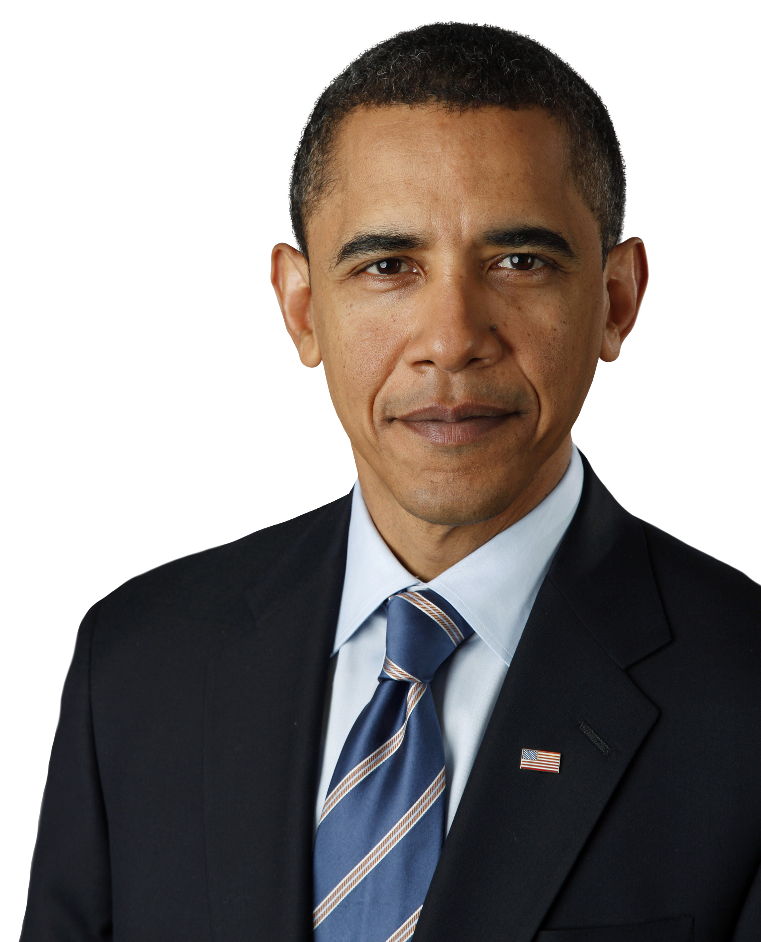
Obama
He was the first black American president.
Obama is currently 61 years old.
He was born on the 4th August 1961.
His full name is Barack Hussein Obama II.
Obama is 1.87 meters tall.

Slide 7
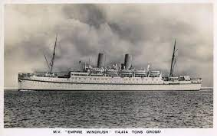
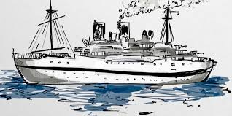
The Windrush Generation!
The Windrush arrived on the 21st of June 1948 ,at least nine or more passengers died before arriving.
500,000 passengers arrived between 1948-1971 from the Caribbean. when the passengers got to Britain they always didn't get the friendliest welcome they hoped for. The boat was called Windrush because it was named after the River Windrush in the Cotswolds.
The Windrush economy travelled at sea for 30 days on the 24th of May(72 years ago).
The Empire Windrush carried people to Britan to help it get back on its feet after many shortages of labourers and destruction after the war.
Years later, they were told that they had entered the country illegally and some were forced to leave.

Slide 8

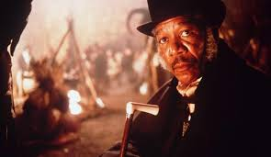
Morgan
Freeman
1937
Morgan was born June first 1937 in Tennessee U.S
He was a narrator a commentator and an actor often playing god
Did you know? Morgan Freeman has enrolled in the Royal Air Force
He is worth 250 million U.S dollars.
He has 4 children : Alfonso Freeman and Morgana Freeman, Deena Freeman and Saifoulaye Freeman.
Morgan Freeman
Freeman is the force behind several humanitarian and charitable initiatives. He established the Tallahatchie River Foundation in his home state of Mississippi with his daughter, Morgana Freeman, in order to promote quality early childhood education for underserved youth.

Slide 9
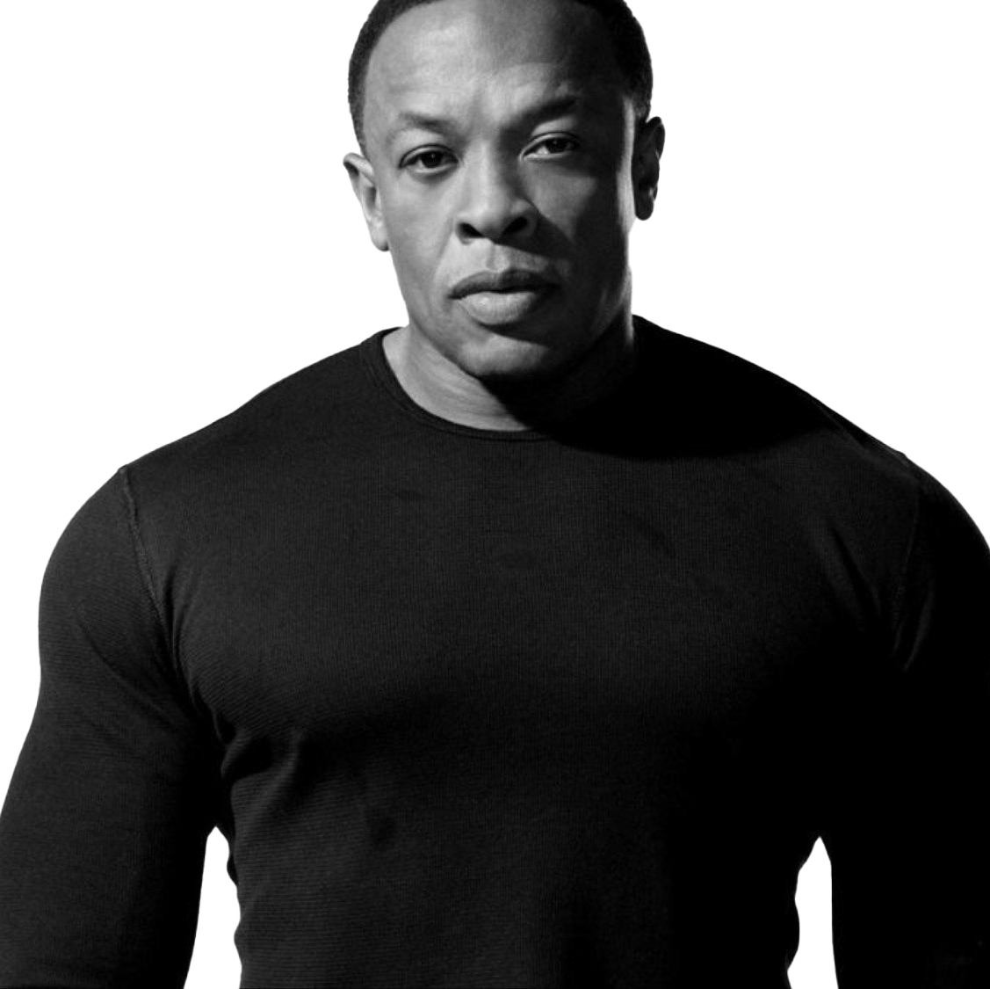
Dr Dre
Also known as Andre Romelle young born February 18 ,1965(age 57) Compton California.
What is Dr Dre net worth?
As of 2021, Dr Dre is reportedly worth around £820 million.
This Photo by Unknown author is licensed under CC BY-NC.

Slide 10

Nelson Mandela
…He was born in 1918-2013… he was in prison till 1990…
…He was the first black president…. He joined A.N.C company
Black history
Nelson Mandela was sentenced to life in prison but people fought to get him out . They knew he was a good man but it took a while but they accomplished their mission after a while.

