Slide 2
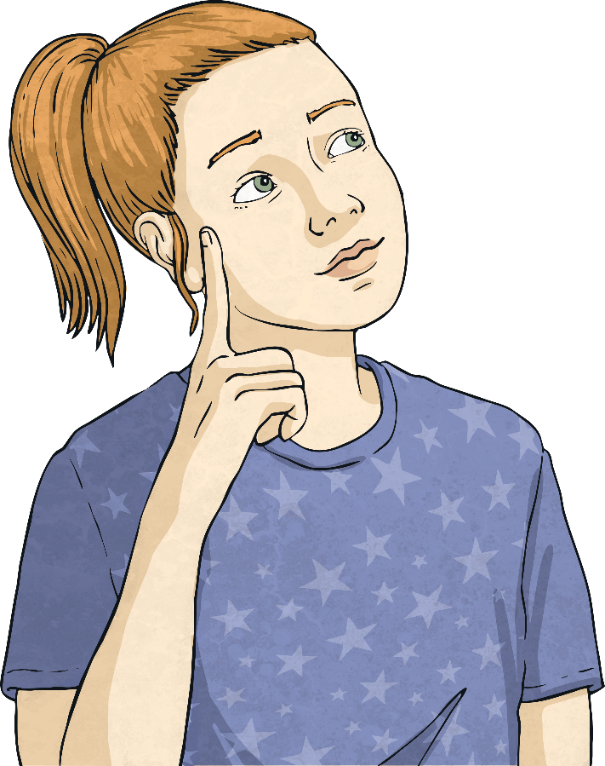
Many or Much?
When creating amazing pieces of writing, it is important to use ‘many’ and ‘much’ correctly.
Just follow these simple tips and you’ll be an expert in no time!

Slide 3

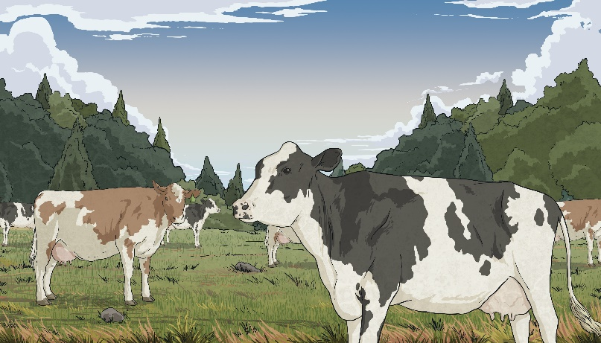
When to Use ‘Many’
We use the word ‘many’ when talking about countable nouns. This means nouns that you can easily count. These nouns can usually have the determiner ‘a’ or ‘an’ before them, e.g. a book.
How many cows are there in the field?
You can count the cows so we use the word ‘many’.
How many books do you own?
You can count the books so we use the word ‘many’.

Slide 4
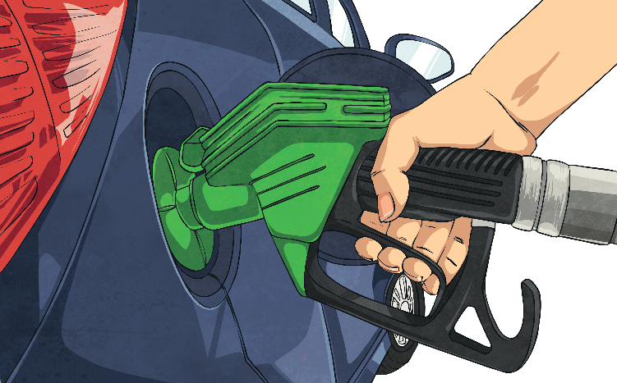
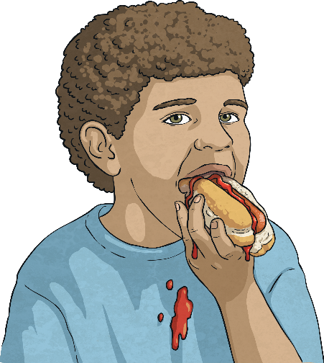
When to Use ‘Much’
We use the word ‘much’ when talking about uncountable nouns. This means nouns that you cannot count and do not have the determiner ‘a’ or ‘an’ before them, e.g. rain.
How much petrol have you put in the car?
You cannot count petrol so we use the word ‘much’.
How much ketchup would you like on your hot dog?
You cannot count ketchup so we use the word ‘much’.
Although you can’t count petrol, you can count litres of petrol. In this case, you would say ‘how many litres of petrol have you put in the car?’

Slide 5
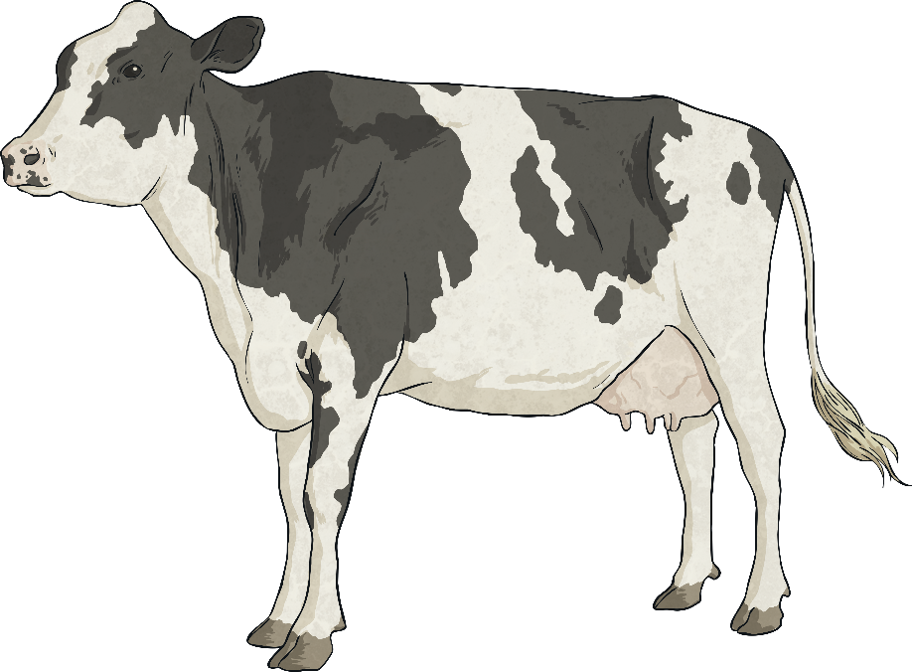
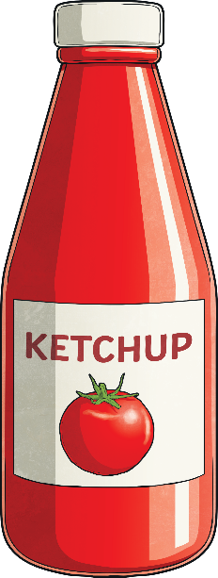
Should You Use ‘Many’ or ‘Much’ ?
Take a look at the sentences on the next few slides. Should you use the word ‘many’ or the word ‘much’?
If you can count the noun, use
‘many’.
If you can’t count the noun, use ‘much’.

Slide 6
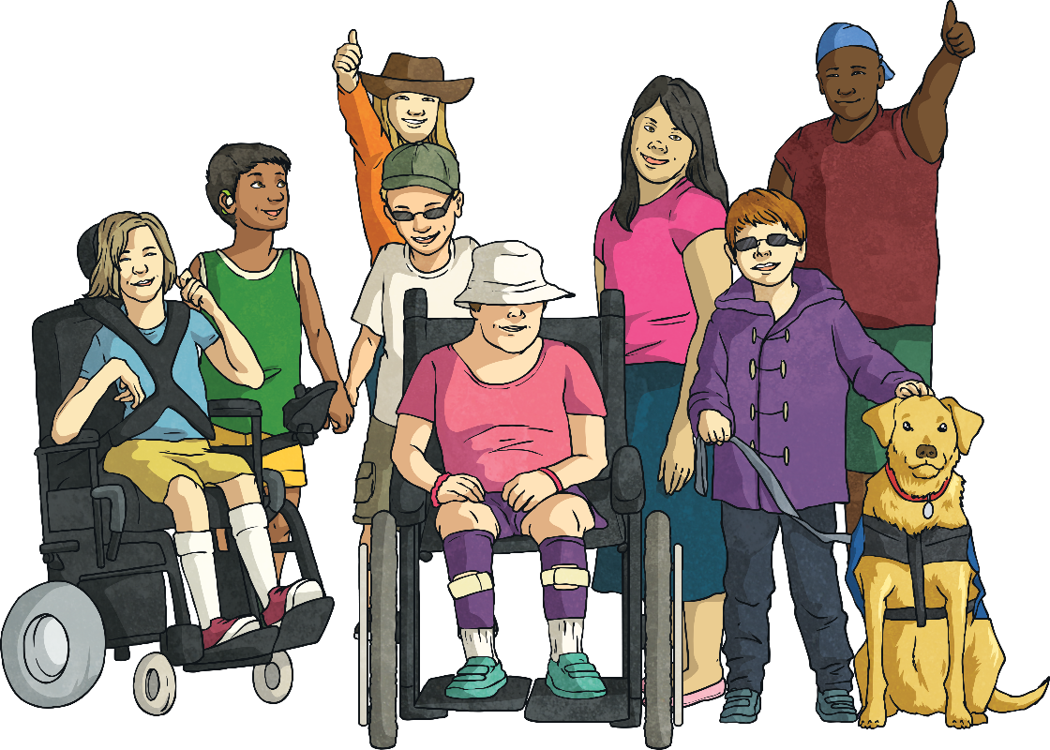
?
How many children will be attending the theatre trip?

Slide 7
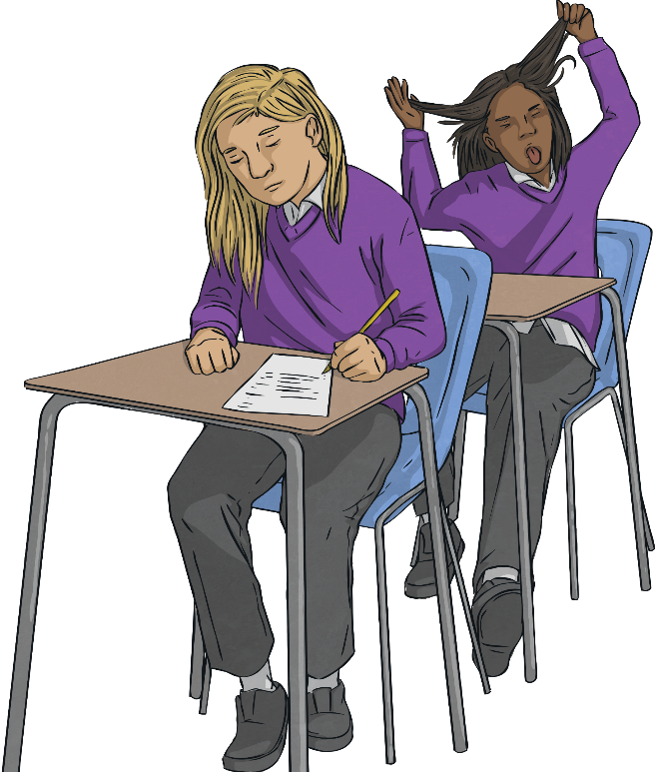
?
There was so much noise coming from inside the classroom that I couldn’t hear myself think!

Slide 8
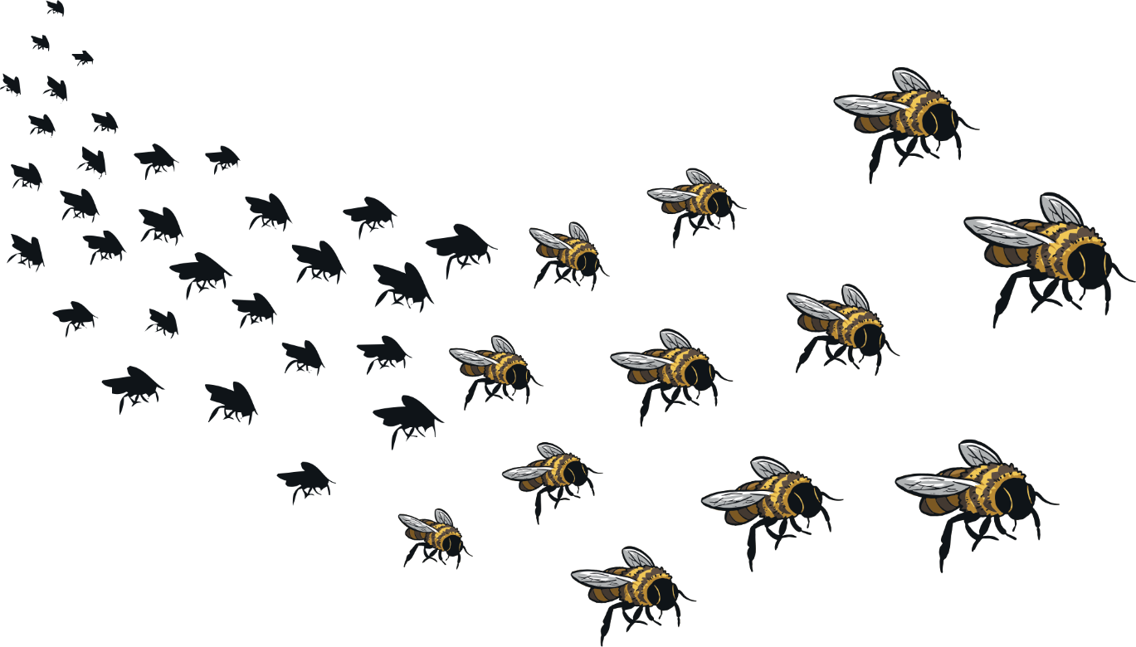
?
I wonder how much honey my bees will produce this year.

Slide 9
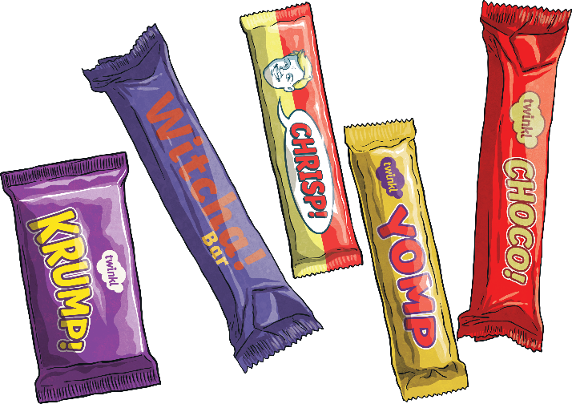
Personally, I think that there are too many chocolate bars there for one person to eat on their own.
?

Slide 10
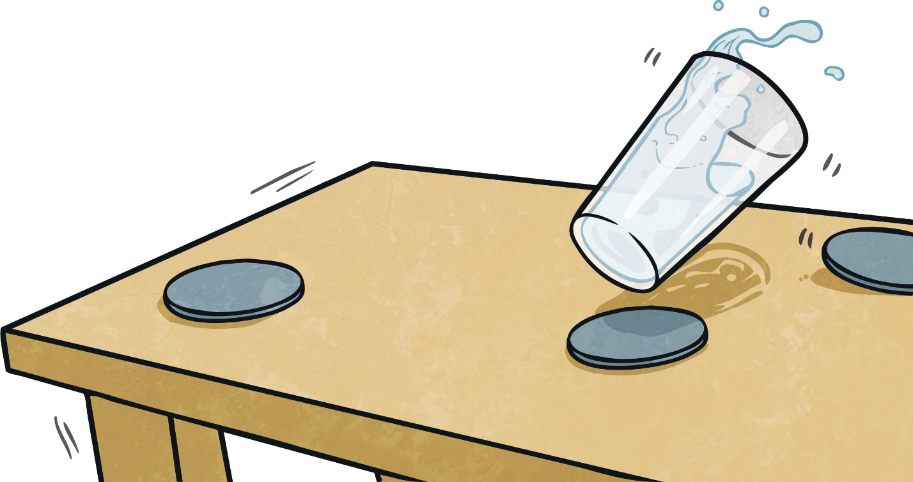
?
I can’t believe how much water you have spilt on the floor!

Slide 11
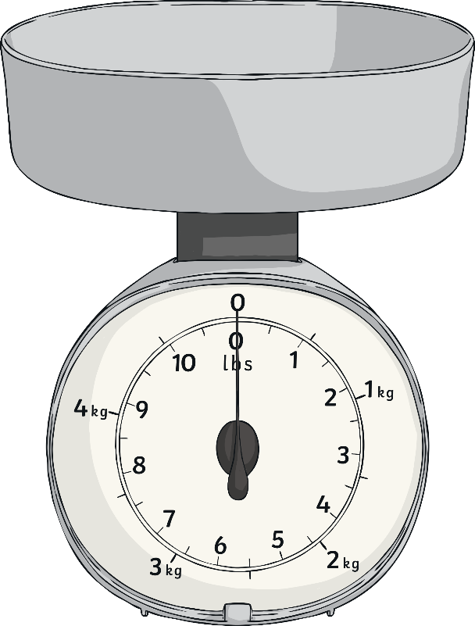
?
How many grams of sugar does the recipe suggest that we use?

Slide 12
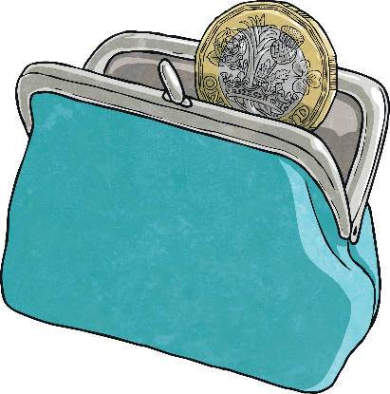
What about Money?
When talking about money, we would ask:
How much money do you have?
This is because the word money can refer to notes, coins, pennies, pounds and lots of other currencies. Therefore, it is a uncountable noun.
If you wanted to ask about a specific coin, you would say:
How many 20p coins do you have?
This is because the 20p coins are a countable noun.

Slide 13
Recap
If the noun is countable, use ‘many’.
If the noun is uncountable, use ‘much’.

Slide 14
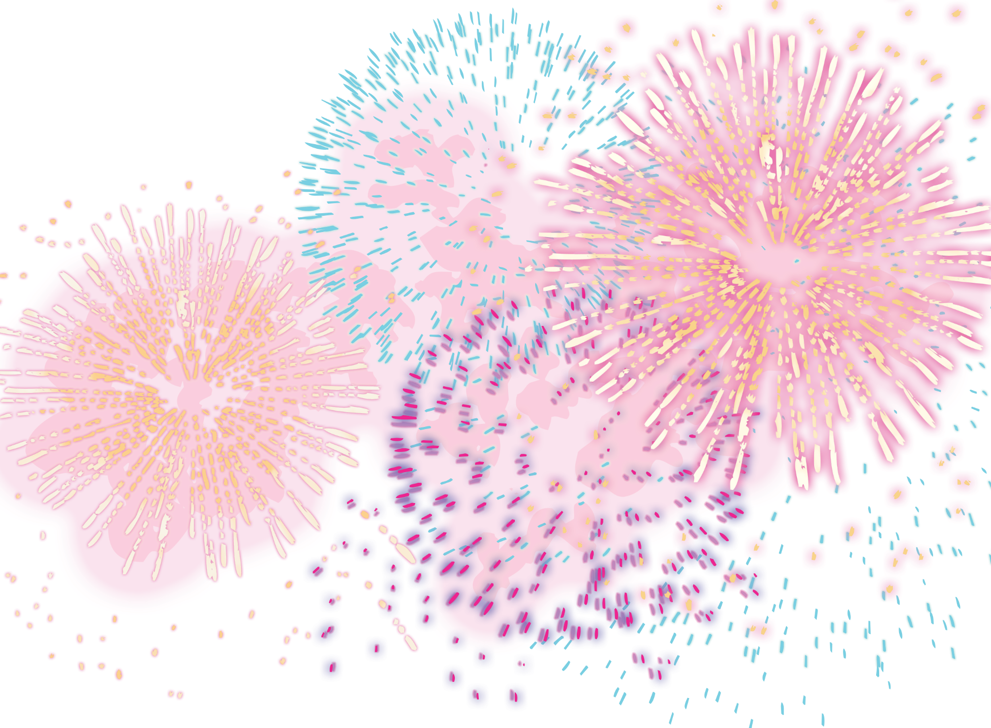
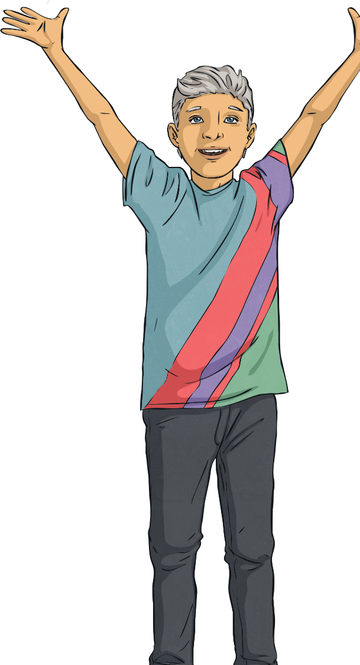
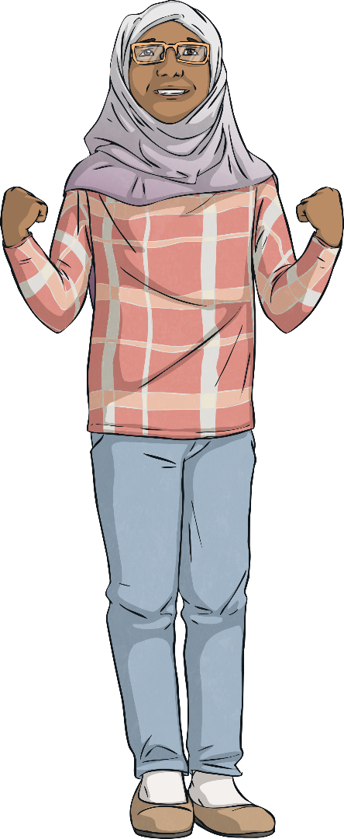
Congratulations!
You are now an expert at correctly using ‘many’ and ‘much’.

