Slide 1
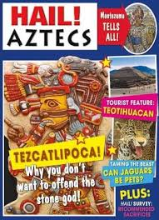
Year 6 Term 1 Curriculum: Are the Aztecs Amazing?
Dear Parents of Year 6 children:
Welcome back to a new school year at St Michael’s. We hope you have had a great summer
Please remember this term….
-PE will be on Monday and Thursday
Homework will be set on Friday and due in on the following Thursday
11+ test will take place Friday 13th September (verbal reasoning) and Friday 20th September (non-verbal reasoning)
As Coningsby believers we will:
Explore the question:
What does it mean if God is holy and loving? We will be exploring the features of a God and focusing on the Christian ideas about their God.
As Coningsby Authors we will:
Be studying the book Hail Aztecs and from this we will write:
letters and diary entries
Job adverts using persuasive language
Newspaper reports
As Coningsby Mathematicians we will:
Be developing our quick recall of number facts including our times table recall.
Read, write, order and compare 7 digit numbers.
Understand and use negative numbers.
Solve problems involving all four operations using formal and mental methods including fractions.
Describing position on the full co-ordinate grid.
Drawing and translating simple shapes.
As Coningsby Historians we will be exploring:
The Aztecs-
Who were the Aztecs?
Where did they come from?
When did they live?
What did they do for fun?
As Coningsby Scientists we will:
Look at the circulatory system and explore:
What would a journey through your body be like?
We will explore eating a healthy diet and the effect that this has on our bodies.
We will learn the names of the parts of the circulatory system and explore keeping this healthy.
As Coningsby Artists and Designers we will:
Be finding more information about Aztec daily life by exploring and making our own Aztec calendar.

