Slide 1
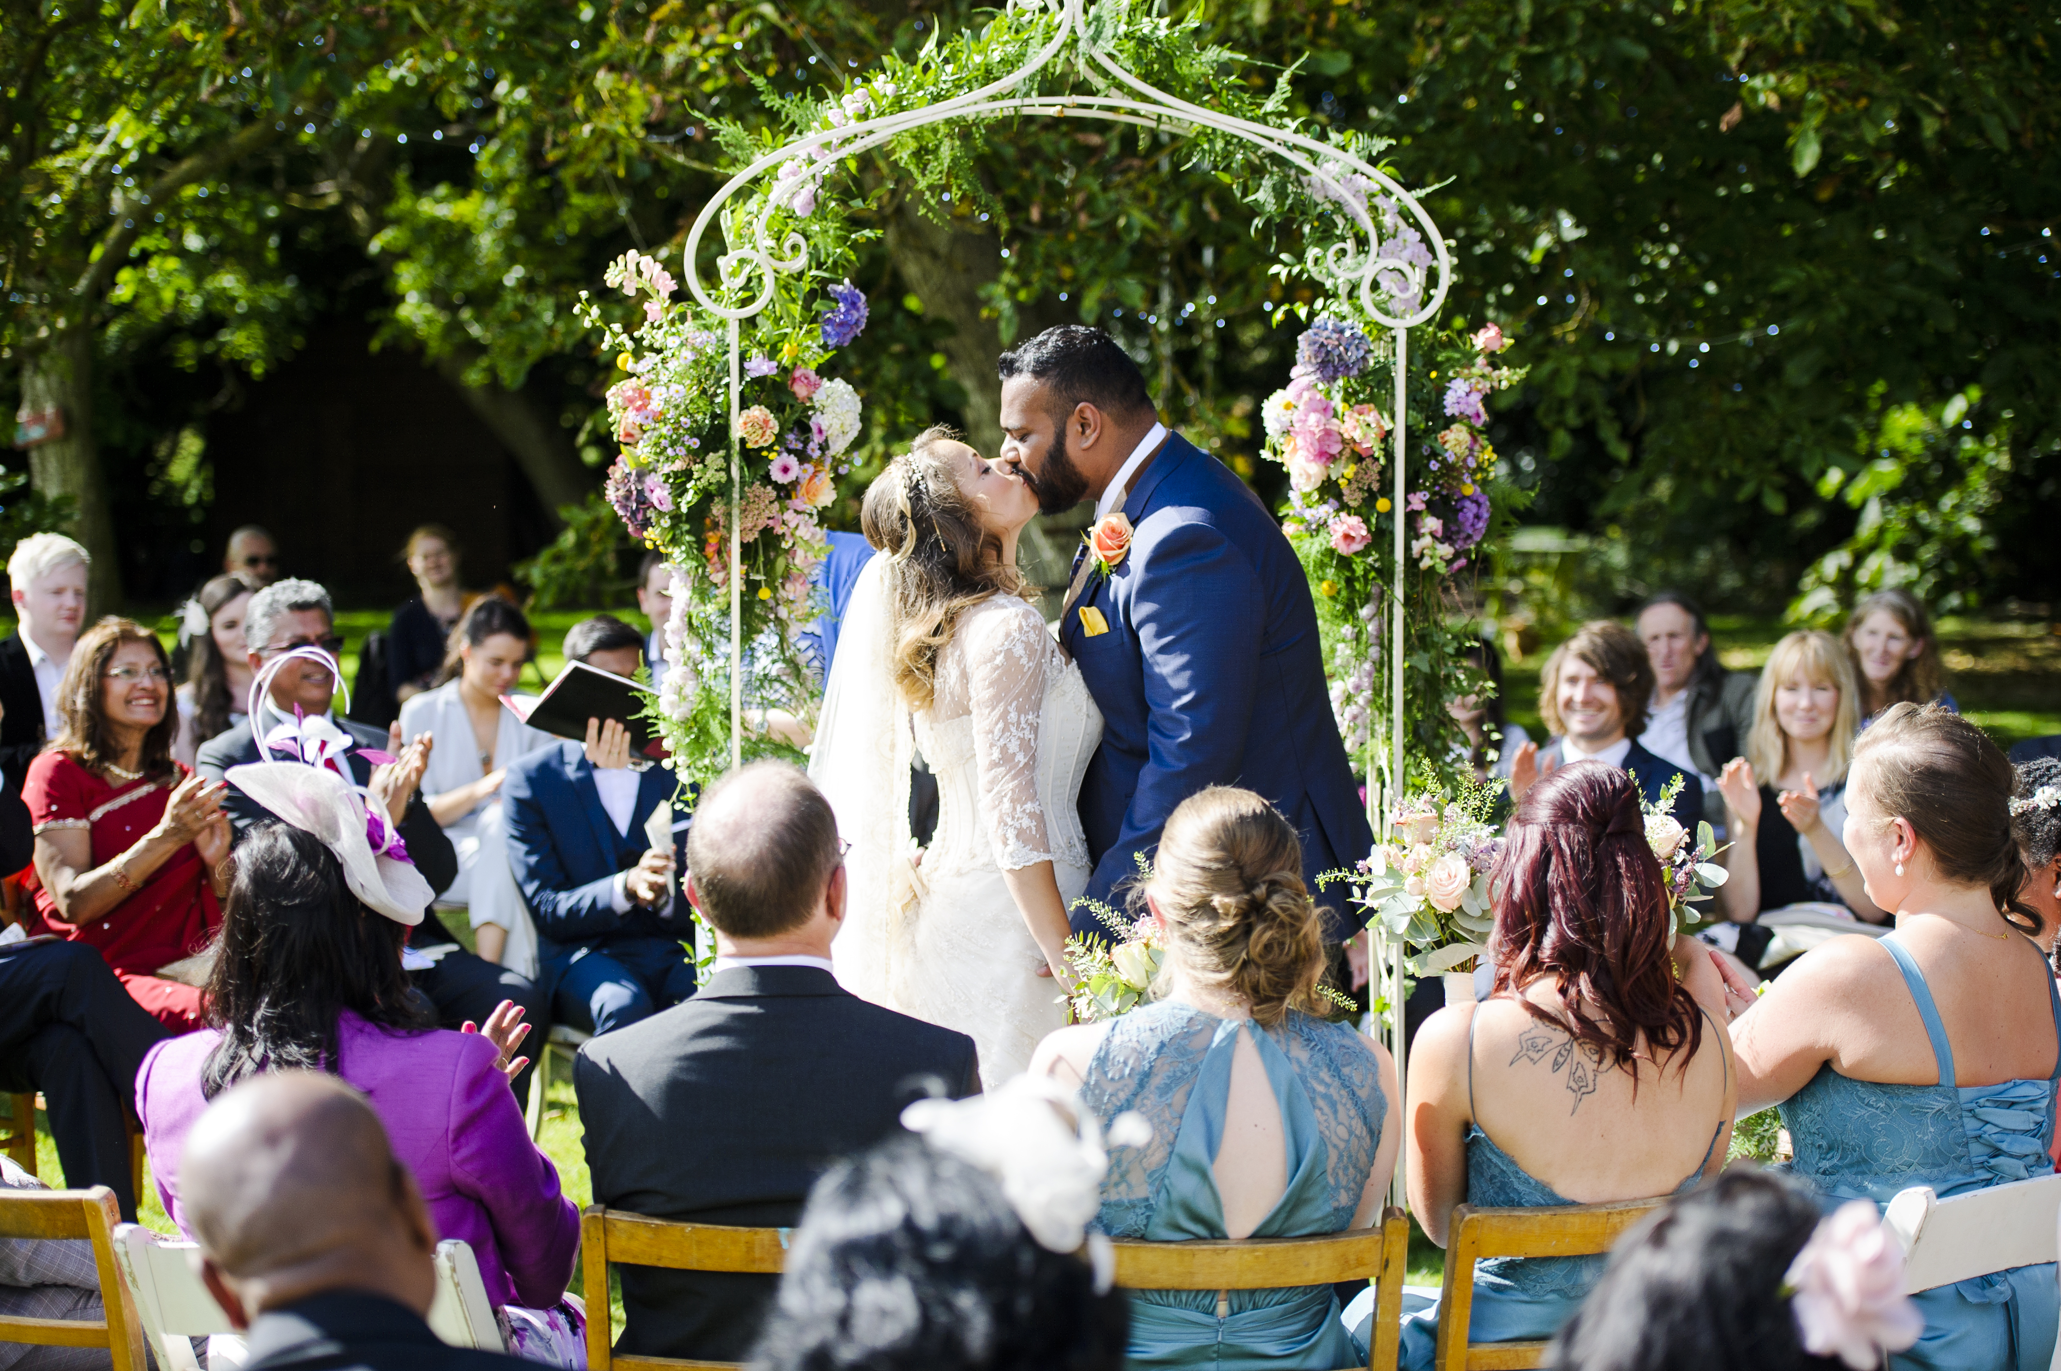
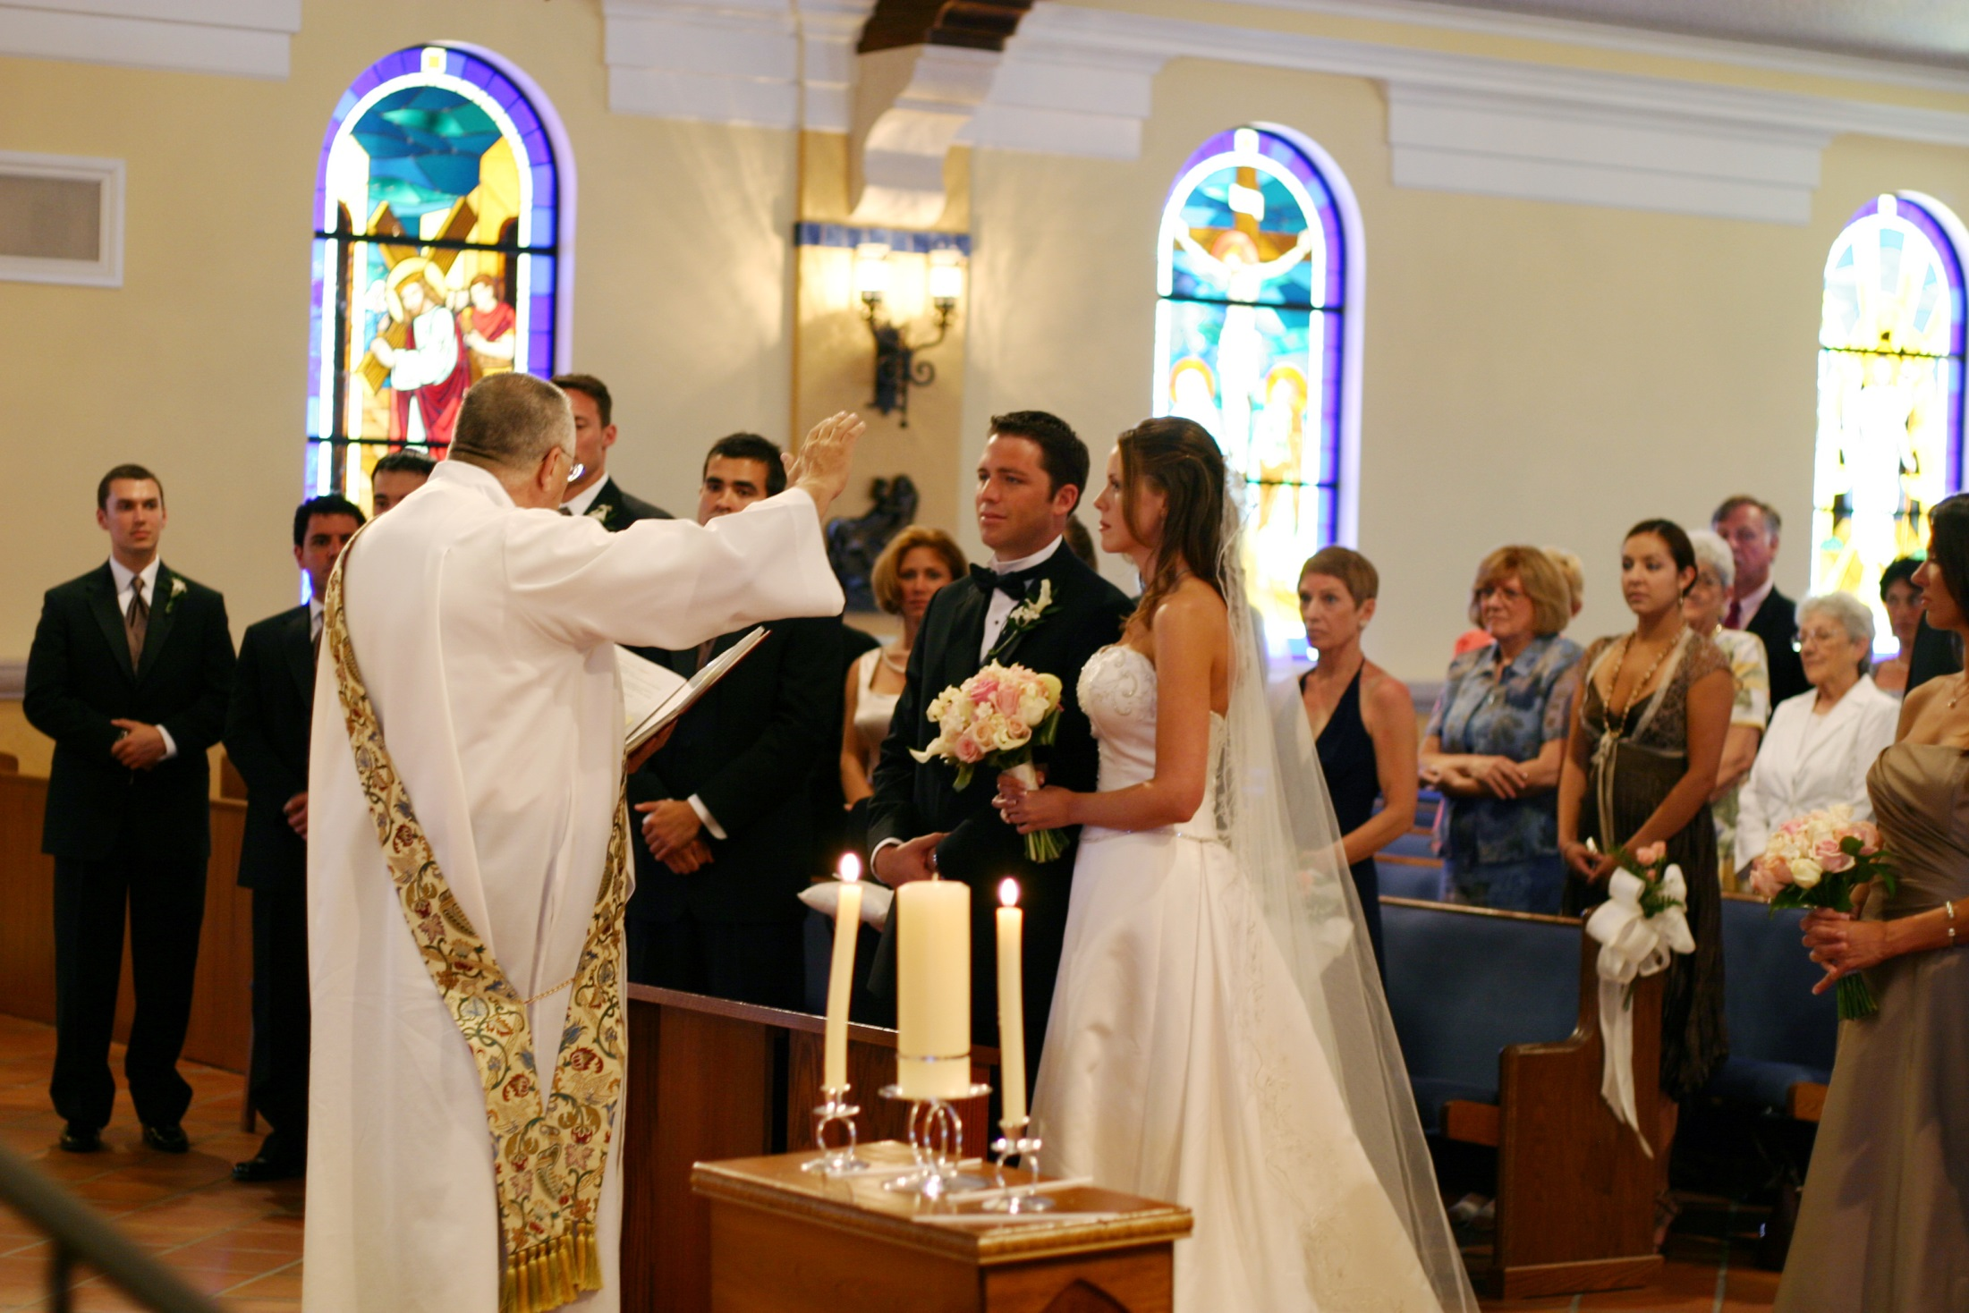
Spot the difference
What is the same? What is different?

Slide 2
What do humanists believe?
Human beings are special and human life is valuable
Humanists don’t believe in a god, or believe we can never know if there is a god
Humanists don’t believe there is any evidence for an afterlife: we should therefore make the most of this life
Human beings should try to live full and happy lives and help others do the same

Slide 3
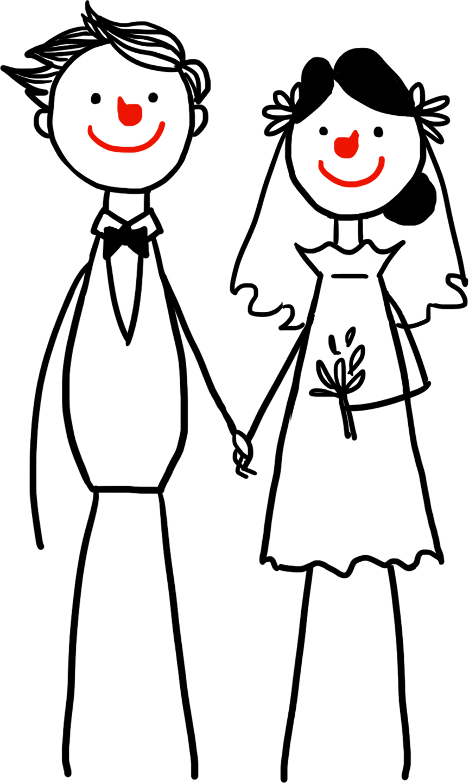
Humanist weddings
Personal and meaningful
For many this is their real ‘marriage’
Show love and commitment
Friends and family show support
Can be held wherever the couple wishes
Couples can write their own promises
Both parties must be free to choose
Both parties hold an equal status
Humanists do not believe that couples should have to get married and many choose not to.

Slide 4
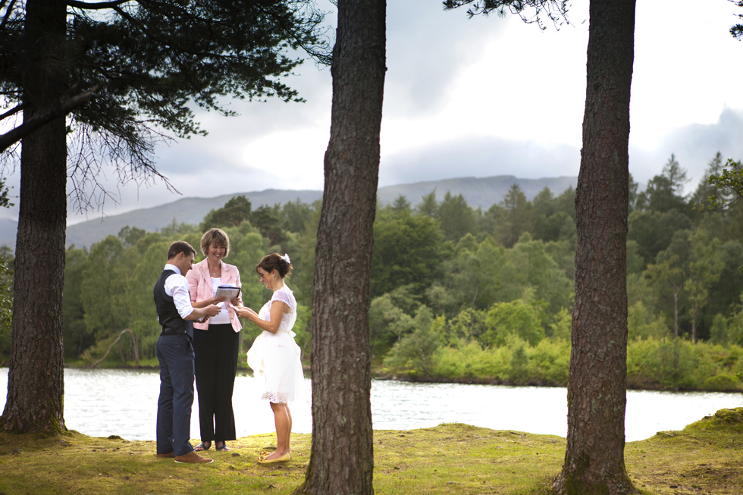
Wedding vows or promises
Couples are encouraged to write their own vows or promises at a humanist wedding.
Take a look at the wedding vows from a Church of England wedding and the promises from humanist wedding.
1) What similarities can you find?
2) What differences do you notice?
3) What promises do you think are important for marrying couples to make? What promises would you make?

Slide 5
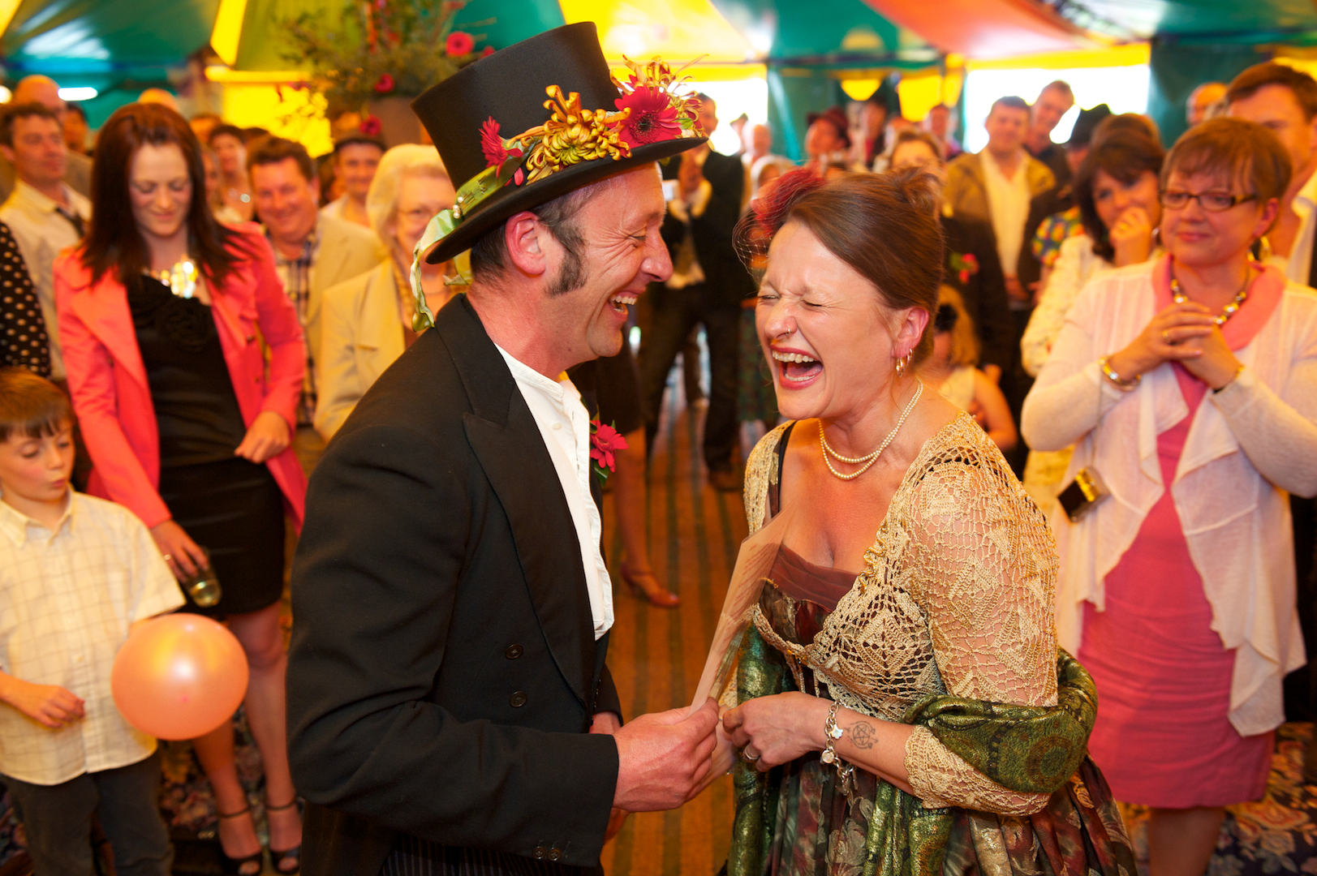
Love and support of other people
Humanists don’t believe in a god or gods or are at least uncertain that they exist.
The love and support of other people in our lives is therefore of particular importance to humanists. We need to take care of each other.
Humanist weddings will often focus on these ideas.

Slide 6
Rituals and symbols
No special rules, traditions, or symbols at a humanist wedding
Each wedding is personal and unique
Some humanists like to perform actions to symbolise their union
Not all humanists feel such action is necessary
Look at the pictures.
Can you explain what is happening without using the words underneath the picture?
How might the objects be used at a wedding?
What might they symbolise or represent?
Which one do you like the best and why?

Slide 7
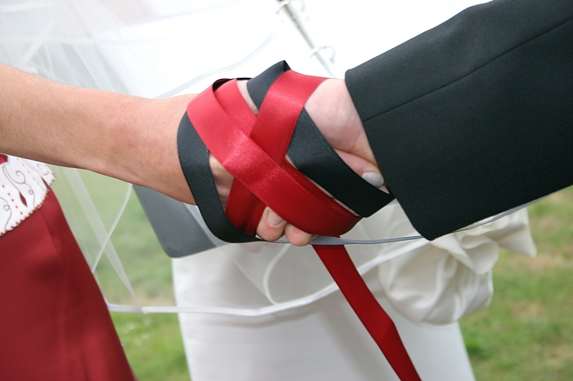
hand
ribbon

Slide 8
Handfasting
The couple will hold hands as coloured ribbons are wrapped and bound around them.
This is a symbol of their desire to be united.
It is an ancient wedding ritual, and is the origin of the phrase ‘tying the knot’.
Often particular coloured ribbons are chosen by the couple, for example red might symbolise love and white might symbolise peace.
The ribbons might be tied by the celebrant, or a specially chosen friend or family member.

Slide 9
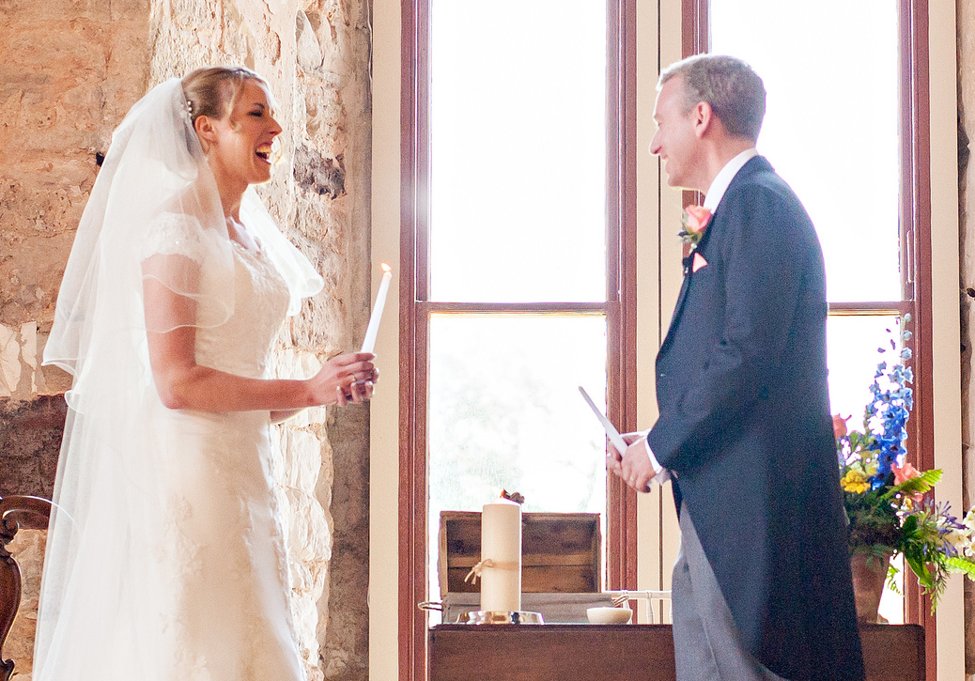
candle
light

Slide 10
Candles
Candles can be used in many different ways in humanist weddings.
The couple sometimes light their own individual candles at the start of the ceremony. Then, after the vows, they will use their own candles to jointly light a third candle.
This is a symbol of their new shared life: ‘Two become one’.
If the couple already have children, they can be included and given their own candle to light a ‘family candle’.

Slide 11
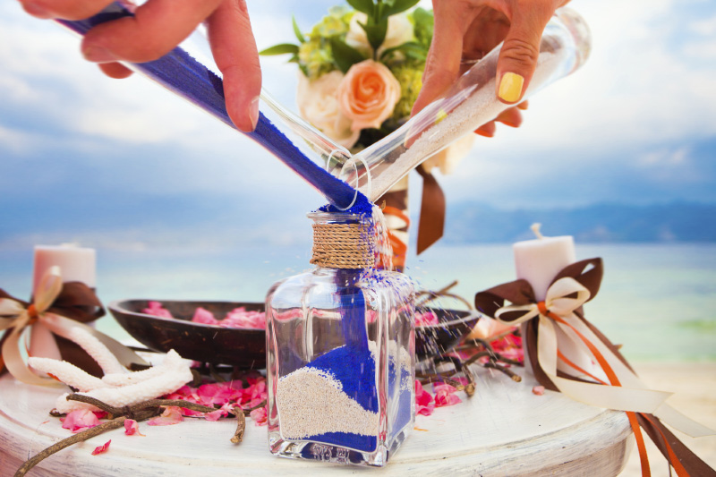
sand
mix

Slide 12
Sand
The symbolism of pouring sand is similar to lighting candles.
The couple each start with a bottle of different coloured sand.
The couple pour their sand into a third bottle, mixing the colours together and symbolising their new union.
The colours of the sand may also have their own meanings to the couple.

Slide 13
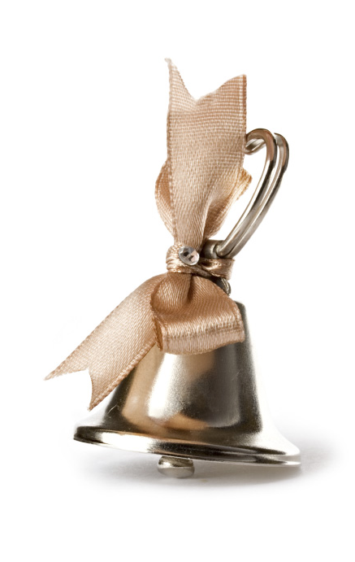
bell
ring

Slide 14
Truce bell
The couple may be presented with a small ‘bell of truce’ at the wedding ceremony.
The bell is rung by each partner in turn as they say positive things about their relationship.
The bell can then be kept in the couple’s home, and if the couple ever argue, it can be rung to symbolise a ‘truce’ and to help remind them of their wedding day.

