Slide 1
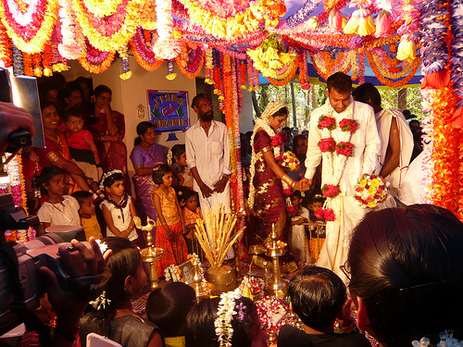
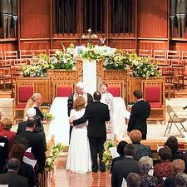
SPOT THE
DIFFERENCE
In pairs spot the differences/ similarities between the Hindu and Christian weddings shown.

Slide 2
The Religious Meaning of Marriage
A marriage ceremony marks the moment when someone makes a committment to another person, to share their life with that person, to set up home together and look forward to the idea of parenthood.
In some religions the making of vows in the precence of God is the most important part of a marriage ceremony.
In most cases a wedding ceremony is both a religious and a social occasion, each religion having its own explanation ofthe meanings and beliefs surrounding marriage.

Slide 3
VIVAHA
MARRIAGE
This is a samskara (a sacrament)

Slide 4
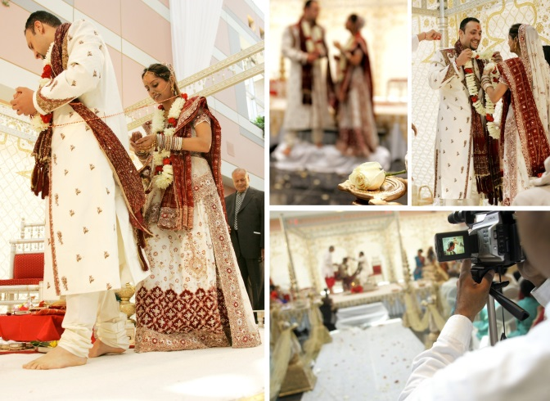
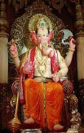

The bride and groom are dressed like royalty: they wear red, white and gold.
The bride arrives with her male relatives and she exchanges a garland with the groom.
The bride’s farewell – rice is thrown.
The bride’s hands are decorated with Mehndi.
Tying of scarf and sari
Saptapadi – Seven promises are made.
Ganesh.
Vows are taken and the bride steps on a stone.
The sacred fire is lit by the Priest.
What happens?

Slide 5
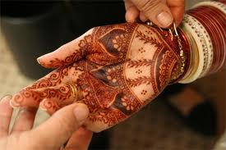
What does this symbolise?
Mehndi
= red to symbolise fertility

Slide 6
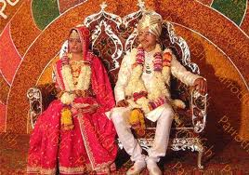
What does this symbolise?
CLOTHING
= to represent Rama and Sita.
= Gold symbolises wealth, red symbolises fertility.

Slide 7
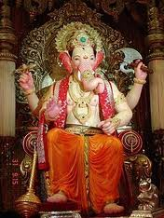
What does this symbolise?
Ganesh:
= Provides prosperity and protects from any obstacles which may arise during the ceremony and married life.

Slide 8
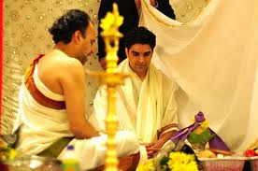
What does this symbolise?
ARRIVAL OF THE BRIDE:
= The uncles are the bride’s male relatives, they show their acceptance and agreement of the match.

Slide 9
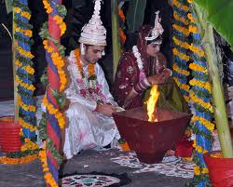
What does this symbolise?
THE SACRED FIRE IS LIT BY THE PRIEST UNDER THE MANDAP:
= The fire represents AGNI the fire Goddess.
= The flames contain sacred energy.
= The fire is a witness

Slide 10
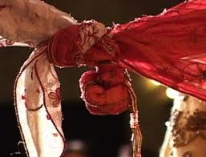
What does this symbolise?
TYING OF GARMENTS AND SACRED GARLAND:
= Represents the joining of the souls (atman) for 7 lifetimes the couple will spend together according to teachings on Samsara.

Slide 11
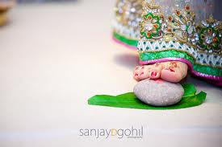
What does this symbolise?
TAKING VOWS/ STEPPING ON THE STONE:
= The 4 rounds represent the 4 goals of Hindu life:
1. Dharma
2. Wealth
3. Kama (love and family)
4. Moksha
= The stone represents the wife being steadfast in fulfilling her role and overcoming obstacles.

Slide 12
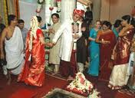
What does this symbolise?
THE 7 PROMISES – SAPTAPADI
Food
Spiritual strength
Wealth
Knowledge
Children
Good health
Friendship
= Where the bride and groom become husband and wife
= represents the 7 guiding principles for their journey through life.

Slide 13
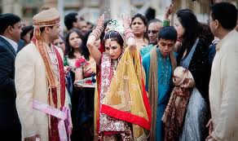
BRIDE’S FAREWELL:
= The bride is about to embark on an important role in life as a wife and daughter-in-law.
= throwing rice represents prosperity: it is thrown backwards to bring happiness to the brides childhood home and again to bring happiness to her husbands home.

